Slide 1
T2-T2S Consolidation
Registration Forms
02-11-2021

Slide 2
Agenda
Timelines, Registration forms – UTEST – A2A and U2A – testing phase
Registration form (note; macro‘s and signatures), TARGET registration and onboarding guide (via ECB For professional use (europa.eu))
Explanation how to fill in, example given by Rabobank;
a. Party
b. Cash Account
c. Administrator User
d. Groups
e. Invoice Configuration
4 Support
Migration

Slide 3
Time lines; receipt of Registration forms, set up and actual Testing
Please submit your Registration forms 12th November 2021
Review, comments by DNB before end November 2021.
DNB to submit DMT files (Data A2A) derived from Registration form to the platform, “valid from” December 1st, 2021
DNB to process manually Data U2A derived from Registration forms
Message & report subscription and Users & Roles by participants in December
Current expectation you can operate the UTEST account from mid December at the earliest to mid January 2022 at the latest
Note: BPMN provided for reference purpose only

Slide 4
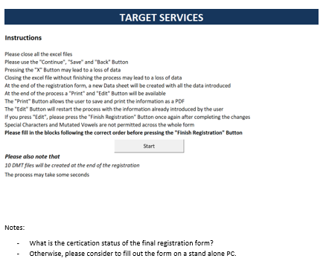
The registration form
Version 1.1 has become available – distributed by DNB.

Slide 5
Registration

Slide 6
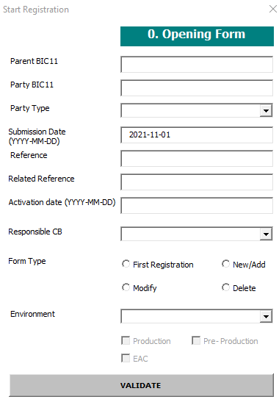
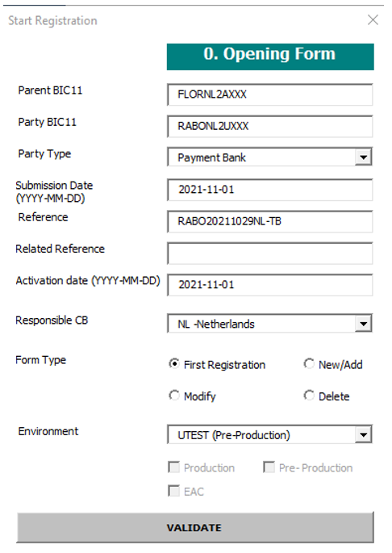
Registration Opening Form (R&O guide 3.1.1.)
BIC11 of DNB; FLORNL2AXXX
BIC11 of the Payment Bank
Select Payment Bank
(focus of this training)
Please use “-” in the Activation date, 2021-12-01 is the first date allowed for the UTEST environment. We will see what is feasible

Slide 7
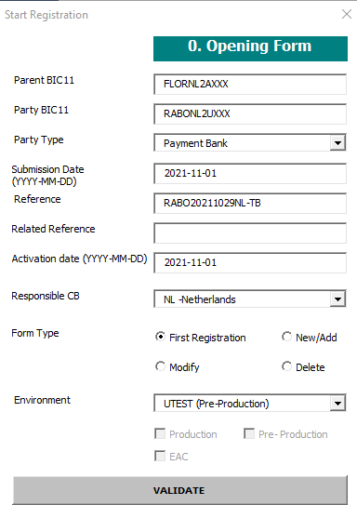
Registration Opening Form (R&O guide 3.1.1.)
Click on “Validate”, a pop-up will appear

Slide 8
Registration Form Menu

Slide 9
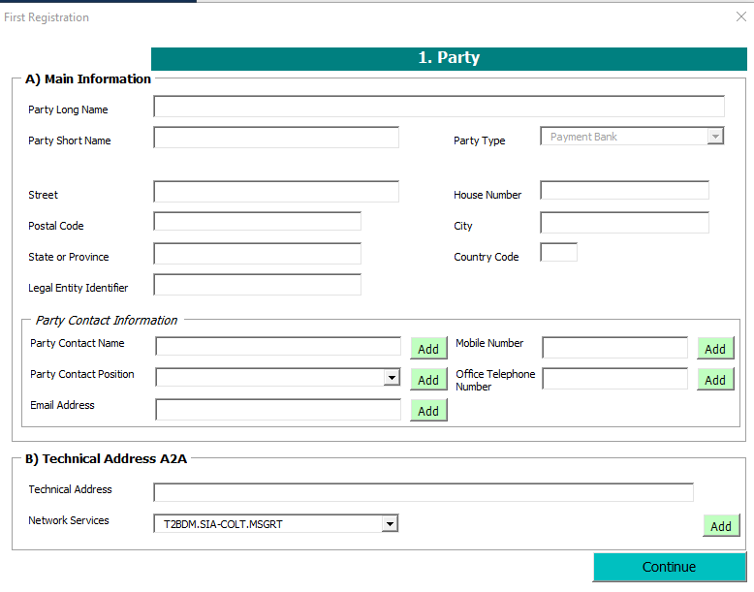
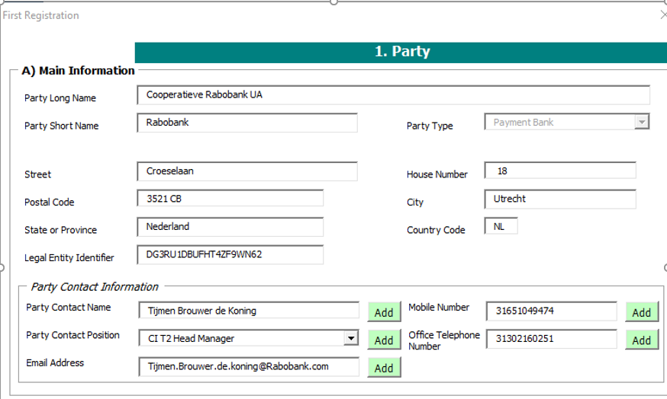
Registration – 1. Party – A.Main Information and B.Technical Address (R&O guide 4.2)
LEI
Mandatory in case the Party is linked to either CLM or RTGS
Optional (e.g. Utrecht)
optional

Slide 10
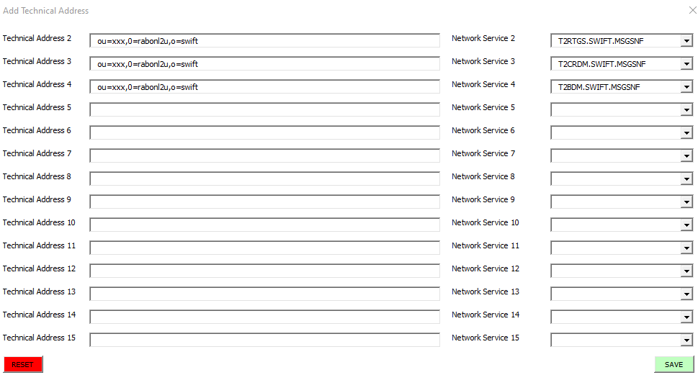
Registration - 1. Party – B. Technical Address (Add)

Slide 11
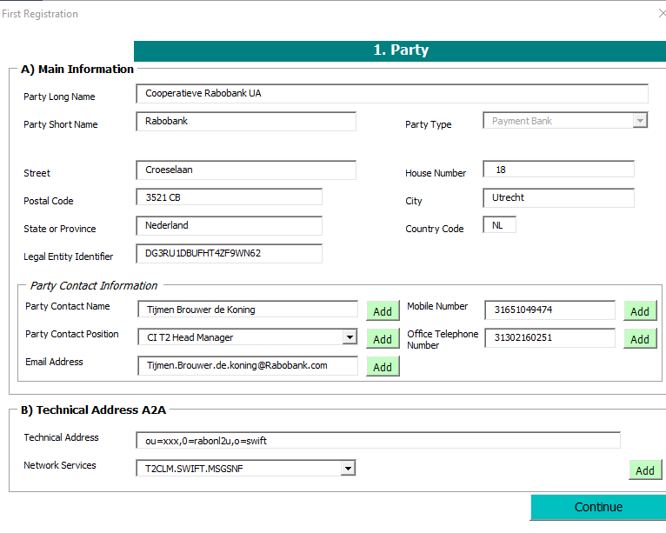
Registration – 1. Party – A)Main Information and B)Technical Address (R&O guide 4.2)
Note:
PTA – Party Technical address for U2A only participants can read: U2A-only

Slide 12
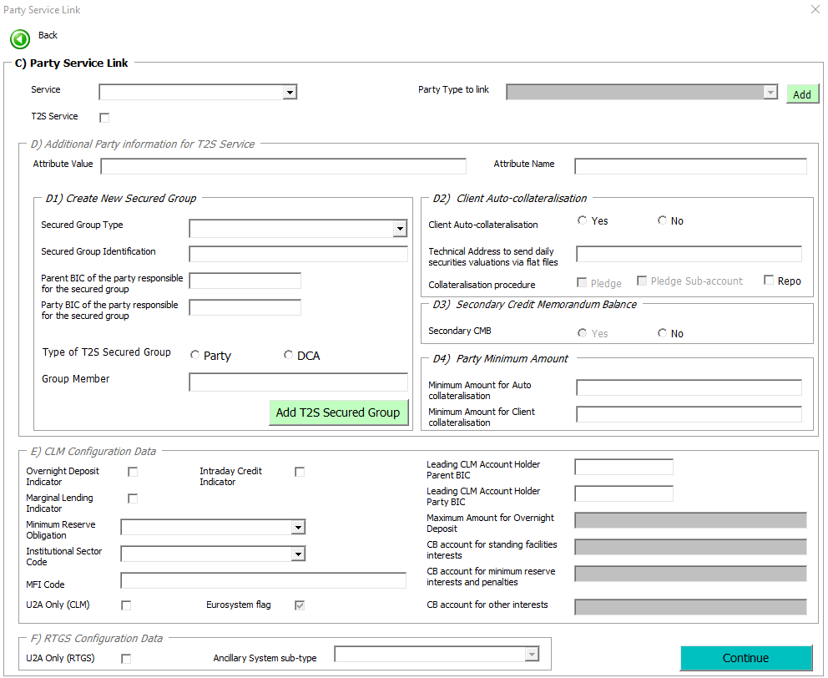
Registration
Party –continued items
C) Party Service Link
D)Additional Party information for T2S Service (out of scope)
E) CLM Configuration Data
F)RTGS Configuration Data

Slide 13
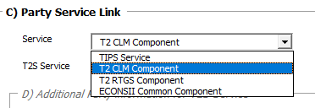
Registration – 1. Party – C) Party Service Link (R&O guide 4.2)
T2S is out of scope for the T2 migration, please ignore

Slide 14
Registration – 1. Party – E) CLM Configuration Data F)RTGS Configuration Data (R&O guide 4.2)
Please tick the O/N, M/L and credit indicators.
please confirm the present situation.
Minimum Reserve Obligation:
Direct
Indirect
Pool
None
In case you are U2A only user
tick one for the CLM account and
the other for the RTGS account

Slide 15
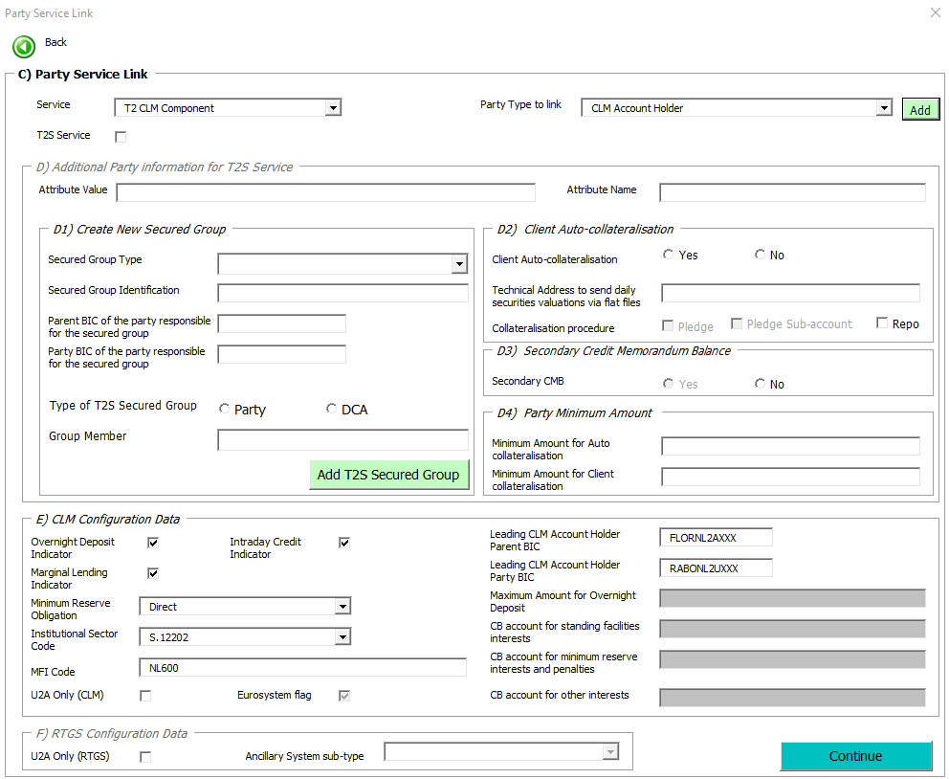
Registration
Party –continued items- C till F concluded
continue

Slide 16
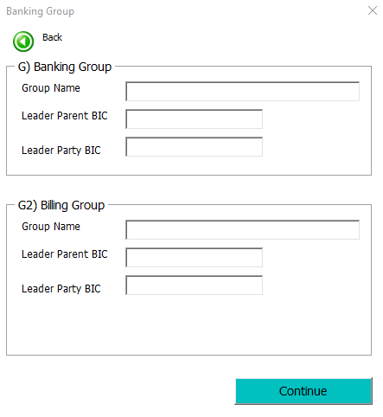
Registration – 1. Party – G) Banking Group G2) Billing Group (R&O guide 4.2)
Naming convention;
NLKBIC11-BANKINGGROUP
Country code (NL)
Group code (K)
BIC11
-BANKINGGROUP
Banking Group is a tool for the Central Banks to see total liquidity for the entity with its branches
NLKRABONL2UXXX-BANKINGGOUP
FLORNL2AXXX
RABONL2UXXX

Slide 17
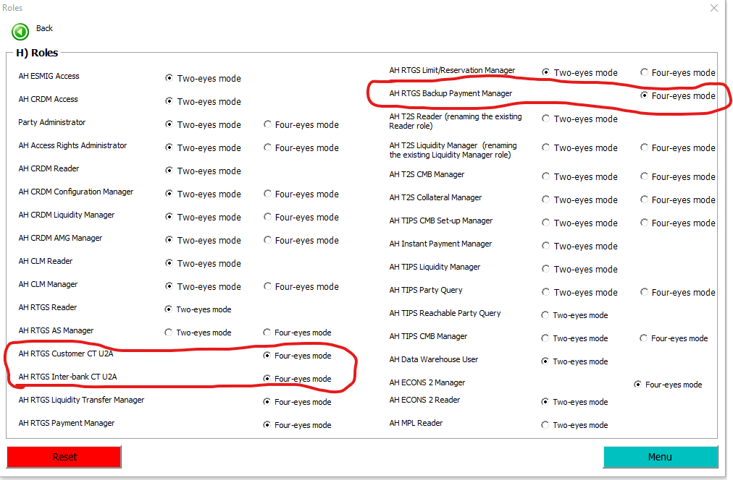
Registration 1. Party – H) Roles (R&O guide 4.2)
Notes:
Some roles contain privileges that can be used in Application-to-Application (A2A) mode. These roles have to be granted in two-eyes mode, except for CLM/RTGS related roles.
AH RTGS Backup Payment Manager. This role allows the user to initiate backup payments and customer backup payments. This Role cannot be selected if the user has already been assigned the AH RTGS Customer CT U2A Role and the AH RTGS Inter-bank CT U2A Role. Note: the participants also have to ask the NCB to activate the backup functionality.
AH CRDM AMG – Account Monitoring Group Manager (for entity to see total liquidity incl. branches)
TIPS and T2S access is already in place or not yet needed.

Slide 18
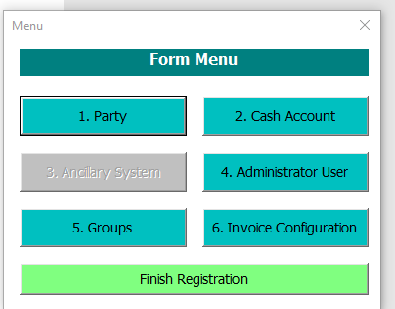
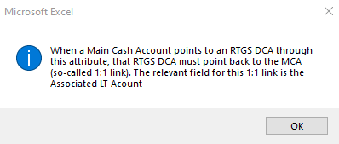
Registration – 1. Party – completed, click “menu” to return to Form Menu
Continue with 2. Cash Account

Slide 19
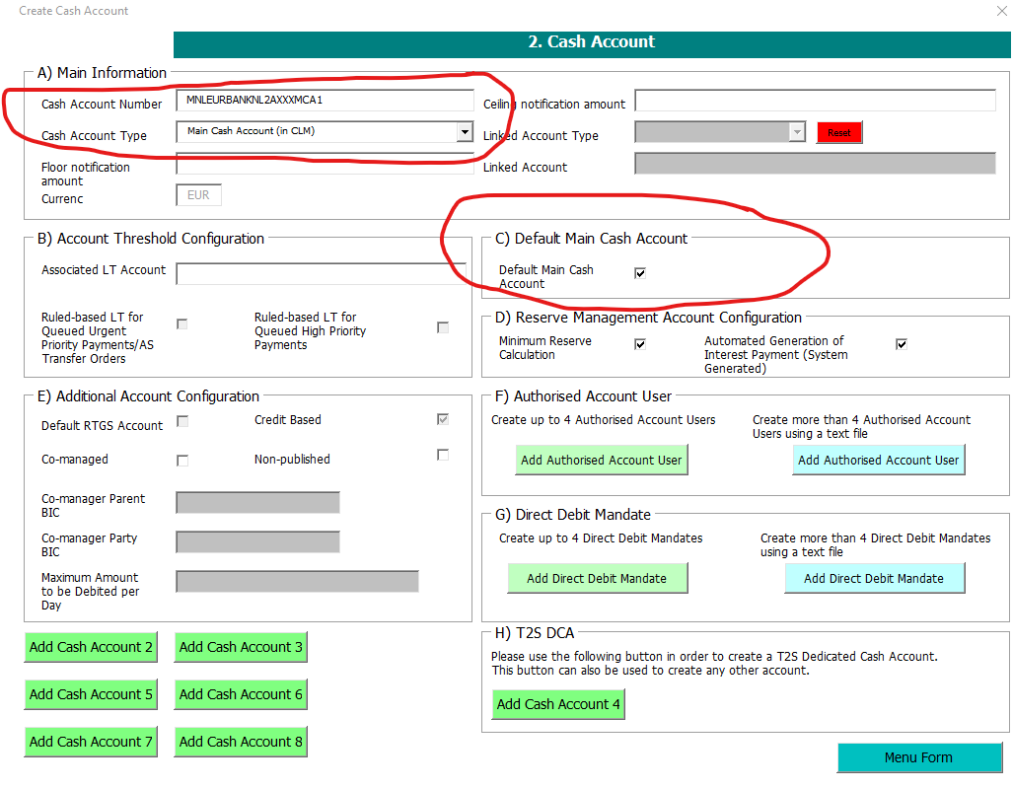
Registration 2. Cash Account
MNLEURRABONL2UXXXMCA
2000000000
125000000
RNLEURRABONL2UXXXRTGS
Note:
MCBEURPartyBIC11max 17 characters free text. Account type: M=CLM MCA CB country code Currency code =EUR BIC=Party BIC11 (not AAU BIC)
Sub-classification=17 character free text
Note:
Max amount = max of DD per day irrespective of sum of individual DD

Slide 20
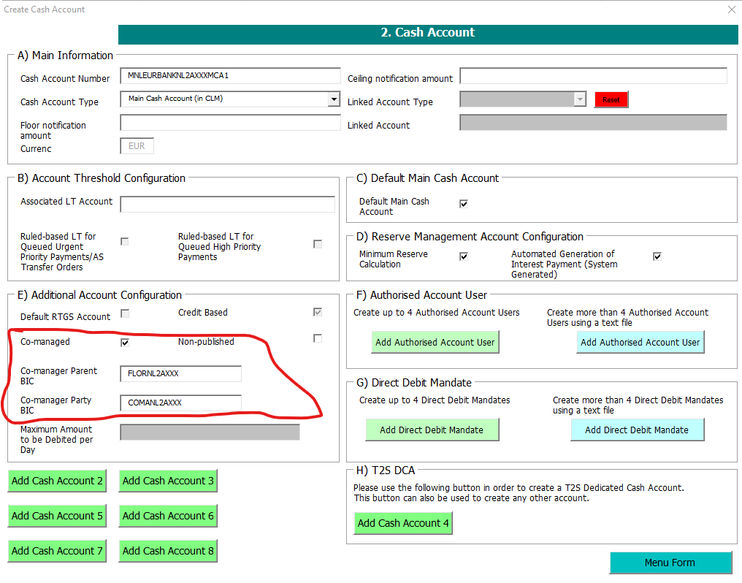
Registration
Documents with explanation about co-management and its options:
Explainer on Co-Management
Explainer on Co-Management – Example Scenarios
Note: only for use in case of co-management on the CLM account

Slide 21
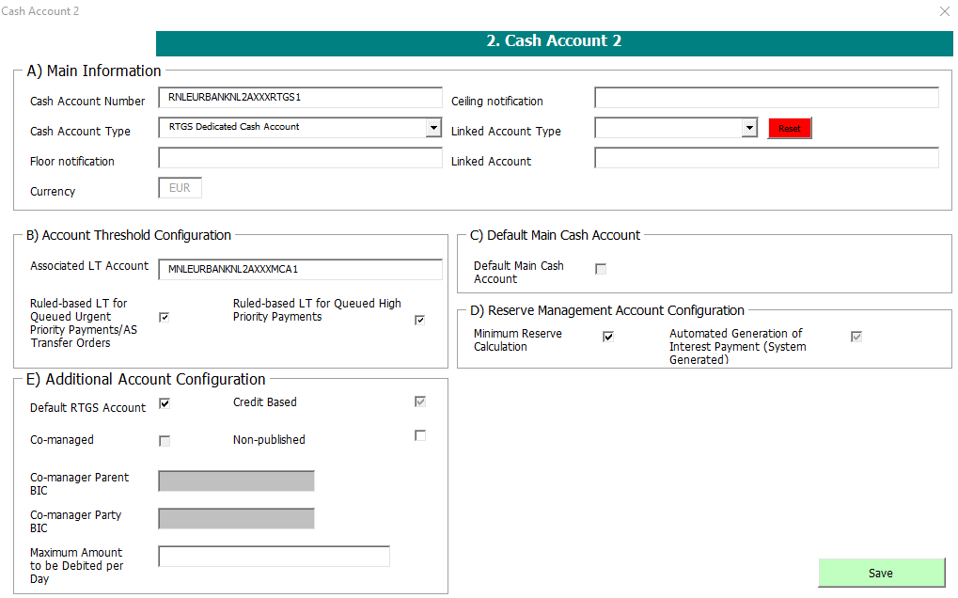
Registration
RCBEURPartyBIC11max 17 characters free text.
Account type: R=RTGS DCA U=RTGS Sub Account T=AS technical account G= AS guarantee funds account
CB country code
Currency code=EUR
BIC=Party BIC11 (not AAU BIC)
Sub-classification =17 character free text. In case of RTGS sub-accounts (account type = “U”) the Ancillary System code (to be requested from NCB )must be the first three characters of the 17 character free text.
RNLEURRABONL2UXXXRTGS
5000000000
25000000
MNLEURRABONL2UXXXMCA
Note:
Max amount = max of DD per day irrespective of sum of individual DD

Slide 22
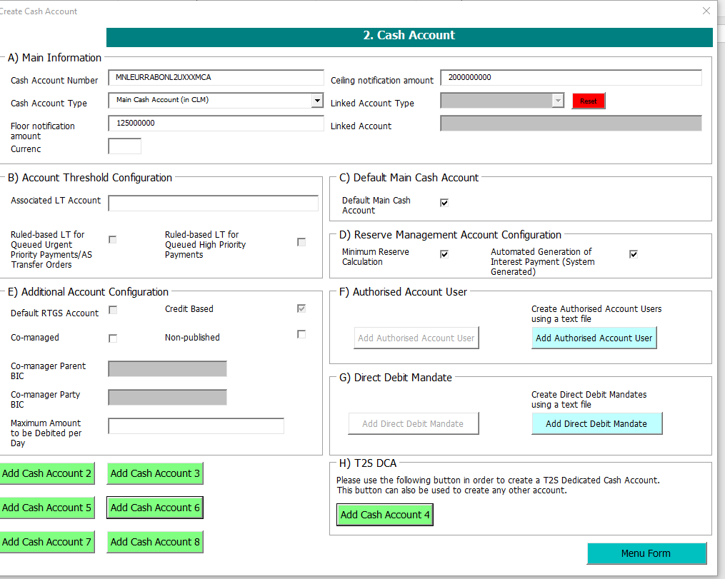

Slide 23
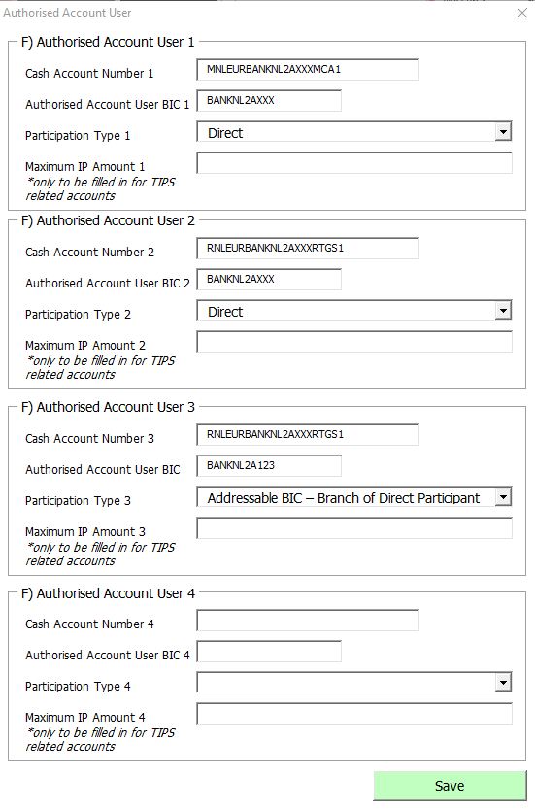
Registration
MNLEURRABONL2UXXXMCA
RABONL2UXXX
RNLEURRABONL2UXXXRTGS
RABONL2UXXX
R&O guide paragraph 6.1

Slide 24
Registration – 2. Cash Account F) Authorised Account User (R&O guide 6.1)
Other accounts opened by the Central Bank:
The PB Contingency Account inherits the AAU BIC of the linked MCA and it will be used for the balance sweep after the ECONS II closure.
Overnight deposit and marginal lending accounts do not need AAU BICs.
Note: also Sub-accounts do not need AAU BICs.

Slide 26
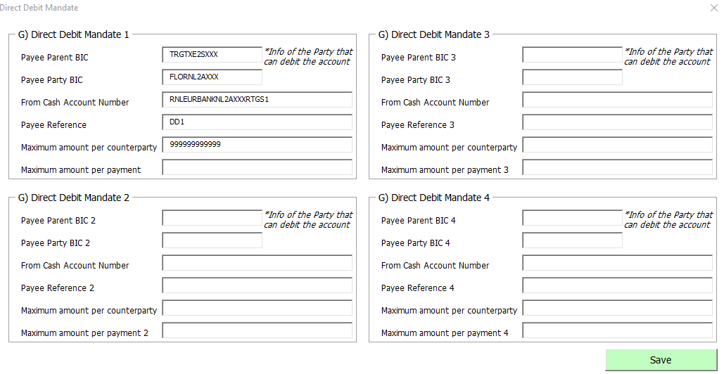
Registration
TRGTXE2SXXX – FLORNL2AXXX has DD mandate on each FLORNL2A – Party BIC in CLM/MCAs but requires a DD for the RTGS accounts.

Slide 27
Registration Form Menu

Slide 28
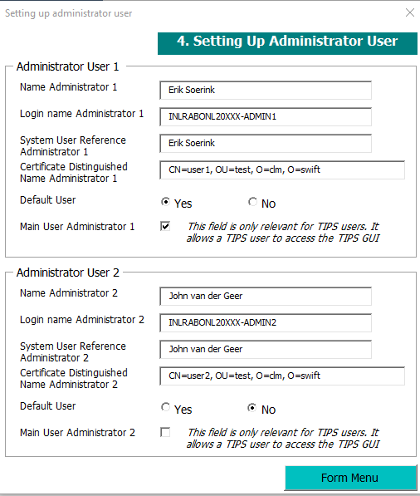
Registration
User DN: regardless of how many qualifiers there are, they should all be written in upper case, and there should be a blank after the comma for each value.
Admin users previously set up for the TIPS or T2S services can operate in CLM and RTGS without any changes to the configuration apart from the granting of the relevant access rights (Roles) by the NCB.
Participants are asked to include two already existing Admin Users from forms 7200 (T2S) and 8200(TIPS) in the registration form. These Admin Users will be granted the relevant roles.
ACBPartyBIC11 + max 21 characters free text. ‘A’ CB country code BIC=Party BIC (BIC 11). Sub-classification=21 character free text

Slide 29
Registration Form Menu

Slide 30
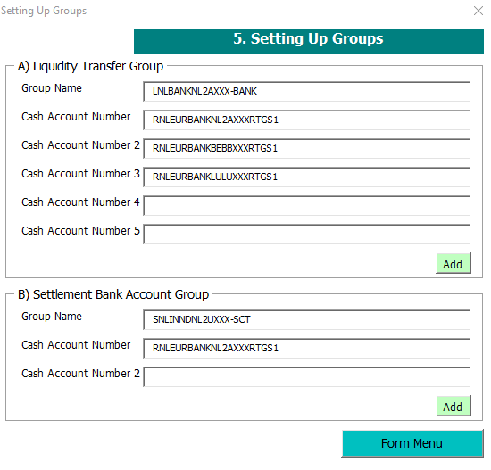
Registration
NLLBANKNL2AXXX-BANK
NLSINNDNL2UXXX-SCT
For reference: Account Monitoring Groups can be setup by the participants. CRDM-UHB 2.4.1.1

Slide 31
Registration Form Menu

Slide 32
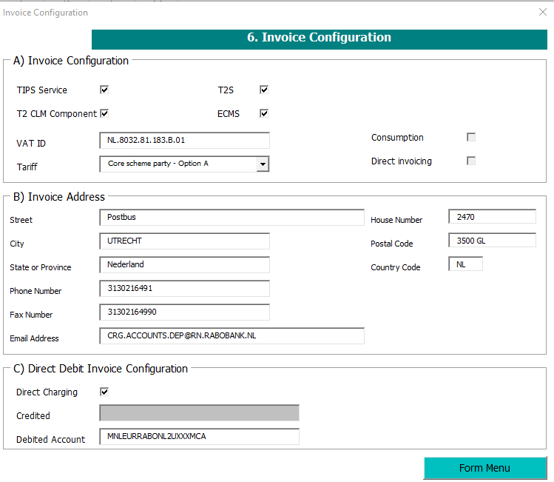
Registration
By policy, members of a billing group must belong to the same banking group

Slide 33
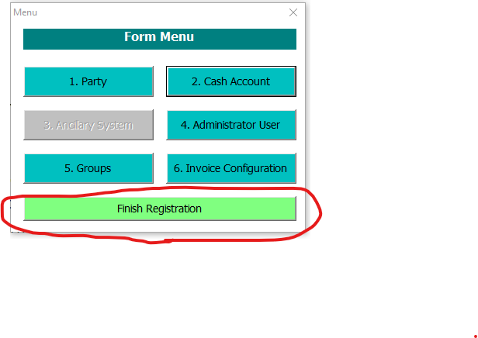
Registration
After pressing finish several subpages will be created. Please safe the excel as: f date-partyname-Registrationform 20211005BANKNL2AXXXT2REGISTRATIONFORM
Electronic signatures are not needed for the test.
In case you need to make a correction after pressing finish > start over from the last tab “user tab”, update the form and “Finish Registration”. (the old info is still there)
In case you need to make a correction after saving than please make the change and also reconfirm all other input, screen by screen, before again you “Finish Registration” .

Slide 34
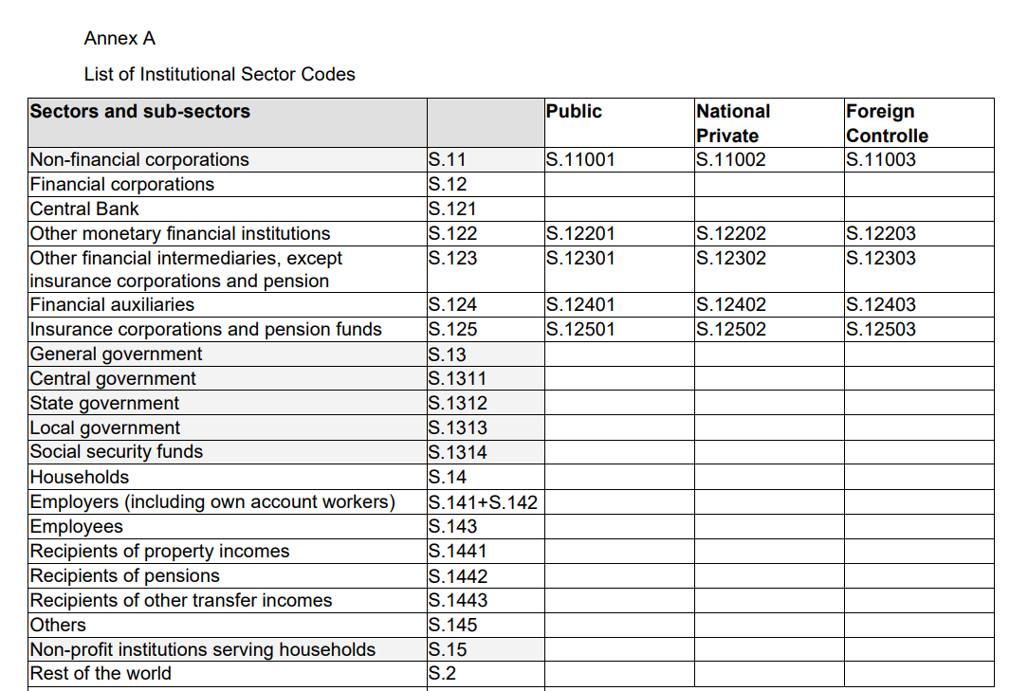
Registration

Slide 35
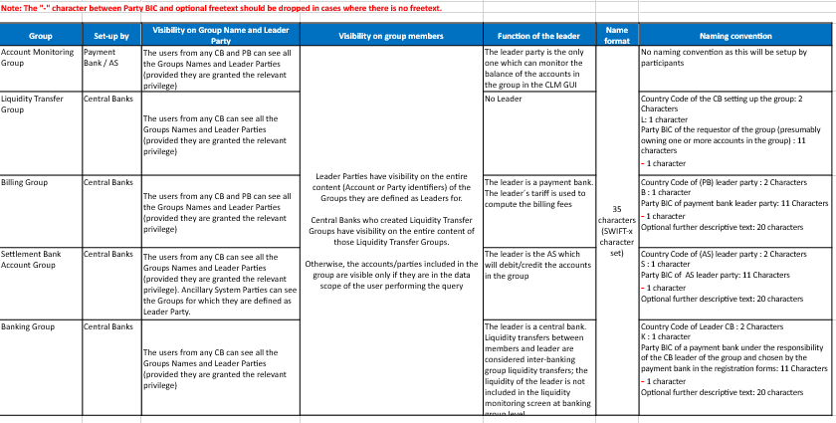
Registration

Slide 36
Registration
A Cash Account cannot be deleted if there still are valid instances of the following entities linked to it: Liquidity Transfer Order, Liquidity Transfer Order Link Set, Credit Memorandum Balance, Authorised Account User, Data Aggregation, Limit, Standing Order for Reservation, Direct Debit Mandate, or if it is referenced in another Cash Account as a Linked Account, Associated LT Account or Debited MCA.

Slide 37
Documentation and Communication
To be found on ECB’s website:For professional use (europa.eu):
TARGET registration and onboarding guide
Consolidatieproject TARGET (dnb.nl)
T2 User Detailed Functional Specifications v2.2 - Common Reference Data Management (CRDM) (europa.eu)
T2-T2S User Handbook v2.0 - Common Reference Data Management (CRDM) (europa.eu)
New from November 2021: Target Services NL newsletters to inform you of relevant developments, interesting Q&A and other migration related news items
TARGET2@DNB.NL for all your questions.

Slide 38
To conclude
TARGET2@DNB.NL

