Slide 1
A quantity-based approach to constructing climate risk hedge portfolio by Johannes Stroebel et al.
Comment rick van der ploeg
DNB-Riksbank-Bundesbank macroprudential conference series 20-21 June 2022

Slide 2
Transition risk
Transition risk:
unanticipated regulatory change and intensification of climate policy
sudden breakthrough of green technology
rapid changing social norms, etc.
Unexpected technological, social, and political tipping points
Risk of stranded financial assets if investments are irreversible or subject to large intertemporal and intersectoral adjustment costs
Unburnable carbon if temperature has to stay below 1.5 or 2 degrees Celsius
Assets may be written off as they become obsolete
Sudden unanticipated changes in stock prices of carbon-intensive and of green assets

Slide 3
Atmospheric capacity vs fossil fuel reserves: keep one third, a half and 80% of oil, gas and coal reserves locked up forever to meet 1.5K cap

Slide 4
Disorderly green transition
Ongoing discoveries cannot go on
195 “carbon bombs”: short-run expansion of oil & gas reserves amount to 18 years of current global emissions
Risk of stranded fossil-fuel-based financial assets
Green Paradox
Race to burn the last ton of carbon
Disrupted financial markets and carbon bubble

Slide 5
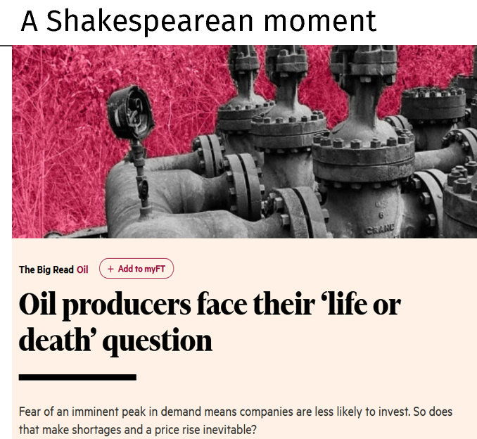
Peak demand is the new peak oil
“Investors biggest fear is that oil demand growth is no longer a given in perpetuity, with some demanding that by the end of the next decade the industry could be facing a peak in consumption, as government policies try to curb the use of fossil fuels”
“ After all, no chief executive wants to be left holding multi-billion dollar oilfields the world no longer wants or needs”

Slide 6
Carbon risk premia
Evidence that firms that emit a lot of carbon must offer higher expected returns than carbon-extensive firms even after controlling for the usual Fama-French factors such as size, book to market, momentum etc. (Bolton and Kacperczyk, JFE, 2021; NBER WP 2021)
Evidence for rising risk premia
High-pollution firms are valued at a discount (also Hsu et al., 2022)
Lower exposure to regulatory climate risk experience higher returns when there are negative climate shocks (Engle et al., RFS, 2020)
Evidence that banks demand a higher rate of interest on corporate loans from firms that are very carbon-intensive from 2015 onwards: 1 s.d. increase in climate policy exposure ⇒ 16bp increase in spread (Delis, de Greiff and Ongena, WP, 2019)

Slide 7
Physical risks: with global warming incidence of rare climate-induced weather events increases
Affects businesses and banks, but also the insurance industry

Slide 8
Temperature extremes will be larger in frequency and intensity

Slide 9
Climate stress tests
Following Mark Carney’s early warning, financial regulators and central banks are checking and containing the effects of transition risk and physical risks on portfolios, systemic risks, and the stability of the financial system
Network for Greening the Financial System
Need full corporate disclosure of carbon risks (IFRS): efforts of Lucrezia Reichlin and others
Need macro-prudential framework to include climate-related systemic risks
Which regulators are responsible for these systemic risks?

Slide 10
Alekseev, Giglio, Maingi, Selgrad and Stroebel: Climate hedging risk portfolios
Koijen and Yogo (JPE, 2019): use holdings data to predict price responses to fundamental shocks
Quantity-based approach to hedge risks from climate change
Novelty: exploit information on how mutual fund managers respond to four types of idiosyncratic (and almost uncorrelated) shifts in their beliefs about climate change:
Experience local extreme heat events: mortalities, extreme temperature relative to the history of that location, crop indemnity payments related to such events (validate using Google searches)
Instance when mutual fund managers change their language to specifically mention climate risks
Use observed changes in portfolio following such idiosyncratic belief shifts to predict how investors will reallocate capital once aggregate climate news occurs that shifts beliefs of many investors and thus change equilibrium prices

Slide 11
Hedging climate risks
A portfolio that holds stocks that investors buy following idiosyncratic climate belief shocks appreciates in value in periods with aggregate negative climate shocks
Quantity-based approach gives better out-of-sample hedging performance
Point is that it learns from rich cross-sectional trading responses which do not affect equilibrium asset prices rather than from time-series price information which is not of much help with newly emerging risks
The methodology is also used to design hedge portfolios that deal with aggregate unemployment and housing risks
Go long on assets that investors buy after an idiosyncratic shock and go short on assets investors tend to sell after such a shock
Such a portfolio should rise in value after an aggregate climate shock

Slide 12
Match location of mutual fund advisers with local climate shocks

Slide 13
Method
First, calculate active change in the share of the portfolio held in industry through active trading (equation (2))
Second, regress these on the four idiosyncratic beliefs of climate risks and time fixed effects to obtain the industry-specific climate quantity beta (equation (3))
Third, use these betas to obtain the excess returns of the corresponding quantity-based hedge portfolio (equation (4))
Fourth, regress these portfolio returns on returns of the market, size and value factors (equation (5)): the Fama-French factors capture about 30% of the variation
Alternatives: narrative approach and mimicking approach

Slide 14
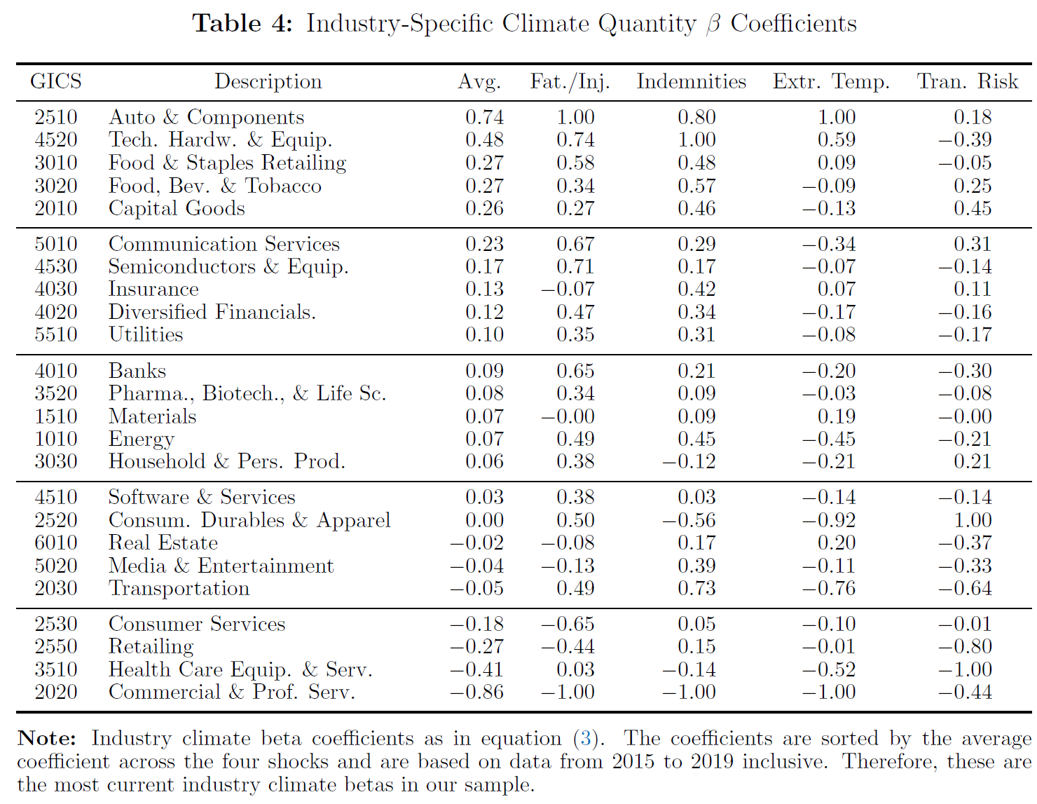

Slide 15
Industry-specific climate quantity betas
Positive industry-specific climate quantity betas:
more trade in car stocks in response to idiosyncratic shocks (surge in demand for E.V.s?)
even in fossil energy stocks (regulation keeps out competitors? play a role in green transition?)
more trade in insurance stocks:
More evidence on the mechanisms?

Slide 16
Empirical strategies and results
Construct long-short portfolios for each of the four types of idiosyncratic climate risks and then check out-of-sample performance with respect to various measures of aggregate climate risk
Compare this strategy with:
Narrative approach (e.g., buy clean energy, sell coal, buy companies with high ESG scores) works only if economic priors are correct (cf. Engle et al., RFS, 2020) but buying clean energy stocks works while shorting traditional energy companies is a bad hedge
Mimicking portfolio approach which projects climate risks on a set of portfolio returns using time series data (not very good for short time series)
These two approaches offer mixed results (good hedge for some risks and bad for others)
Hedging climate risks is tough: few attain more than 20% out-of-sample correlation with the climate shock series
But quantity-based method hedges against all risks and maximum out-of-sample correlation above 30%

Slide 17
Less effective strategies?
Long-short portfolios: buy assets that benefit from climate risk realisation and sell assets that loose (Engle et al., RFS, 2020)
Mimicking portfolios (Lamont, 2001)
Invest in ESG or other green trackers
Divestment:
Institutional investors are divesting away from carbon-intensive stocks
Impact investing does not have much of an effect on cost of capital of carbon-intensive corporations (Berk and van Binsbergen, 2021)
Catastrophe bonds
Can we show empirically that the quantity-based hedging is also superior for the latter three strategies?

Slide 18
Other questions
Is it reasonable to assume that investors react similarly to aggregate climate risks as to idiosyncratic risks?
Exercise is done for U.S. mutual funds where we can observe trading: can results be improved for other types of investors, other types of assets, and other countries?
Treat transition risks differently from physical risks when designing climate hedging portfolios?
Do you recommend investors to have separate hedging portfolios for each of the four and possibly other climate risks given that they seem uncorrelated?
Can you give some estimate of the counterfactual of how much money has been lost in the out-of-sample exercise by not using your climate hedging portfolios?

Slide 19
Conclusion
A great paper on quantity-based hedging which is a must for every investor and its hedge portfolio performs better than mimicking portfolios
Novelty: look at idiosyncratic shocks rather than time-series evidence
Can do even better if one also uses trading data on retail and other investors and uses other assets (e.g., carbon futures)
The extent of data collection for the four types of idiosyncratic climate shocks and the holding and location data of the mutual fund managers needed to link portfolio holding to local heat shocks is impressive
Leads the way on how to hedge climate risks, unemployment risks, housing risks using local climate, unemployment and house price shocks

