Slide 1
Loan guarantees, bank lending and credit risk reallocation
Carlo Altavilla | Andrew Ellul | Marco Pagano
European Central Bank | Indiana University | University of Naples Federico II, EIEF
Andrea Polo | Thomas Vlassopoulos
Luiss, UPF, BSE, EIEF | European Central Bank
DNB-Riksbank-Bundesbank Macroprudential Conference
21 June 2022
The opinions in this presentation are those of the authors and do not necessarily reflect the views of the European Central Bank and the Eurosystem.

Slide 2
Loan guarantees: objectives and possible issues
Objective: encourage lending by shifting default risk to the govt.
Standard policy instrument, but used on a massive scale in the COVID-19 crisis: key fiscal policy plank in most countries
Why? Provide liquidity to viable firms facing cash flow dry-up ⇒ avoid costly liquidations
  Policy leakage? Guarantees may not generate a commensurate increase in lending, as banks may substitute non-guaranteed with guaranteed loans:
  “The main danger is the transfer of pre-existing exposures. A bank with an exposure to a firm could ask it to use the guaranteed debt to repay its existing loans” (Blanchard, Philippon & Pisani-Ferry, 2020)
  But in principle firms may ask for such substitution as well:
  they may use guarantees to restructure debt and lower its cost
  So the issue of substitution is intertwined with that of selection, i.e., which firms have access to loan guarantees

Slide 3
Selection and substitution
Insights:
bad selection (guarantees to firms in the tails) ⇒ more substitution
even with good selection (guarantees to firms in the middle), banks may engage in substitution, and more so for riskier firms (supply-side story)
bank-driven substitution?
bank-driven substitution
firm-driven substitution
firm credit risk & liquidity
non-viable & illiquid
viable but risky & illiquid
viable & liquid
Notes:
Imagine i can rank
Bad selection if they go to tails. Group 3 is support that companies do not need/limited resources given to firms in need. Group 1 they are not viable these programs usually cut companies who would fail anyways
If bad a lot of substitution. Group 3, group 1 incentive for banks to take risk from their balance sheet to government

Slide 4
Policy makers are aware of these issues…
The Communication of the EU Commission about State aid in the pandemic (2020/C 91 I/01) lays out these eligibility guidelines:
  “The guarantee may be granted to undertakings that were not in difficulty … on 31 December 2019” ⇒ exclude firms in the lower tail
  “[…] but that faced difficulties or entered in difficulty thereafter as a result of the COVID-19 outbreak” ⇒ exclude firms in the upper tail
  National regulators tolerate at most a limited degree of substitution:
    In France, “enforcement of the guarantee will be subject to the bank evidencing that the loan granted under this scheme leads to an increase in the bank’s commitments to the borrower”
    In Italy, loans guaranteed by Fondo Nazionale di Garanzia and designed for refinancing of existing loans must involve at least 25% new lending
Notes:
Empirica questions

Slide 5



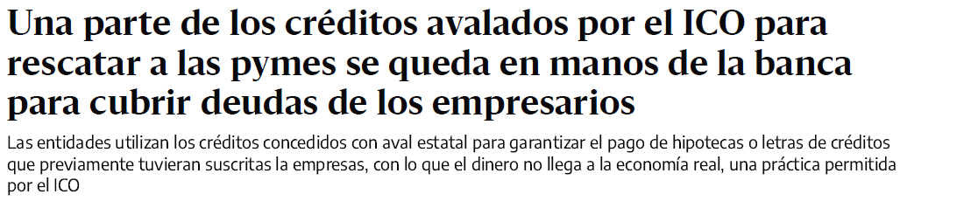
… and the media are aware too

Slide 6
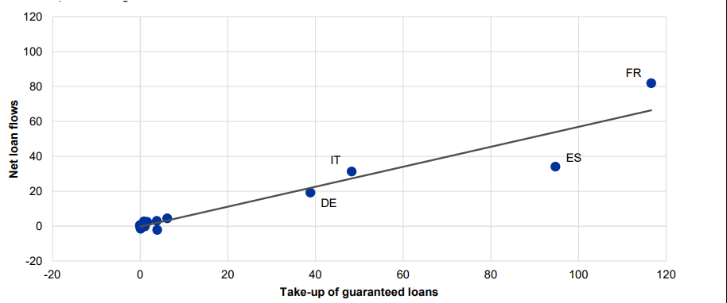
Guarantees and lending: aggregate public data
Slope < 45°: at the aggregate level, net lending increases less than proportionately to guaranteed loans
Source: ECB Economic Bulletin, Issue 6/2020
Notes:
So the aggregate public data suggest 1) substitution and 2) need to focus on «big four»

Slide 7
Contribution

Slide 8
This paper
We use bank-firm-level euro-area data to investigate
selection: which firms received loan guarantees and which banks provided them?
substitution for guarantee recipients: how much reduction in the pre-existing loan exposure is observed? How does it vary across firms and banks characteristics?
cross-country consistency: do the answers to questions 1 and 2 vary significantly across euro-area countries?
Novel data: harmonized euro-area credit registry (Anacredit) matched with ECB supervisory bank-level data
Main identification strategy: we compare lending to the same firm by banks that issue a guaranteed loan and by those that do not

Slide 9
Related research

Slide 10
Related research
Pre-Covid-19 evidence on loan guarantees:
Mostly positive effect in credit supply, employment and firm survival rates (Bachas et al., 2020; Schich et al., 2017; De Blasio et al, 2017; Ciani et al., 2020)
Evidence on U.S. loan guarantee programs:
Allocation of guarantees (Granja et al., 2020; Chodorow Reich et al., 2020; Cororaton and Rosen, 2020)
Real effects (Autor et al., 2020; Bartik et al., 2020)
Evidence on European loan guarantee programs:
Allocation of guarantees in Italy and Portugal (Core and De Marco, 2020; Kozeniauskas et al., 2020)
Role of relationship lending in the Spanish loan guarantee program (Jimenez et al., 2022)
Comparison of different loan guarantee programs in Italy (Cascarino et al., 2022)
Notes:
mostly showing that they went disproportionately to worst hit areas and sectors, and to smaller, less liquid and more indebted firms
There is a a paper by Cascarino gallo palazzo sette on credit additionality (which shows that this is less than 100%) which is of course related to the issue of substitution (of what banks do with their pre-existing exposure which is the focus of our paper) the paper is with italian data and analyze different programs within the country
in the U.S., PPP loans raised employment at eligible firms and increased firms survival

Slide 11
Data

Slide 12
Guaranteed loans by firm size (million Euro)
Largest amount of funding in Spain and Italy
Most of the funds allocated to SMEs in all countries

Slide 13
Guaranteed loans by number of firms
Greatest number of firms involved in Italy and Spain
In terms of number, small firms dominate everywhere

Slide 14
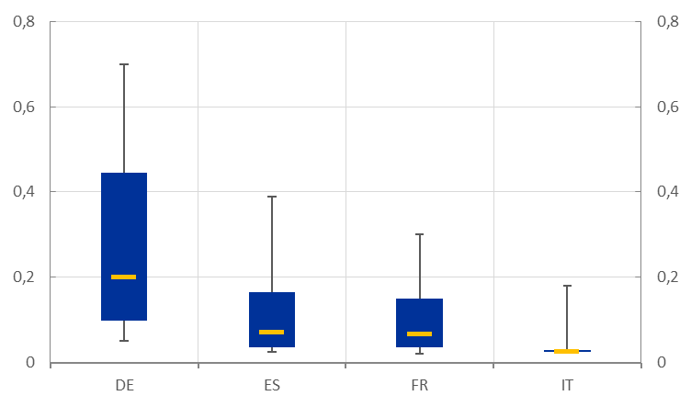
Amount of guaranteed loans (million euro)
Largest loans in Germany: more loans given to large firms
Smallest loans in Italy: many 100% guaranteed loans up to 25k given to small firms
Notes:
Larger and more dispersed loans in Germany than in other countries and especially Italy

Slide 15
Empirical strategy

Slide 16
Empirical strategy
Selection: how do firms that received guaranteed loans differ from those that did not? Dimensions:
  size, sector-country and risk
  borrowing from banks with different size, liquidity, capital & NPLs
Substitution: did banks issuing guaranteed loans reduce their non-guaranteed exposures?
  Focus only on firms with guarantees:
    at firm level, estimate the elasticity of non-guaranteed lending to the size of the guarantees
    within each firm, compare the change in non-guaranteed lending by banks with guarantees with that of banks without guarantees (Khwaja-Mian, 2008)
  Identify firm and bank characteristics for which substitution is larger
  Investigate how interest rates and maturities of guaranteed loans correlate with substitution (to disentangle demand from supply)

Slide 17
Results: selection

Slide 18
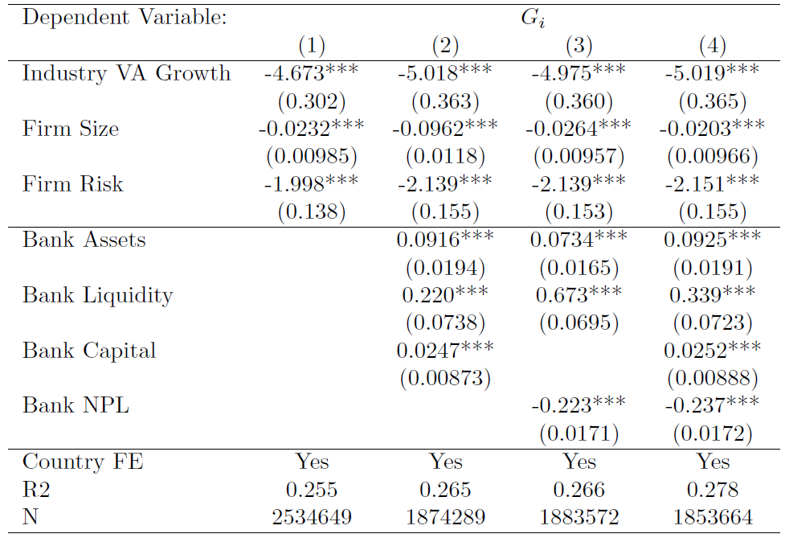
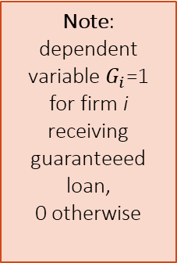
Which firms received guaranteed loans?
Note: dependent variable $G_{i}$=1
for firm i receiving guaranteeed loan,
0 otherwise
Especially:
  firms in more affected sectors and countries
  smaller firms but less risky ones (lower share of arrears)
  borrowing from larger and stronger banks

Slide 19
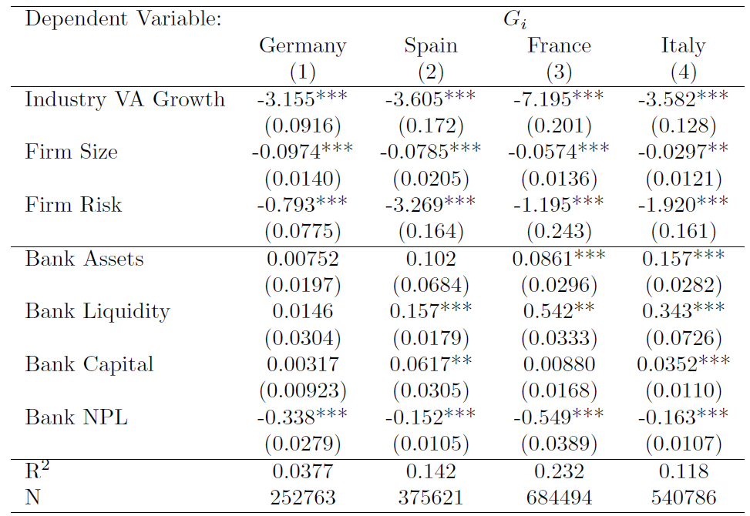
Did the selection differ across countries?
Note: dependent variable $G_{i}$=1 for firm i receiving guaranteeed loan,
0 otherwise
No, the selection of guarantee recipients was qualitatively similar across the four countries

Slide 20
Results: substitution

Slide 21

Measuring substitution
How much did banks lending to a firm with a guaranteed loan change their pre-existing exposure to the firm?
with initial date = February 2020, and final date = August 2020
Measure of substitution $s_{i}$= − y_{i}

Slide 22
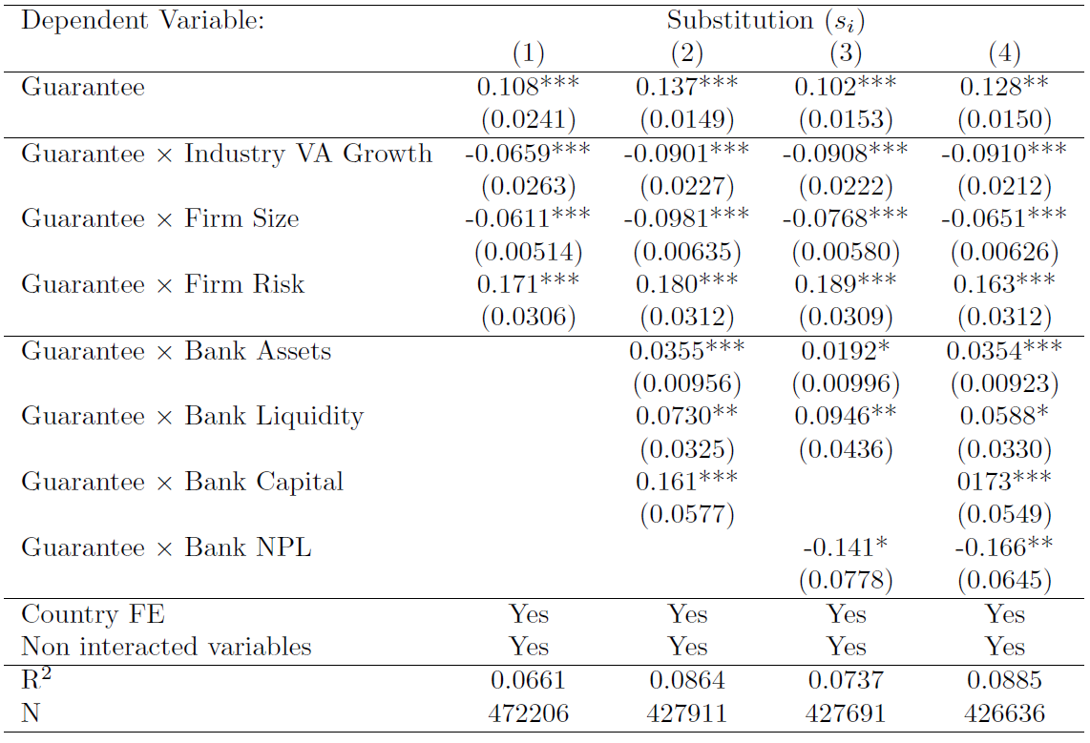
Substitution: firm-level analysis
On average, larger guarantees are associated with more substitution:
  elasticity of 0.13: €1 guaranteed loan ⇒ -€0.13 non-guaranteed credit (above)
  elasticity of 0.30: €1 guaranteed amount ⇒ -€0.30 non-guaranteed credit (table)
Elasticity is larger for firms that were
  more affected, smaller and riskier
  borrowing from larger and stronger banks
Notes:
We need desriptive stats for the variables of this table in the subsample of firms with guarantees. Econ significance???? How much is the guaranteed amount in this subsample?
Interpretation? For 1 unit increase in GGA/E (which means 100%: company had 25 k of credit and now obtains 25k in new guaranteed credit) on average the firms sees a reduction of 0.1 (10%) of the preexisting credit?
To understand interaction, for instance:
Change in gva is 0.03 at 75p.le and 0.26 at 25 p.le. Coeff is 0.08 so 0.08*0.03=0.02, 0.26*0.08=0.021 so firms in industries at at 25p.le of lost sales (bad sectors) see a larger reduction in pre-existing credit of around 2% more (which corresponds to a 20% of the average reduction due the guarantee)

Slide 23
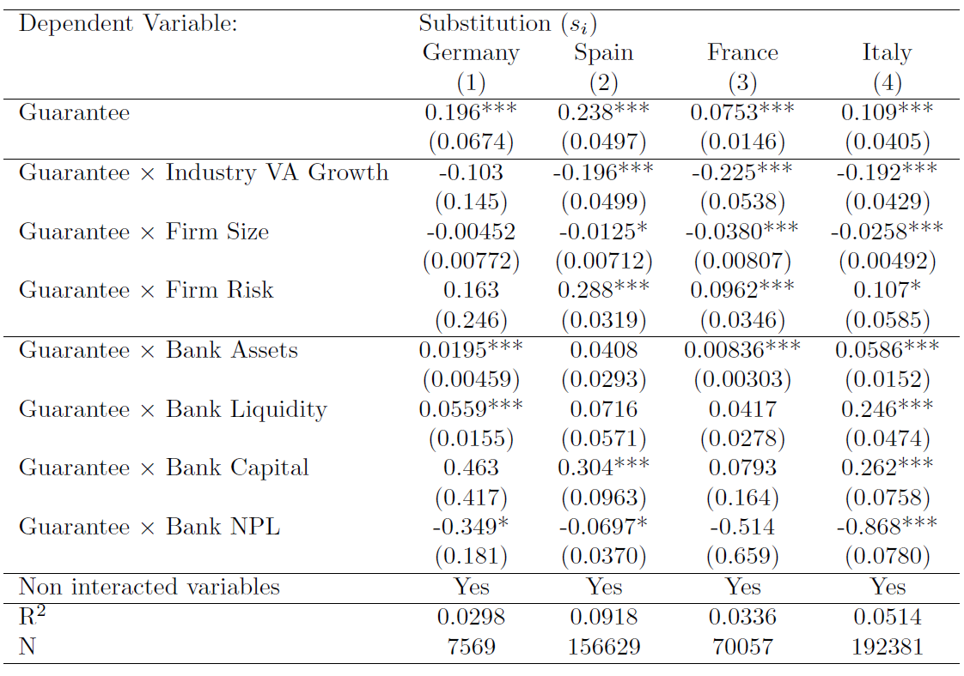
Substitution: firm-level analysis, by country
Elasticity varies across countries: smallest in France, largest in Spain
But heterogeneity matters in a similar way in all four countries

Slide 24
Substitution: firm-bank descriptive statistics
 | Guarantee | Average Δ bank-firm non-guaranteed credit (y) | Number of observations
Euro Area | N | -0.038 | 240,310
 | Y | -0.361 | 223,068
Germany | N | -0.020 | 4,967
 | Y | -0.080 | 2,213
Spain | N | -0.002 | 98,006
 | Y | -0.448 | 127,234
France | N | -0.005 | 5,914
 | Y | -0.089 | 7,891
Italy | N | -0.068 | 131,423
 | Y | -0.266 | 85,730
On average, in all four countries the bank issuing the guaranteed loan cuts its non-guaranteed exposure more than other banks lending to the same firm

Slide 25
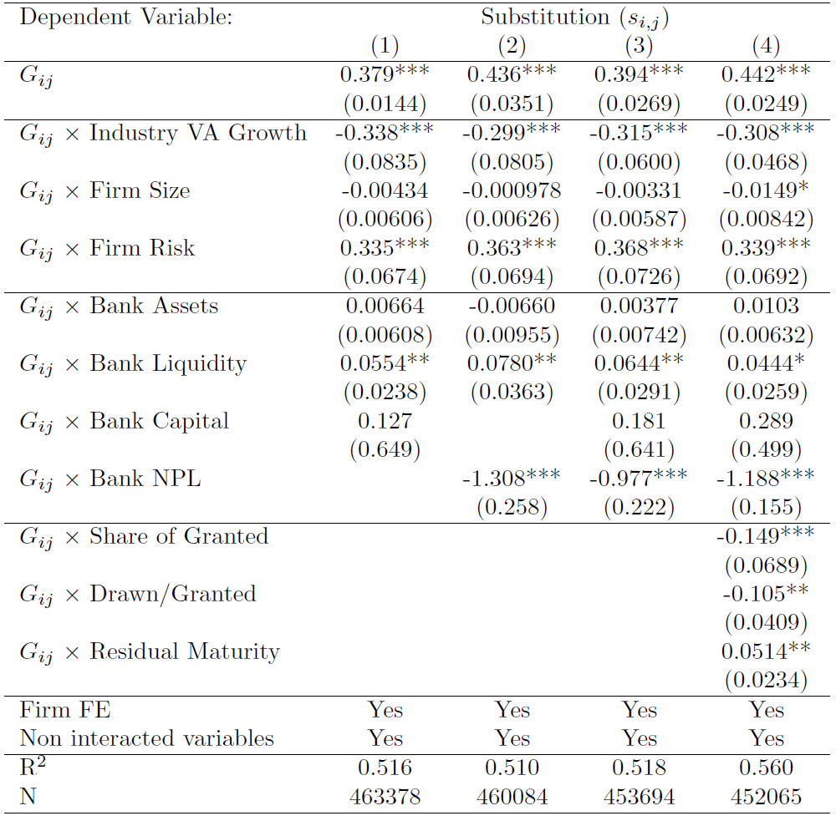
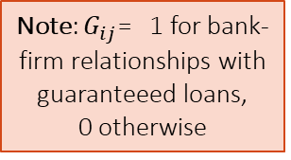
Substitution: firm-bank level analysis
Note: $G_{ij}$= 1 for bank-firm relationships with guaranteeed loans,
0 otherwise
Bank issuing guaranteed loans cuts its non-guaranteed exposure relative to other banks lending to the same firm:
  more for weaker firms (more affected sectors & countries, smaller, riskier)
  more for larger and stronger banks

Slide 26
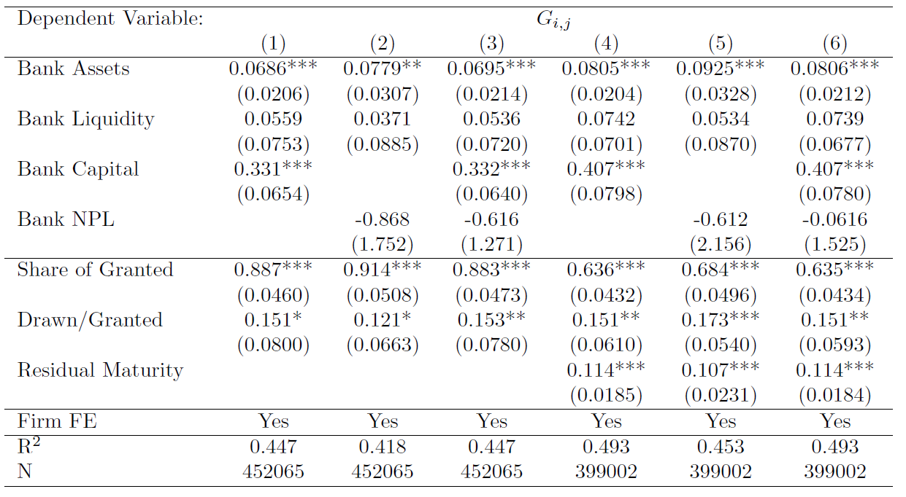
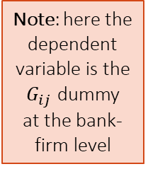
Within-firm selection of bank with guarantee
Note: here the dependent variable is the $G_{ij}$ dummy at the bank-firm level
Even within-firm estimates may be biased by a different selection issue: the bank issuing the guaranteed loan is not randomly chosen
But the characteristics of selected banks (higher capital & relationship banks, i.e. larger share of granted) are typically associated with greater supply of credit during shocks (e.g. Bolton et al. (2016), Jimenez et al. (2012)) ⇒ should lower substitution!

Slide 27
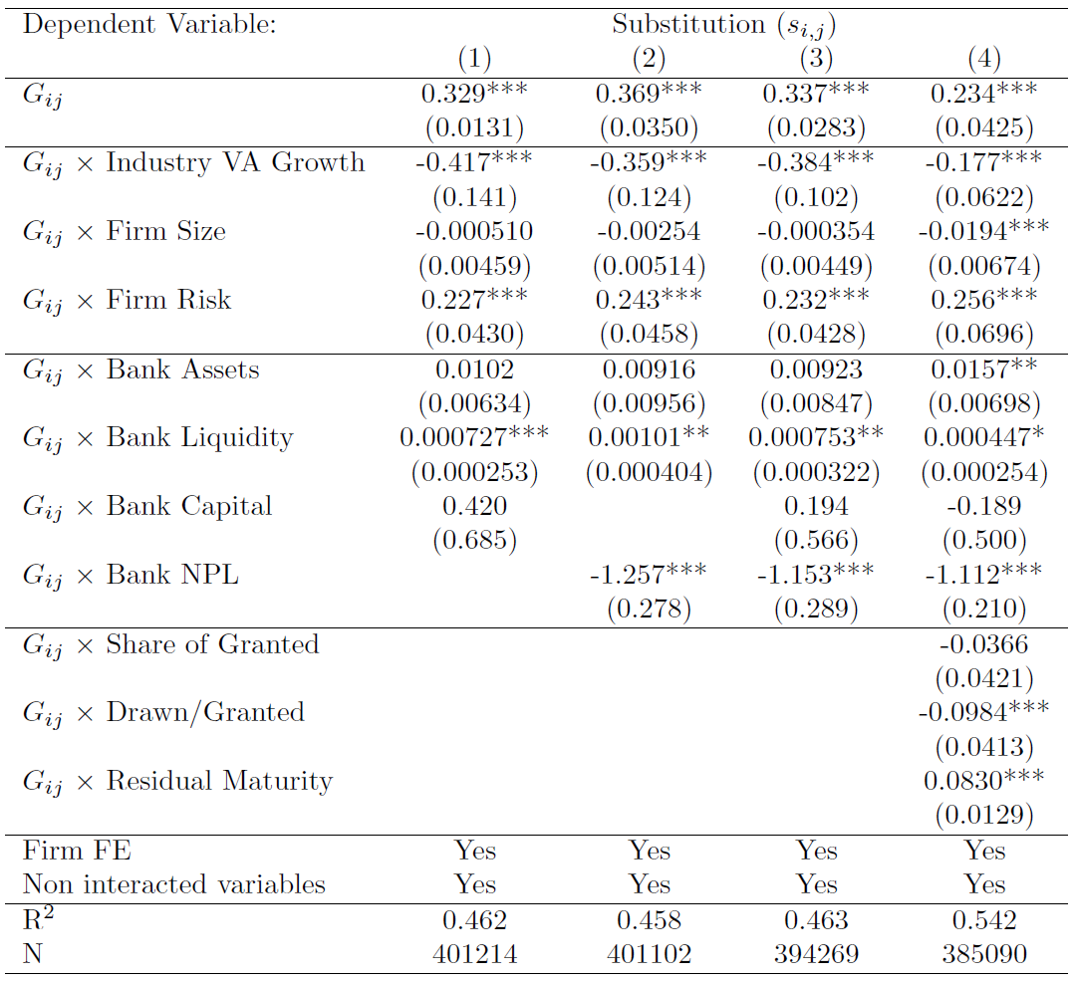
Role of maturity of pre-existing loans?
Estimates in the previous slide already show that the bank providing the guarantee is not the one with shorter residual maturity: actually the opposite!
Here we show that the main results still hold dropping bank-firm relationships with at least 1 loan maturing between March and August 2020
Hence credit substitution does not mechanically reflect rollover of expiring non-guaranteed credit

Slide 28
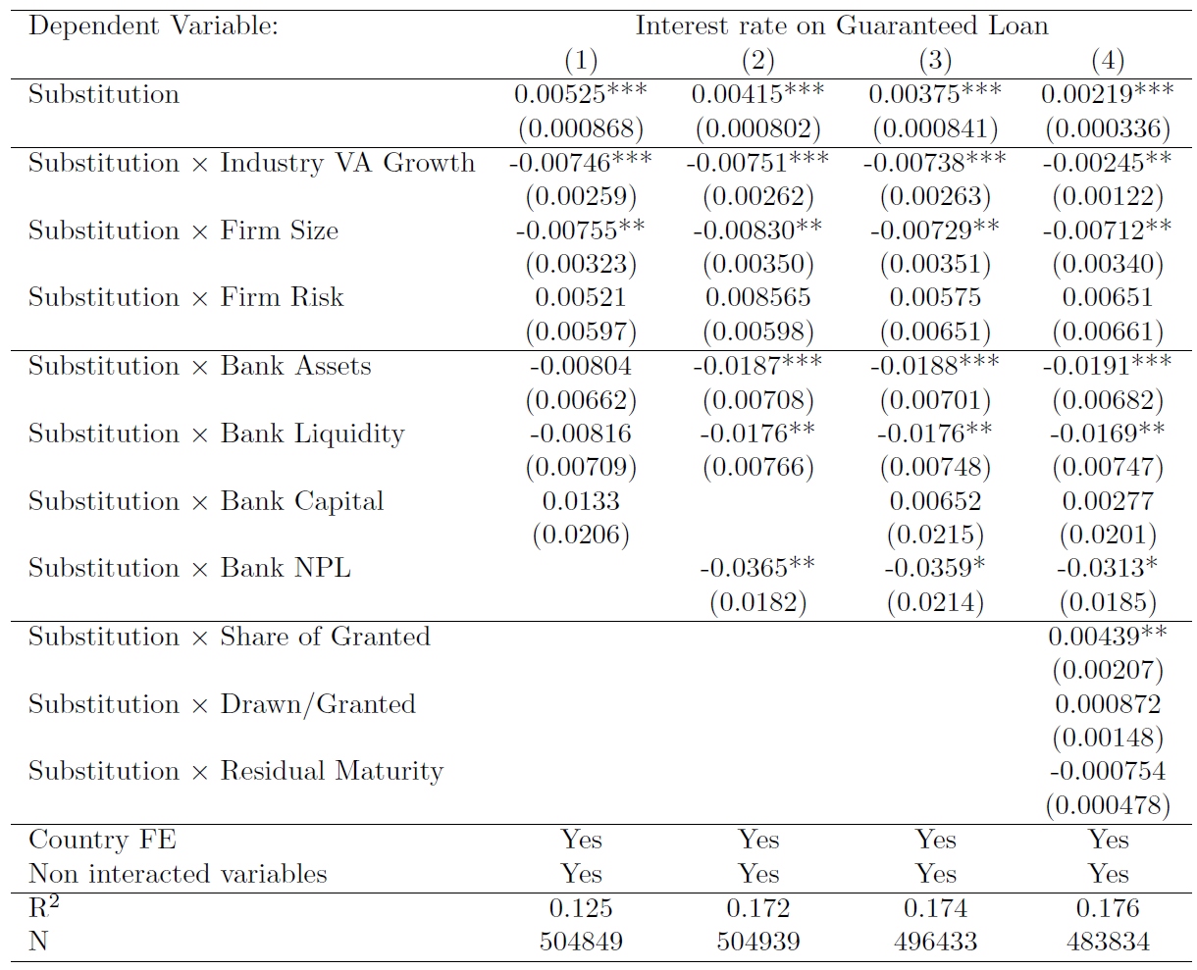
Correlation between substitution and interest rates on guaranteed loans?
If negative, consistent with substitution being demand- driven
If positive, supply driven
Recall that substitution is stronger for weaker firms: already suggests supply-driven story
Findings:
more substitution is associated with higher interest rates on guaranteed loans
this effect is stronger in more affected sectors and countries
Consistent result for maturities: substitution correlates negatively with them

Slide 29
Conclusions

Slide 30
Conclusions
  On the whole, good selection of guarantee recipients:
    guaranteed loans mainly directed to firms in affected sectors, but not those with highest pre-crisis risk level
    similar selection in all countries despite different rules and institutions
  We are the first to document substitution between guaranteed loans and pre-existing exposure:
    differs across countries: smallest in France, largest in Spain
    but similar response to firm and bank characteristics: positive response to credit risk and positive correlation with interest rate on guaranteed loans suggests that substitution is bank-driven
    any policy upside? Loan guarantees may have contributed to the recapitalization of banks exposed to firms hit by COVID-19
      yet, substitution is greater for more solid banks!

Slide 31
Thank you!

Slide 32
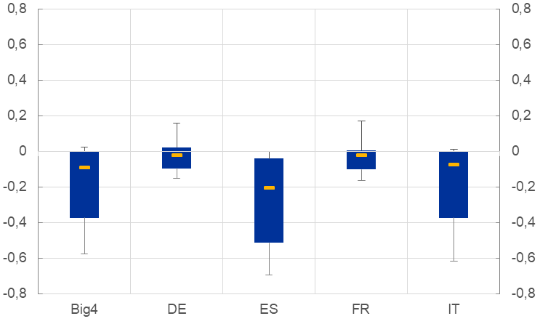
Distribution of y for firms with guarantees
In all four countries, substitution (y < 0) occurs for the majority of firms
But much more so in Italy and Spain
These differences may reflect cross-country differences in the firms that receive gauaranteed credit
Notes:
P16, p25, p50, p75, p84

Slide 33
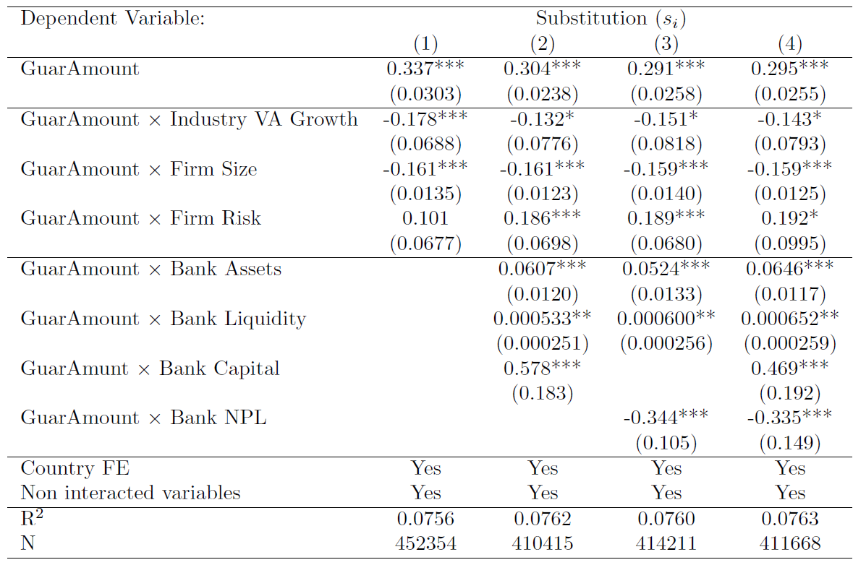
Substitution: firm-level analysis, using guaranteed amount instead of guaranteed loan
Back

Slide 34
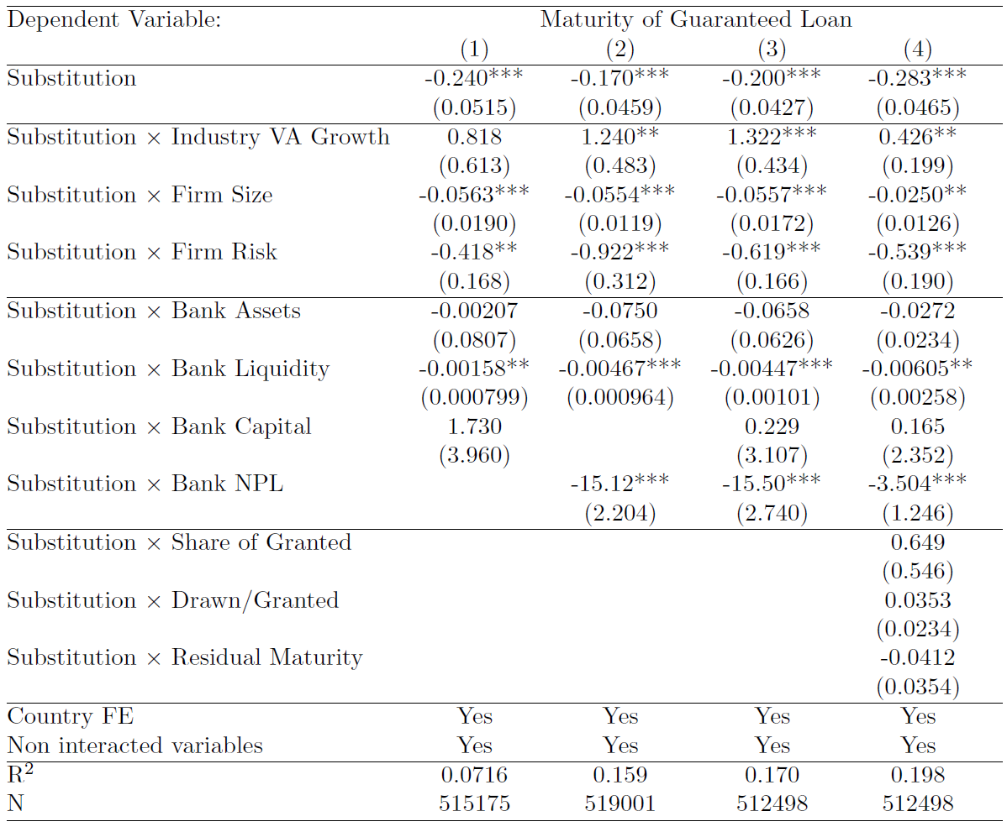
Maturity of guaranteed loans and bank substitution
Back

