Slide 1
Organic Data and
Economic Measurement
Roberto Rigobon
MIT, CSAC, CNStat, NBER

Slide 2
Data
Information
Knowledge
Big Distance!
The world is not lacking of Data
Lacking of Careful Empirical Analysis
Lacking of Managerial Data Analysis
Notes:
Word processors have reduced the cost of writing a word or a sentence…. But we have not produced better literature.

Slide 3
Different Types of Data
Data
Designed
Survey
Administrative
Organic
Aspirational
Public
Private
Transactional
Aggregate

Slide 4
Requirements
Weaknesses that matter
 | Survey | Estimation | Forecasting | Measurement
Representativeness |  |  |  | P
Selection Bias |  | P |  | P
Reliability and Consistency | P |  | P | P
Transparency on Data Collection and Treatment | P | P |  | P
Errors-in-variables |  | P | P | P
Aspirational (Transactional) | P | P |  | P
Private (as opposed to public) | P |  | P | P
Model Uncertainty and Behavioral Changes |  |  | P | P
Notes:
Finally, true measurement.
I think everything matters here.

Slide 5
Forecasting versus Measurement
Forecasting
  Need a benchmark
  Out-of-sample accuracy is important
  Constant evaluation
Measurement
  Constructs the benchmark
  Consistency in data collection
  Representativeness of data

Slide 6
Measurement
Official Statistical Offices
  Federal Statistics
    GDP, Labor Market Conditions (Unemployment), Inflation, Real Estate, etc.
  Tremendous challenges
    Response rates
    Cost and Budgets
    Political Manipulation

Slide 7
Online Inflation Rates
Billion Prices Project

Slide 8



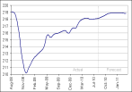
Billion Prices Project
Our Approach to Daily Inflation Statistics
1
2
3
4
5
Use scraping technology
Connect to thousands of online retailers every day
Find individual items
Store and process key item information in a database
Develop daily inflation statistics for ~20 countries
Date
Item
Price
Description

Slide 9
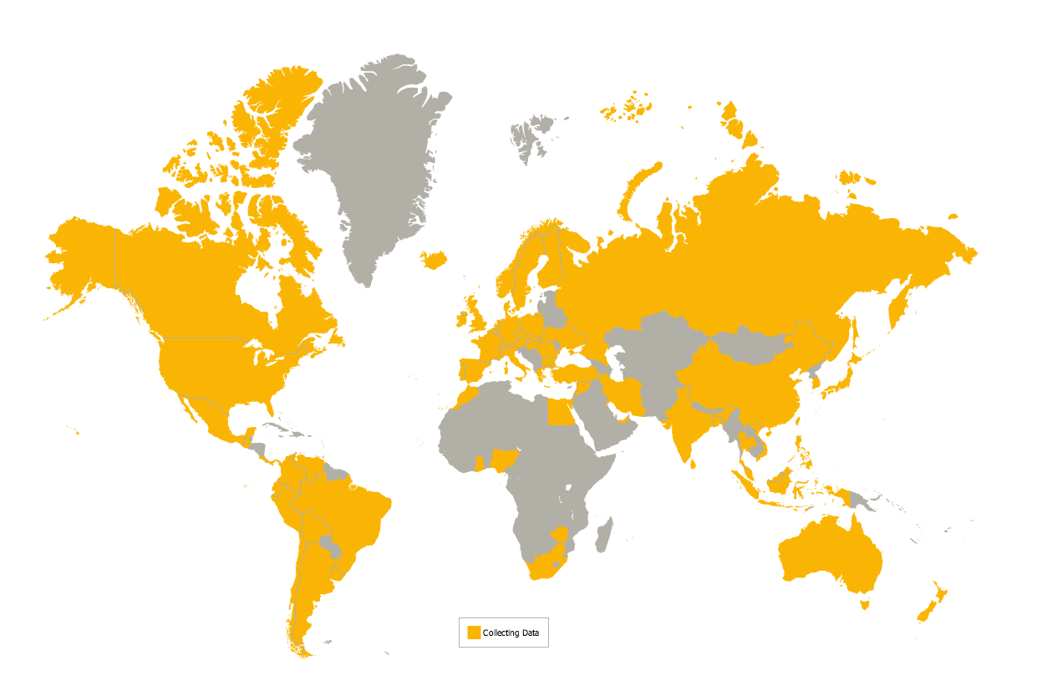
Countries covered

Slide 10
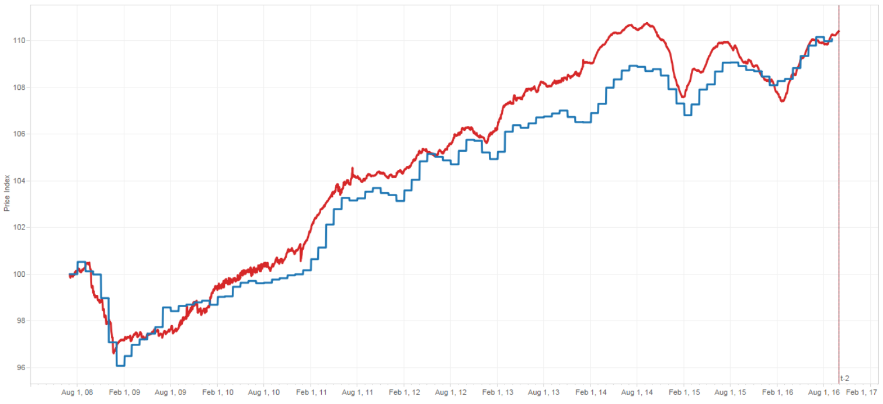
USA

Slide 11
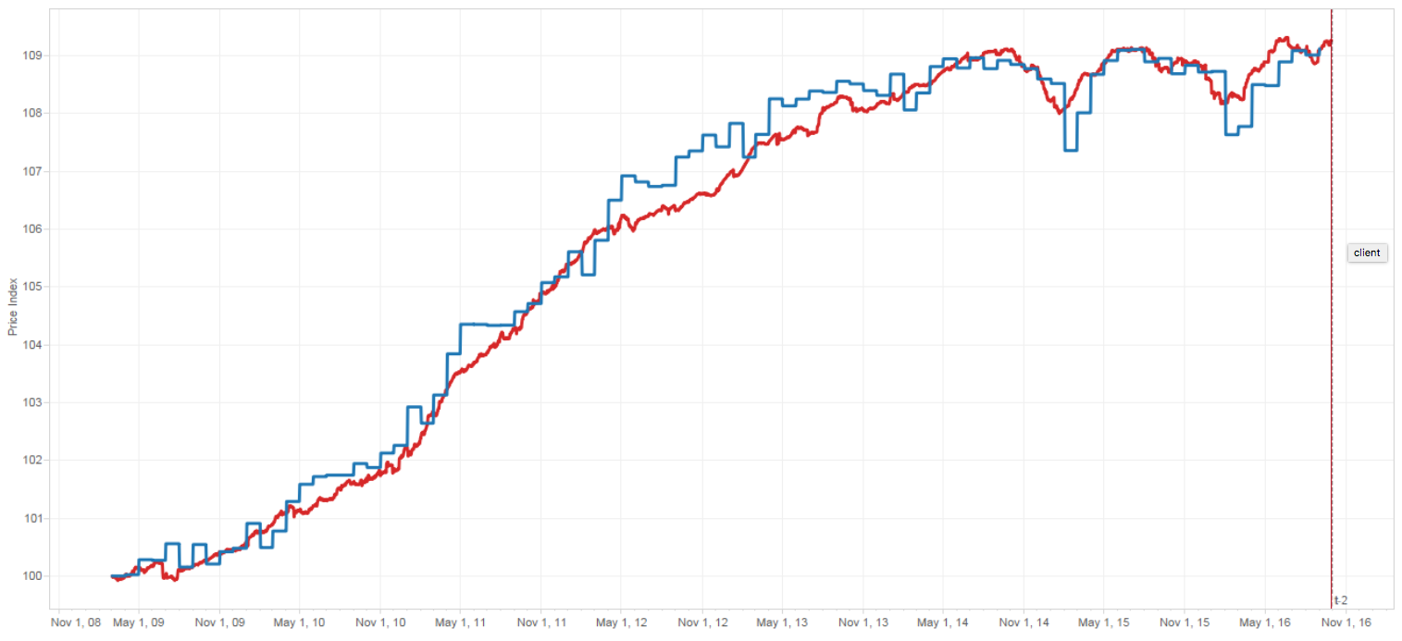
Euro

Slide 12
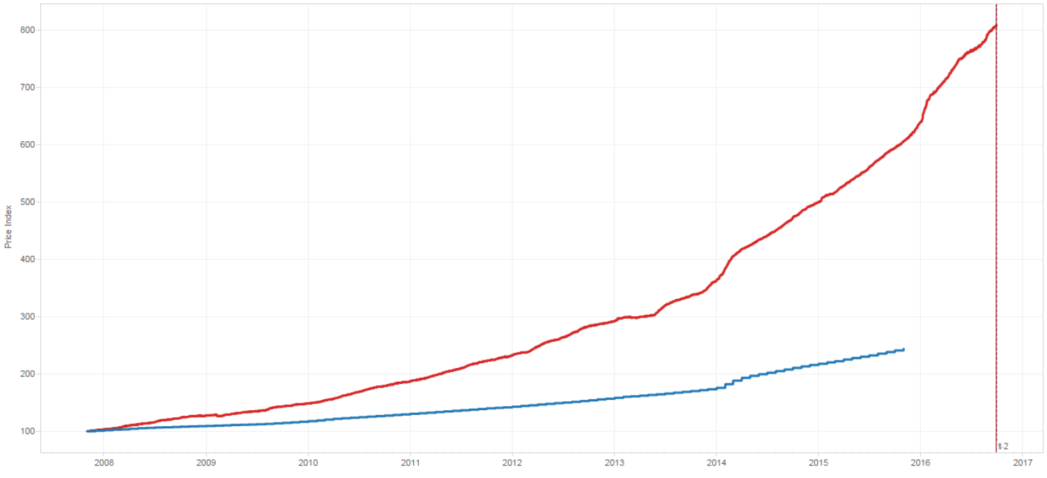
Argentina

Slide 13
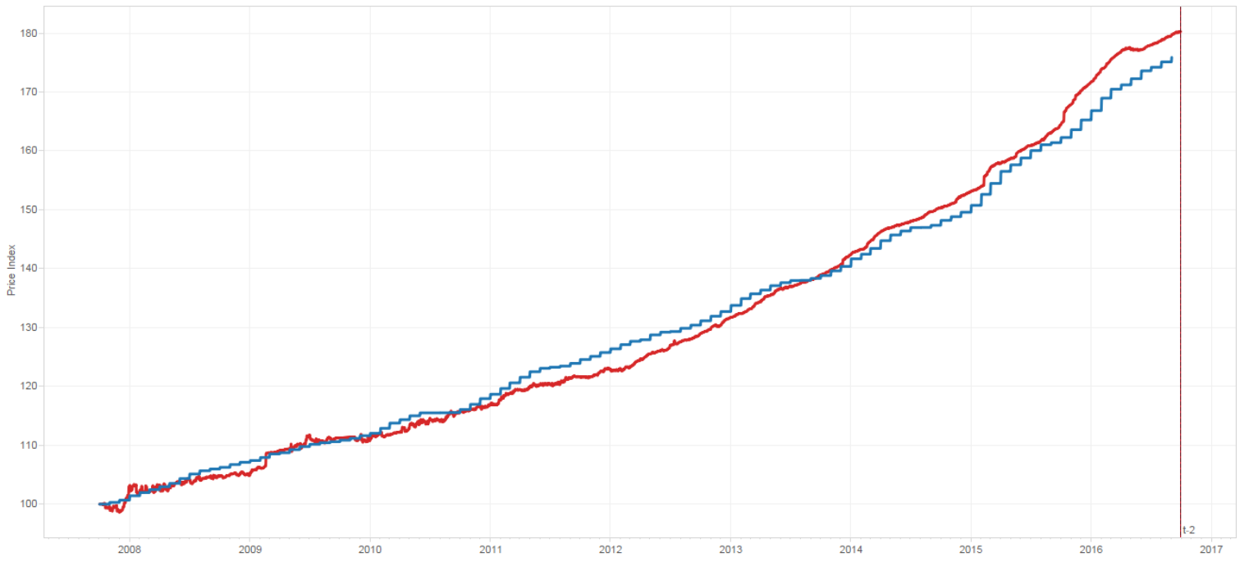
Brazil

Slide 14
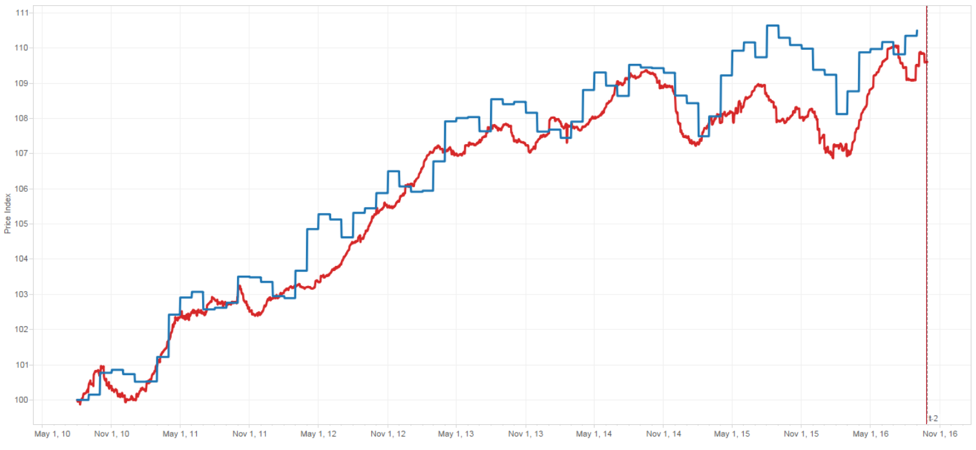
Neatherlands

Slide 15
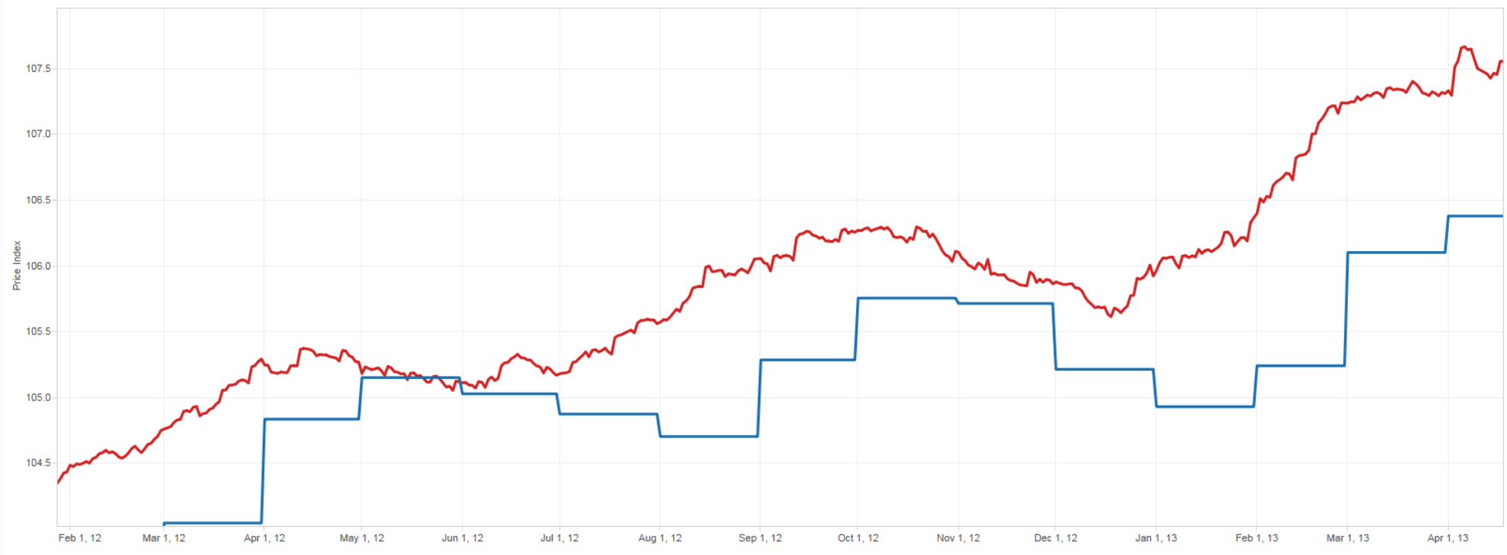
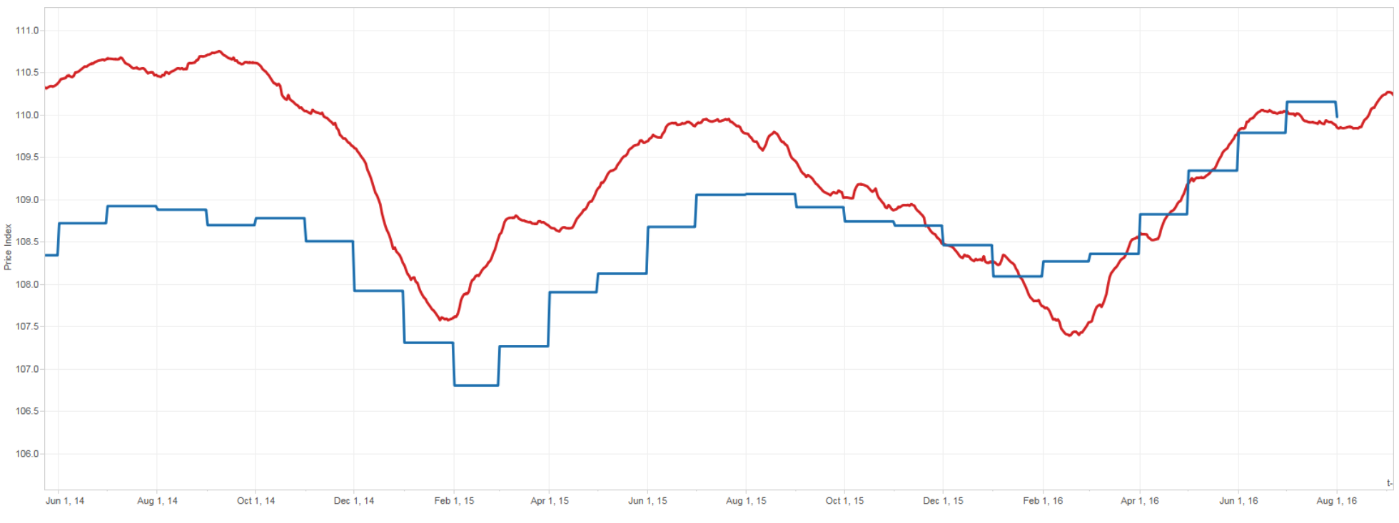


USA: Anticipation

Slide 16

Properties
Congruence
  Most countries the inflation rate online is similar to the inflation rate offline
Anticipation
  Consumers have less memory
  Prices are easier to change

Slide 17
Core Inflation
BLS: Direct Effect
BPP: +Indirect Effect

Slide 18
Real Exchange Rates
Thousand BigMac Indexes

Slide 19
The International Comparison Program
The International Comparison Program (ICP) is the world's largest statistical initiative.
  Established in 1968
  It is now the largest international data collection exercise involving five regions and 107 countries.
  The results will be combined with the OECD/Eurostat PPP program for 43 countries, bringing the total to about 150 benchmark countries.
Measure disequilibrium two ways:
  Compare the purchasing power across nations for similar goods or basket of goods
  Compare the time series or international relative prices for similar goods or basket of goods

Slide 20

Thousands Big Mac’s Project
Online prices represent an effective tool to measure PPP fluctuations
  Identical items sold around the world
  Detailed descriptions to achieve a nearly perfect matching
  Daily Prices
PPP indices:
  More than 300 narrow product categories
  With thousands individually matched items
  In food, fuel, and electronics: we are missing clothing, personal care, household products.
  Cars we will never match
Compare prices for a bottle of Coke across countries
Apply similar approach to hundreds of products on a daily basis
PPP Indices
20

Slide 21
Two exchange rates
E: Nominal Exchange Rate
  Determined in financial markets
    Uncovered and covered interest rate parity
    Order Flows
Eppp: Implied Exchange Rate
  Computed from retailer’s relative prices

Slide 22
Australia

Slide 23



South Africa

Slide 24


UK

Slide 25


Brazil

Slide 26

Argentina

Slide 27
Why is there information about the exchange rate?
What retailers DO NOT do?
  Predict the exchange rate
What retailers DO?
  Price according to the local demand
    Movements in the relative price of identical items reflect shifts in relative demands
      If prices at home are increasing faster than at foreign, then it means that the demand at home is stronger than abroad.
      This demand is the demand for imports/exports. It is for tradeable products
      Shift in demand for tradeables have implications on hedging demand and foreign exchange rates, that ultimately has an impact in nominal rates.
      The theories say that an increase in the demand for imports leads to a depreciation of the real exchange rate.
    We measure the “agreement” across retailers about their relative demands
  This implies that price increases have different signals than price decreases because increases are more likely than decreases.

Slide 28
Brazil

Slide 29
Australia

Slide 30
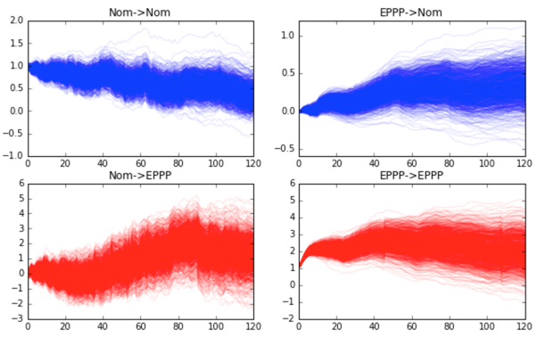
Brazil: Impulse Responses

Slide 31
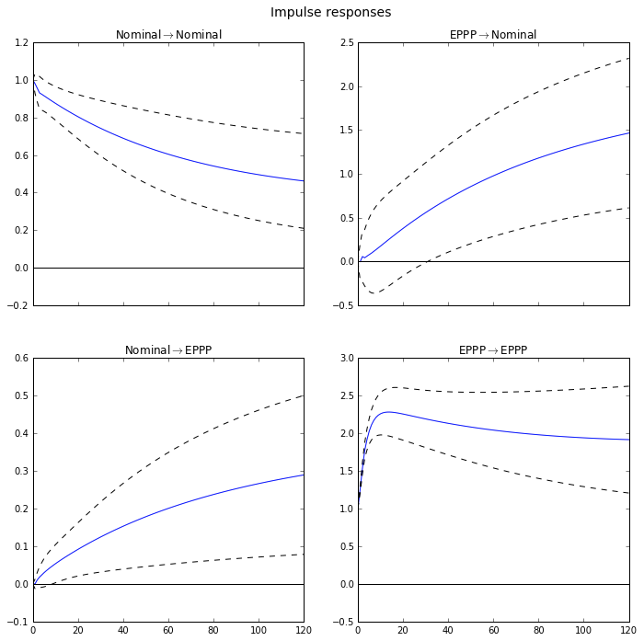
Brazil: Impulse Responses

Slide 32
Final Remarks
Type of data
What is the objective?
Designed | Response Rate and Response Accuracy
Organic | Representativeness
Objective | What is the problem?
Complement a Survey
Pattern Detection | Stability
Estimation | Representativeness and Independence
Forecasting | Stability and Missing Variables
Measurement | Everything

