Slide 1
Trading around Geopolitics by Corsetti, Demir and Javorcik Discussion by Antoine Berthou
27th Annual DNB Research Conference
21-22 November 2024

Slide 2
Geopolitical fragmentation and trade reallocation
Geopolitical tensions are growing and have a strong impact on global trade relations
Evidence from the IMF and others (including recent study by Banque de France) of trade reorientation along geopolitical blocs
East / West tensions related to rising tensions between large economic powers (US and China) or the Russian invasion of Ukraine
Economic implications are subtle and there is need for more evaluation
Global trade and welfare impact
Heterogeneity and distributional impact between countries, sectors, agents
Micro and macro implications for growth, inflation, at different time horizons
This paper focuses on micro channels of transmission
Firm level exports in Turkey
Price setting and markups
Terms of payment and invoicing currency
Great paper with useful theoretical insights and clean firm-level evidence

Slide 3
Main ingredients in the theory
Exporting to countries under sanctions can be profitable but risky and costly
Profitable: higher export volumes, and/or markups due to lower competition
Model with endogenous markups and strategic complementarity
Costly: higher transactions costs, esp. when using global currencies
→ Affects entry decision of firms through zero profit condition
Risky: Risk of non-payment, US secondary sanctions
Add two theoretical motivations to discuss (i) choice of payment contract; (ii) choice of the invoicing currency

Slide 4
Theory remarks I : financial costs and heterogeneity
Financial costs are fixed by assumption, but:
Could also have an ad-valorem component (e.g. due to use of financial instruments for hedging)
How they change is ambiguous as CIA + PCP a priori reduce variable or fixed cost (no funding of working capital, no financial hedging)
However, alternatives to SWIFT can be very costly + reputation cost can increase
Consequences for the zero-profit condition are ambiguous
Firm heterogeneity :
Increase in entry costs benefits more to large profitable firms
Switch to CIA for payment or PCP for invoicing beneficial to small exporters
Look at changes in the composition of exporters by size, in the data?

Slide 5
Theory remarks II : export volumes vs prices
Theory with endogenous markups – literature on the exchange rate puzzle
Atkeson and Burstein (2007), Berman, Martin and Mayer (2012), Amiti, Itskhoki and Konings (2019)
Exchange rate depreciations increases price competitiveness but large firms tend to adjust more their markups with strategic complementarity
Similar evidence in the context of tariffs
Context of sanctions: fixed cost /competition channel
Fixed costs increase for competitors in sanctioning countries (ambiguous for exporters based on Turkey), competition is reduced
Expect: Firm entry (??) / prices and markups (+) / export volumes (??)
Data: Firm entry (+) / prices and markups (+) / export volumes (+)

Slide 6
Theory remarks III : Connector countries after sanctions
Consider different theoretical frameworks
In structural models such as Caliendo-Parro, or Baqaee-Fahri, with CES preferences and fixed markup, exports would be reallocated proportionately to all third countries not implementing sanctions
Alternative Demand channel :
Non-homothetic preferences in the importing country
Preference shock in RU for TUR goods
Alternative Supply channels:
Fajgelbaum et al., (2023) Positive impact of US-China trade war on exports by bystander countries
Model : Slope of the supply curve and substitutability with the supply from the targeted country
Trade networks and supply chains:
Trade routes reorganize along second best options, beyond specialization and demand structure

Slide 7
Data: Micro to macro
The increase in Turkish exports to Russia is not controversial
Paper is focusing on micro channels
Based on micro data: would be interesting to give more insights on aggregate contribution of firm entry vs exports growth among continuers, sector patterns, volume vs price effects
USD appreciation vs TRY
USD appreciation vs TRY
Source: Turkey customs via Trade Data Monitor

Slide 8
Micro to macro: impact on output growth
Industrial output is pretty flat since Feb 2022
Consistent with table 6 in paper on total exports (weaker specification).
Other counteracting macroeconomic forces : weak domestic demand?
Other stories: re-exports of EU products not detected in re-exports data
Additional outcome variables:
Within: Real output, sales, employment, TFP…
Between : changes in the average size of exporters, how that this informs about entry costs?
TurkStat, Industrial Production Index, September 2024

Slide 9
Empirical analysis is very convincing … just few remarks
Most (~2/3) of the export response is not going through sanctioned goods
Substantial share of the impact is due to goods with ex-ante high EU market share
Even though data excludes new exporters and re-exports, looks like network effect with EU exports re-routed through connector countries such as Turkey

Slide 10
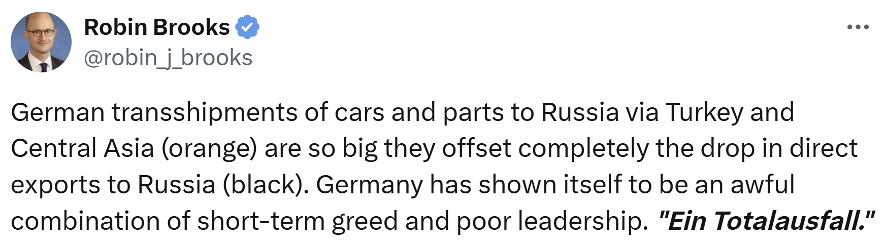
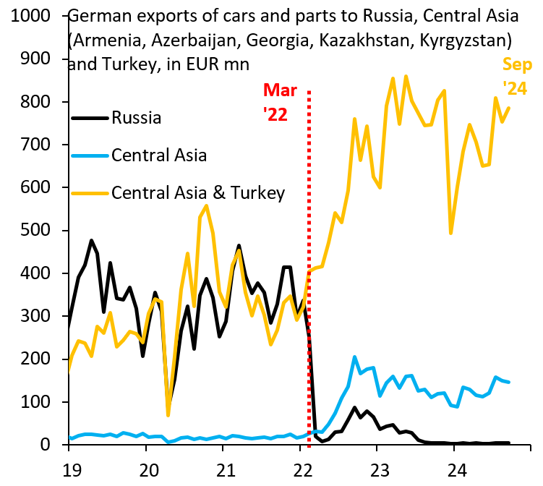

Slide 11
Empirical analysis is very convincing … just few remarks
Most (~2/3) of the export response is not going through sanctioned goods
Substantial share of the impact is due to goods with ex-ante high EU market share
Even though data excludes new exporters and re-exports, looks like network effect with EU exports re-routed through connector countries such as Turkey
Which theory fits the most well this pattern?
Alternative story: Turkish firms with export experience in RU agree to re-export EU goods affected by sanctions but do not want to take any risk:
Payment made before delivery
Payment in TYR to avoid any currency risk or hedging cost

Slide 12
To conclude
A great paper on sanctions, with very original insights for Turkey
Really like the specific case study of Turkey
Different experience than sanctioning countries (e.g. Berthou, 2023 – impact of sanctions on USD invoicing by FR exporters) or sanctioned country (e.g. Chupilkin et al. on Russia)
Looking forward reading future updates of this research!

