Slide 1
Residential Real Estate Mortgage Loans
Information session – 29 June 2017

Slide 2
Outline of the presentation
Background and content
Architecture and the data delivery agreement
Logical data model
Organisation and planning

Slide 3
Background
Wim Goes

Slide 4
The first start...
Since Q4 2012 – data on a quarterly and voluntary basis
10 reporting agents – approx. EUR 530 billion – approx. 80% coverage of total RRE mortgage market
Based on ECB’s loan level initiative – initial focus on securitised loans – mainly via business area instead of reporting area
Main use: analysis of financial stability household sector and financial sector
Notes:
In het allereerste begin kregen we de data op allerlei manieren aangeleverd, waaronder zelfs memory sticks. Destijds verliepen de contacten via uitvoerende toezichtafdelingen zelf. Al snel werd deze rapportage overgedragen aan Statistiek, omdat toezicht zelf het niet meer kon behappen. Toen heeft Statistiek er een e-Line containerrapportage van gemaakt. En successievelijk de taxonomie wat strikter gemaakt zodat we aan DNB-zijde het inlezen wat beter konden automatiseren. In het begin deden we er soms maanden over om alle bestanden in te lezen, omdat we soms ook technische zaken moesten aanpassen in de bestanden. Nu kan het binnen een week gebeurd zijn.

Slide 5
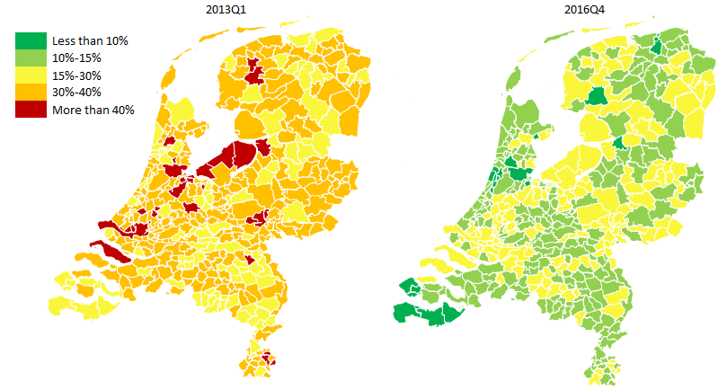
Some analysis...
Percentage of underwater
mortgages
Maturing non-amortizing debt (billions of EUR)
[Graph not shown because still for internal use only]
Valuable new insights, used on all levels within DNB, including the Board
Notes:
Dergelijke analyse worden van hoog tot laag gebruikt en zijn zeer nuttig om kwetsbaarheden in kaart te brengen. Tegelijk kan het ook helpen om mythes die over de Nederlandse hypotheekmarkt leven door te prikken, ook voor bijvoorbeeld instellingen als het IMF.

Slide 6
The legal basis
CBS Mandate is expanded and published in the Staatcourant for the purpose of the RRE report in March 2016.
Reporting agents are informed of the legal basis in May 2016 in the so-called ‘Aanbiedingsbrief’.

Slide 7
The reason for the legal basis
Lacking data quality
Some important attributes are missing
Guidelines originating from the ECB loan level initiative are not strict enough. Every reporting agent uses different definitions and scope -> lack of harmonisation.
Abovementioned issues were accepted while the report was voluntary. In order to professionalise the granular data on mortgages a legal basis is deemed necessary.
Data sharing with CBS for statistics production (sector accounts).

Slide 8
The CBS Mandate
Since several years, close cooperation between CBS and DNB regarding sharing of (confidential) data.
Cooperation implies that DNB collects all data on the financial sectors and (if needed) shares the data with CBS.
CBS Mandate authorizes DNB to collect information from the financial sector on the basis of the competences of CBS written down in the Wet op het CBS.
Advantages: data needs of both institutions can be combined into one report avoiding double reporting burden. One figure for the financial sector (één-cijfer-gedachte) which leads to more consistency and better communication.
Sharing data also with supervisory tasks of DNB and AFM, combining data needs into one data model avoiding double reporting burden.

Slide 9
The usage of the RRE data
Quality improvement and filling data gaps in existing statistical frameworks, e.g. the (financial) accounts of the sector households governed in the ESA regulation and the interest rate statistics governed in the MIR regulation.
Performing new and improved (statistical) analysis regarding vulnerabilities of the sector households and the financial sector and institutions.
Calibrating new macro-prudential instruments.
These goals are in line with the strong recommendations of the European Council, European Systemic Risk Board and the IMF regarding the Dutch RRE mortgage market.

Slide 10
Why now?
Data needs from users!
Increasing international pressure for measures on RRE issues (ECB, ESRB, IMF/FSAP, EC)
AnaCredit focusses on legal entities, leaving RRE mortgages out of scope. Uncertain if and when AnaCredit will include these instrument. Given the relevance of the market in the Netherlands, additional data is needed.

Slide 11
Content
Wim Goes

Slide 12
Overriding principle
In general, to the extent possible, the same concepts, attributes and definitions as in AnaCredit.
This should lead to a maximum consistency in data models.
Sometimes, new or modified attributes were introduced, mainly due to user needs and specific characteristics in the RRE mortgage markets.
More details will be made available in the RRE manual.

Slide 13
Reporting and observed agents
Reporting agents -> credit institutions. Other institutions e.g. insurance corporations, investment funds and pension funds are out of scope for the moment. DNB is assessing whether and when other institutions can be added to the scope.
Observed agents -> only the domestic part of reporting agents, i.e. the legal entity resident in the Netherlands and all the domestic branches (one institutional unit). All foreign branches are excluded (contrary to AnaCredit). In line with the BSI, however a domestic subsidiary of a reporting agent which is a credit institution will be treated as a separate reporting agent (like in AnaCredit).

Slide 14
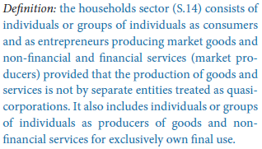
Debtors
Only those instruments should be reported of which the debtor is included in the sector households (S.14) according to ESA2010 instructions. In addition to individuals, the sector also includes sole proprietors (‘zzp-er’ and ‘eenmanszaak’) and partnerships (‘VOF’, ‘CV’, ‘rederij’ and ‘maatschap’). But excludes large corporations which, although they might be partnerships, can be regarded as quasi-corporations. In line with BSI sector 2251.

Slide 15
Instruments (1/2)
RRE mortgage loans are loans which are used for the purpose of investing in residential real estate (houses), irrespective whether the real estate is for own use or for rental purposes. Investing means purchasing, building or refurbishing. The majority of the loans are secured on residential real estate. However, also other loans meant for the abovementioned investing in residential real estate which are made on a personal basis or secured against other forms of assets are included. This is in line with the BSI definition.
In addition, the RRE mortgage loans ...
...give rise to credit risk for the observed agent, or
...are an assets of the observed agent, or

Slide 16
Instruments (2/2)
...are recognised under the relevant accounting standard used by the observed agent’s legal entity and gave rise to credit risk for the observed agent in the past, or
...are serviced by the observed agent and are held by a legal entity which is not a credit institution resident in the Netherlands.
There is no reporting threshold.

Slide 17
Data attributes (1/2)
In total 116 data attributes, of which 11 keys and 105 other data attributes.
After defining the user needs...then,
(1) if feasible, data attributes were taken from the AnaCredit requirements [61]
(2) on top and if non-existent in (1), data attributes for OSBE purposes were included [29]
(3) on top and if non-existent in (1) and (2), some existing LLD data attributes were included [10]
(4) on top and if non-existent in (1), (2) and (3), some extra data attributes were included [16]

Slide 18
Data attributes (2/2)
In the manual, elaborate definitions will be presented.
In principle, no changes in definitions of concepts, data attributes and domain values which originate from existing frameworks (AnaCredit, OSBE, LLD). However, in an exceptional case this might be needed. This will of course be well documented and communicated.
The domain list of the data attribute ‘Type of protection’ is expanded in comparison to the AnaCredit domain list, e.g. KEW, SEW, BEW, NHG, Bankspaarrekening, Bankspaarrekening met beleggingscomponent. Due to special characteristics of the mortgage market and high relevance for users.

Slide 19
National identifier for resident natural persons
The unique identification of debtors across observed agents which is also stable in time, is essential for data users.
Solution is designed in which DNB receives an alternative number for the BSN based on an encryption only known to CBS and the reporting agents. Ergo, DNB receives no personal data or no data which can be derived to a specific natural person. CBS is able to combine existing sources within the CBS, which has the mandate and experience to work with personal data. Proposed solution will be assessed by Autoriteit Persoonsgevens soon, on request of the NVB.
Implementation of RRE not to be delayed by the discussion. National identifier is no key, only another data attribute.

Slide 20
Position of national identifier in data model

Slide 21
Architecture and DDA
Ronald Damhof

Slide 22
What is our mission in data?
A focus on elementary data quality, from the get-go
An unambiguous (public) formalisation of concepts, meaning and structure
Focusing on protecting the data, keeping its integrity and being fully transparent
Enabling – as much as possible - all parties to automate and validate their data

Slide 23
Why did we choose the formal approach
Some characteristics of granular data:
Quality needs to be established on the granular level
Granular data contains many perspectives and huge opportunities for integration
In the supply chain process the risk of interpretation/ambiguity grows exponentially and the risk of worthless data at the end of the chain is high

Slide 24
Why did we choose the formal approach
It is vital for concepts and relationships between concepts to be described precise and non-ambiguous
It is vital that all parties involved in the supply chain process of RRE are talking the same language
It is vital for concepts and relationships between concepts to be described precise and non-ambiguous
A logical data model and data delivery agreement as the formal language is necessary for data to be precise and transparent

Slide 25
Why did we choose the formal approach
Characteristics of a formal language:
Communication with business
Is the ‘middle man’ between business and technical implementation
Is based on existing formal theory, notation and specification, methodology
Addresses concerns on the business/domain level, never on the technical level
Is developed and maintained in professional data modelling software
Is communicated and shared with all parties involved in the supply chain process

Slide 26
Why did we choose the formal approach
Characteristics of the logical data model as the formal language:
A non-ambiguous representation of regulation & related documents and functions as linking pin between those documents
A mathematical transformation of these documents (text)
Entails the structure, consistency and integrity of the data
Leading in how the (technical) delivery is designed
Leading with regards to the validation strategy
Agnostic with regards to technical implementations of RAs (e.g. API)
Is a pre-requisite for a data supply chain to be automated
Is a pre-requisite for data to be integrated with other data domains

Slide 27
Why did we choose the formal approach
Characteristics of the data delivery agreement as the formal language:
Three objectives:
    Governance instrument
    Design instrument
    Processing instrument
Two files delivered periodically:
    1 Logius metadatafile containing 1 zip:
      1 metadata file (XML)
      1 zip file containing 1 csv for every entity in the logical data model
  1 reporting agent, 1 model, 1 delivery per <xxx>, 1 deadline
Keep it simple stupid (KISS); NO delta’s, NO differentiation between static & dynamic data, NO differentiation in type of data, NO variety in data deliveries
Content of the RRE DDA:
    Leading document in how RRE data is to be delivered to DNB
    Responsibilities of parties involved
    References to legislation and additional information
    Formal logical data model + business glossary
    Supply chain process, data quality strategy, validations (feedback) & plausibility
    Detailed technical specifications & delivery schema
    Aspects of the supply chain process: e.g. channel, messages, security, periodicity

Slide 28

Managed data collection, validation, integration and dissemination
A production line in the DNB Data Factory for any data delivery
Reporting Agent
DNB
Data Delivery Agreement
Publish on website
Data Delivery Agreement
Techn
Public Key
Techn
Public Key
.
.
LDM
Specs
LDM
Specs
.
.
DNB
Reporting
Portal
Agreement &
Obligations
DNB
Process
Monitor
Status obligation =Open
Status obligation =Open

Slide 29

Managed data collection, validation, integration and dissemination
A production line in the DNB Data Factory for any data delivery
Reporting Agent
DNB
Data Delivery Agreement
Publish on website
Data Delivery Agreement
Techn
Public Key
Techn
Public Key
.
.
LDM
Specs
LDM
Specs
.
.
DNB
Reporting
Portal
Agreement &
Obligations
DNB
Process
Monitor
Status Obligation =Open
Status Obligation =Open
Logius
Validation result
RRE
Technical
Validations
Logius XML
Container
DNB Metadata XML
CSV’s

Slide 30
Managed data collection, validation, integration and dissemination
A production line in the DNB Data Factory for any data delivery
Reporting Agent
DNB
Data Delivery Agreement
Publish on website
Data Delivery Agreement
Techn
Public Key
Techn
Public Key
.
.
LDM
Specs
LDM
Specs
.
.
DNB
Reporting
Portal
Agreement &
Obligations
DNB
Process
Monitor
Status Obligation =Open
Status Obligation =Open
Logius
Validation result
Status 400 / 410
RRE
Technical
Validations
RRE
Pre-technical
Validations

Slide 31
Managed data collection, validation, integration and dissemination
A production line in the DNB Data Factory for any data delivery
Reporting Agent
DNB
Data Delivery Agreement
Publish on website
Data Delivery Agreement
Techn
Public Key
Techn
Public Key
.
.
LDM
Specs
LDM
Specs
.
.
DNB
Reporting
Portal
Agreement &
Obligations
DNB
Process
Monitor
Status obligation =Open
Status Delivery = Received
Status obligation =Open
Status Delivery=Received
Logius
Validation result
Status 400 / 410
Administrative
Validations
RRE
Technical
Validations
RRE
Pre-technical
Validations

Slide 32
Managed data collection, validation, integration and dissemination
A production line in the DNB Data Factory for any data delivery
Reporting Agent
DNB
Data Delivery Agreement
Publish on website
Data Delivery Agreement
Techn
Public Key
Techn
Public Key
.
.
LDM
Specs
LDM
Specs
.
.
DNB
Reporting
Portal
Agreement &
Obligations
DNB
Process
Monitor
Status obligation =Open
Status Delivery = Received or Not Accepted
Status obligation =Open
Status Delivery= Received or Not Accepted
Logius
Validation result
Status 400 / 410
Post-technical
Validations
Administrative
Validations
RRE
Technical
Validations
RRE
Pre-technical
Validations

Slide 33
Managed data collection, validation, integration and dissemination
A production line in the DNB Data Factory for any data delivery
Reporting Agent
DNB
Data Delivery Agreement
Publish on website
Data Delivery Agreement
Techn
Public Key
Techn
Public Key
.
.
LDM
Specs
LDM
Specs
.
.
DNB
Reporting
Portal
Agreement &
Obligations
DNB
Process
Monitor
Status obligation =Open
Status Delivery = Not Accepted
Status obligation =Open
Status Delivery= Not Accepted
Logius
Logical
Validations
Validation result
Status 400 / 410
Post-technical
Validations
X
Administrative
Validations
Delivery not accepted, correct and resumbmit (same obligation)
RRE
Technical
Validations
RRE
Pre-technical
Validations

Slide 34

Managed data collection, validation, integration and dissemination
A production line in the DNB Data Factory for any data delivery
Reporting Agent
DNB
Data Delivery Agreement
Publish on website
Data Delivery Agreement
Techn
Public Key
Techn
Public Key
.
.
LDM
Specs
LDM
Specs
.
.
DNB
Reporting
Portal
Agreement &
Obligations
DNB
Process
Monitor
Status obligation =Completed
Status Delivery = Accepted
Status obligation =Completed
Status Delivery= Accepted
Logius
Logical
Validations
Validation result
Status 400 / 410
Post-technical
Validations
Administrative
Validations
Delivery accepted, Obligation completed
RRE
Technical
Validations
RRE
Pre-technical
Validations

Slide 35
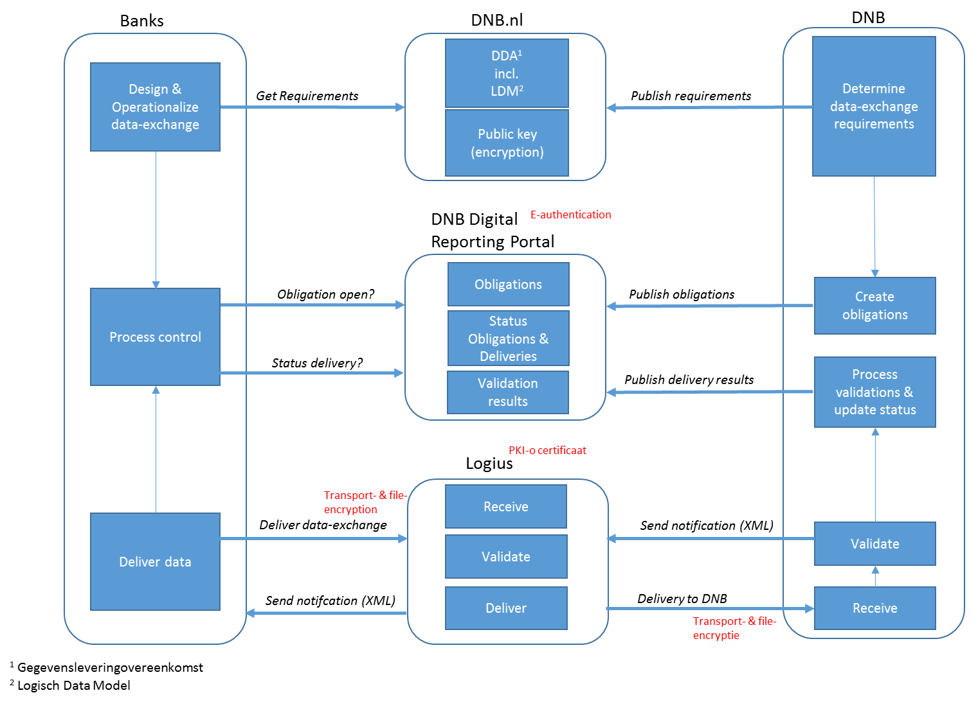
Overview
Global description of the process:
DNB determines the RRE data-exchange specifications (Data Delivery Agreement, Logical Data Model);
DNB publishes these specifications, including the public key for encryption on the website of DNB;
Banks use this information to operationalize the RRE data exchange;
DNB publishes the RRE data-exchange obligations in the DNB Digital Reporting Portal;
Banks have secure access to the DNB Digital Reporting Portal where they can view the obligation;
Banks deliver the RRE data exchange files to Logius, transport as well as files are encrypted;
Logius receives the data, performs a number of technical checks and send a delivery notification back to the bank. Subsequently Logius is pushing the to DNB;
DNB received the data, performs a number of technical and logical validations, updates the status of the obligation and publishes the outcome of these validations to the DNB Digital Reporting Portal;
Designated (by the bank) employees will receive a notification;
Banks can view these outcomes (and status) in the DNB Digital Reporting Portal.

Slide 36
Logical data model
Arjan Bos

Slide 37
A Logical data model reflects the structure of data concepts
Main concepts for RRE:
    Instrument
    Counterparty
    Counterparty role: Debtor, protection provider
    Protection
These concepts are named in terms of the AnaCredit regulation
Additional concepts complete the data model (creditor, servicer, LGD-model, …)

Slide 38
Concepts translate to attributes and entities
Concepts are taken from the definition of the required attributes
Attributes are concepts as well
The structure between concepts stems from the meaning of the definition
These links in the meaning translate to attributes of entities and relationships between entities.

Slide 39
Concepts translate to attributes and entities - Examples
Name: Full legal name of the counterparty.
➔ This links the concept “Name” with the concept “counterparty”. This will translate to the attribute “name” of the entity “counterparty”
Year of birth: Year of birth of the natural person.
➔ Links the concept “Year of birth” with the concept “natural person”. This will translate to the attribute “Year of birth” of the entity “natural person”.
Legal final maturity date: The contractual maturity date of the instrument.
➔ Link the concept “Legal final maturity date” with the concept “instrument”. This will translate to the attribute “legal final maturity date” of entity “instrument”.

Slide 40
Relationships are the glue between concepts
Relationships determine how concepts
relate to each other.
Example:
Country: ISO 3166-1 alpha-2 code of the country. For counterparties, the country refers to the country of residence of the counterparty.
➔ This links the concept “country” to the concept “counterparty”. Because there is extra information on the country, namely its name, and on the counterparty, this translates in the LDM to a relationship type between the entity “country” and the entity “counterparty”.

Slide 41
Subtypes partition the applicable attributes
Subtypes split the data according to reporting needs.
Subtypes reduce the number of optional attributes.
This reduction reduces reporting omissions and errors thus increasing data quality.
➔ Year of birth is only applicable to a natural person not to a legal entity. Both are subtypes of counterparty.

Slide 42
Subtypes - Example
Accumulated impairment amount is only applicable to impaired instruments.

Slide 43
LDM – test question 1
Where does the following attribute sit in the data model?
inception date of first mortgage: The date on which the first mortgage instrument originated between the debtor and the reporting agent.

Slide 44
LDM – Answer to test question 1
Where does the following attribute sit in the data model?
inception date of first mortgage: The date on which the first mortgage instrument originated between the debtor and the reporting agent.
Three concepts in the definition: ‘mortgage instrument’, ‘debtor’, ‘reporting agent’.
‘inception date of first mortgage ’ should be linked to one of those three, but which one?
Correct answer is ‘debtor’ because it the first mortgage of the debtor will not change with subsequent mortgages. It is only dependent on the debtor.

Slide 45
LDM – test question 2
Where does the following attribute sit in the data model?
income at inception: The net annual income of the debtor at the moment of inception of the instrument.

Slide 46
LDM – Answer to test question 2
Where does the following attribute sit in the data model?
income at inception: The net annual income of the debtor at the moment of inception of the instrument.
Three concepts in the definition: ‘net annual income’, ‘debtor’, ‘instrument’.
‘income at inception’ should be linked to one of those three, but which one?
Correct answer is ‘debtor-instrument data’ because it deals with the combination of debtor and instrument.

Slide 47
LDM is basis for data delivery agreement
LDM is integral part of the DDA
HTML report of the LDM is provided separately
LDM is the source for these parts of the DDA:
List of .csv files to report
Lay-out of the .csv files
Mapping of the .csv files to the LDM
List of validations
List of entity types, attributes and primary keys

Slide 48
LDM is basis for content-based validations
Referential integrity is build in. Validations on correct relationships are done automatically. This also includes reference data ‘pick-lists’.
As much of the integrity checks as possible are build into the model
Subtypes are deployed for specific sub-sets of data where extra attributes are applicable.
Business rules describe validations on the element where they are applicable.

Slide 49
RRE closely follows AnaCredit
There are 87 entity types in the LDM of RRE
Those provide structural integrity
Results in 39 files to report
Of which 28 overlap with AnaCredit
And 10 are specific for RRE

Slide 50
Organisation and planning
Wim Goes

Slide 51
Communication
Communication via mailbox (rre@dnb.nl). New documents will be posted on the dedicated RRE website (https://www.dnb.nl/statistiek/digitaal-loket-rapportages/statistische-rapportages/residential-real-estate-rre/index.jsp).
Plenary meetings and bilateral meetings if necessary
Documentation (v0.7) available on the website. Version 1.0 of data model, data delivery agreement and manual are foreseen to be ready in end-November 2017.

Slide 52
Testing and shadow reporting
Test period is foreseen to start in April. More details will follow in due course.
Current way of reporting the loan level data should be maintained up to and including reference periode Q4 2018. So there will be a period of shadow reporting.

Slide 53
Planning and phase-in
First RRE report should be submitted the last working day of July 2018 on reference period Q2 2018.
Back data should be reported as well on Q1 2018 and Q4 2017. Q1 2018 should be submitted on the last working day of August 2018 and Q4 2017 on the last working day of September 2018.
Some attributes have special high relevance. In the documentation on the website, we have indicated which attributes belong to stage 1 and which to stage 2. Stage 1 attributes should be reported from the start (including back data). Stage 2 attributes should be reported from reference periode Q4 2018 onwards at the last working day of January 2019 (without back date).

Slide 54
Thank you for your attention. Questions??

