Slide 1

Global Disinflation in an Era of Constrained Monetary Policy
19th Annual DNB Research Conference
World Economic Outlook
International Monetary Fund
Samya Beidas-Strom, Sangyup Choi, Davide Furceri (lead author), Sinem Kılıç Çelik, Zsoka Koczan, Ksenia Koloskova, Weicheng Lian, with contributions from Jaebin Ahn, Luis Catão, Juan Angel Garcia Morales, Bertrand Gruss, Keiko Honio, Ben Hunt, Doug Laxton , Fan Zhang and support from Hao Jiang and Olivia Ma.

Slide 2
Inflation declined in many countries
Headline Consumer Price Inflation
Sources: Haver Analytics; and IMF staff calculations.
Note: Labels in footnotes 1–6 below use International Organization for Standardization (ISO) country codes.
¹ AUS, AUT, BEL, CAN, CHE, CZE, DEU, DNK, ESP, EST, FIN, FRA, GRC, HKG, ISL, ITA, IRL, ISR, JPN, KOR, LVA, LTU, LUX, NLD, NOR, NZL, PRT, SGP, SVK, SVN, SWE, GBR, USA.
² ARG, BGR, BRA, CHN, CHL, COL, DOM, ECU, EGY, HUN, IND, IDN, JOR, KAZ, MAR, MEX, MYS, PER, PHL, POL, ROU, RUS, THA, TUR, VEN, ZAF.
³ AUT, BEL, DEU, ESP, EST, FIN, FRA, GRE, IRL, ITA, LTU, LUX, LVA, NLD, PRT, SVK, SVN.
⁴ CHN, IDN, IND, MYS, PHL, THA.
⁵ AUS, CAN, CHE, CZE, DNK, GBR, ISL, ISR, JPN, KOR, NOR, NZL, SGP, SWE, USA.
⁶ ARG, BGR, BRA, CHL, COL, DOM, ECU, EGY, HUN, JOR, KAZ, MAR, MEX, PER, POL, ROU, RUS, TUR, VEN, ZAF.
11
Notes:
Note: will reformat the figures.

Slide 3
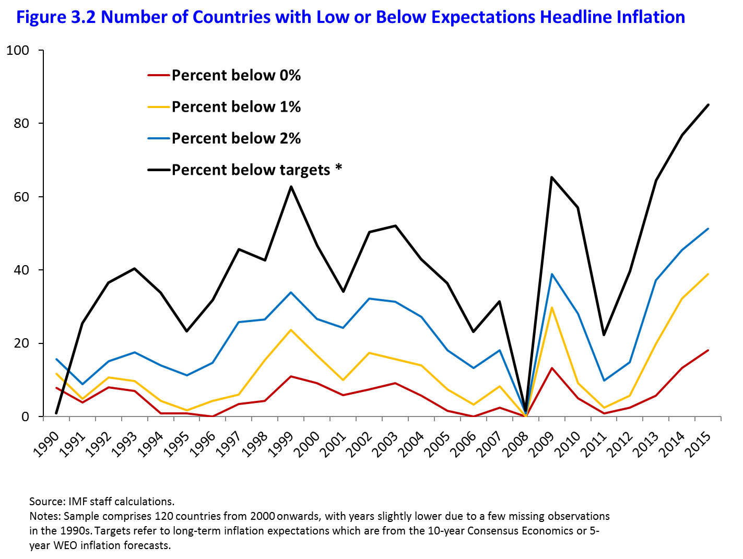
Broad-based decline in inflation.
Number of Countries with Low or Below Expectations Headline Inflation
2

Slide 4
Weak demand and commodity prices main drivers but…industrial slack in large exporters playing a significant role
Correlation of Manufacturing Slack in China, Japan, and the United States with Import Price Contribution to Inflation in Other Economies
Sources: Consensus Economics; Haver Analytics; Organisation for Economic Co-operation and Development; and IMF staff calculations.
Note: Vertical lines denote interquartile ranges. The figure shows the means, medians, and interquartile ranges of coefficients of manufacturing slack from country-specific regressions. See Annex 3.4 for the regression specifications.
¹ No controls.
² Controlling for manufacturing slack in the other two economies, change in oil prices, and global output gap.
³ Controlling for global output gap and change in oil prices in current and previous four quarters.
4

Slide 5
Should we worry? Are IE becoming unanchored?
Sensitivity of Survey-Based Inflation Expectations to News
Sources: Consensus Economics; Haver Analytics; and IMF staff calculations.
Note: ELB = effective lower bound. ***,**,* denote that the differences in the change in sensitivity of inflation expectations between countries at the ELB and the rest are significant at the 1, 5, and 10 percent confidence level, respectively, using Mood’s median test. The sensitivity of inflation expectations corresponds to the response of inflation expectations to a 1 percentage point unexpected increase in inflation based on time-varying coefficients from country-specific estimations using a Kalman filter. The change in sensitivity is constructed as the average deviation of the median sensitivity across countries from a linear trend (an exponential trend) fitted over the period 1997–2007 for countries at the ELB (not at the ELB). Countries at the ELB are defined as those with policy rates or short-term nominal interest rates of 50 basis points or lower at some point during 2008–15 and include: Canada, the Czech Republic, Estonia, France, Germany, Hong Kong SAR, Italy, Japan, Latvia, Lithuania, the Netherlands, Singapore, the Slovak Republic, Slovenia, Spain, Sweden, Switzerland, the United Kingdom, and the United States.
5

Slide 6
Should we worry? Are IE becoming unanchored?
Sensitivity of Marked-Based Inflation Expectations to Inflation News
Sources: Bloomberg L.P.; Consensus Economics; University of Michigan Consumer Survey; and IMF staff calculations.
Note: **,* denote significance at the 5 and 10 percent confidence level, respectively. The figure shows coefficient estimates of inflation expectations on changes in oil price futures (simple average of 1-year-ahead Brent and West Texas Intermediate) controlling for changes in the Chicago Board Options Exchange Volatility Index and scaled by a 50 percent drop in oil price futures. Blue bars denote estimation results using survey-based inflation expectations: “Professional” denotes the results using 5-year-ahead inflation forecasts from Consensus Economics; while “Households” denotes results using inflation expectations (5–10 years) from the Michigan survey. Red bars denote results using market-based inflation expectations based on five year/five year inflation swaps. The effective lower bound (ELB) is defined as starting in 2009. The full sample refers to the period 2004–16.
6

Slide 7
Policy implications
Most likely outcome: gradual recovery of inflation as commodity prices recover and most measures of medium-term inflation expectations have not declined significantly.
Downside risks: increased sensitivity to downside inflation surprises, increased persistence, slack might be larger than currently estimated.
Comprehensive and coordinated approach: monetary accommodation, fiscal policy, structural reform; reducing industrial slack.
In countries where MT IE shifted down: more aggressive approach, including a modest and temporary overshooting of target.
33

