Slide 1
Maintenance reporting frameworks
BSI & MIR – taxonomy updates

Slide 2
Overview – taxonomy updates
Timelines
Preparing for xBRL-csv - also applicable to other DNB taxonomies
Taxonomy – additions
Taxonomy – removals
Taxonomy – other changes
Changes to assertions
Update Manual on Monetary Reporting (DNB)

Slide 3
Timelines
Apr/26 | May/26 | Jun/26 | Jul/26 | Aug/26 | Sep/26 | Oct/26 | Nov/26 | Dec/26 | Jan/27 | Feb/27 | Mar/27 | Apr/27
implementation DNB
 |  |  | Implementation by reporting agents
 |  |  |  |  |  |  | Test period (not mandatory)
 |  |  |  |  |  |  |  |  |  | 1st month
 |  |  |  |  |  |  |  |  |  |  |  | 1st quarter
Taxonomy documents were published on the end of June, and reporting agents were notified by e-mail via contact persons (contact person updates via monrap@dnb.nl).
  Release notes, taxonomy, annotated templates
  Documentation of changes to taxonomy, updated manual: clean & track changes version
Taxonomy updates were briefly discussed at the CRAP meeting on July 2nd
Test period in Q4 of 2026 – start November 1st – testing is not mandatory but recommended
First reporting (green bars) apply to the first reference periods of 2027; January and Q1 2027

Slide 4
xBRL-csv transition (1) – BSI and MIR
As of 2027, the new taxonomies of the BSI and MIR can be submitted via xBRL-CSV and for the time being via xBRL-XML as well
 | xBRL-XML, Excel | xBRL-XML, xBRL-CSV, Excel
BSI | version 2.2.0 or earlier | version 2.3.0 1st reference period of 2027 (January for monthly and Q1 for quarterly reporting)
MIR | version 1.1.0 or earlier | version 1.2.0 1st reference period of 2027 (January for monthly and Q1 for quarterly reporting)

Slide 5
xBRL-csv transition (2) – other taxonomies
For information: Overview for other reporting frameworks
 | xBRL-XML, Excel | xBRL-XML, xBRL-CSV, Excel
MESRAP | version 4.0.0 or earlier | version 5.0.0
 |  | 1st reference period of 2027
 |  | (January for monthly and Q1 for quarterly reporting)
MER | version 2.0.0 or earlier | version 3.0.0
 |  | 1st reference period of 2027
 |  | (January for monthly reporting)
PAY | version 2.2.0 or earlier | version 2.3.0
 |  | 1st reference period of 2027
 |  | (Q1 for quarterly and H1 for semi-annual reporting)

Slide 6
xBRL-csv transition (3) – other information
As of 2027 - new versions of taxonomies can be submitted via xBRL-CSV.
As of 2027 - new versions of taxonomies can be submitted via xBRL-XML for the time being.
Submissions are thus possible with both formats for the time being.
In addition, submitting using excel templates via the Excel-convertor also remains available.
If submitting via xBRL-CSV, please note that this changes how the filing indicators are being checked. See Changes to Filing Indicator validation with the introduction of xBRL CSV.
For xBRL-CSV submissions the EBA-CSV Filing Rules apply.
For xBRL-XML submission, DNB-filing Filing Rules apply – this is the current situation.

Slide 7
Taxonomy – additions
Content of the MIR taxonomy remains unchanged
Content of the BSI taxonomy changed somewhat, but these are minor changes
1. (Not for banks/credit institutions!) - Money Market Funds - units issued – counterparty country breakdown
2. Counterparty sector breakdown for “Accrued interest during the month” (T9007HK3)
Breakdown for (i) loans granted and deposit placed, and (ii) loans and deposits received
Summary of changes. Please see official release notes for more details.
Taxonomy | Table | Details | Reason
BSI | T9001HK1 | r1015,c210 | 1
BSI | T9001HK6 | r150,c010
BSI | T9007HK1 | r485,c170
BSI | T9007HK4 | r100,c010
BSI | T9007HK3 | r020,r040;c080-c290 | 2

Slide 8
Taxonomy – removals
Removal of T9001HK5 – series will be compiled based on AnaCredit data
Removal of cells related to Bulgaria – became part of the euro area
Taxonomy | Table/Assertions | Details
BSI | T9001HK5 | All of it
BSI | T9001HK1 | r101, r181 removal of Bulgarian Lev

Slide 9
Taxonomy – other changes
Changes to hierarchy “Country of origin SPV” – Bulgaria now included
Changes to Assertions – see extra Excel-file published at the end of June for details
    Changes in severity from ‘warning’ to ‘error’ – assertions become blocking
    Changes in conditionality of cross-table assertions
    Improvements in formulae and descriptions of assertions
    24 new assertions – e.g. clarifying classification of international organizations

Slide 10
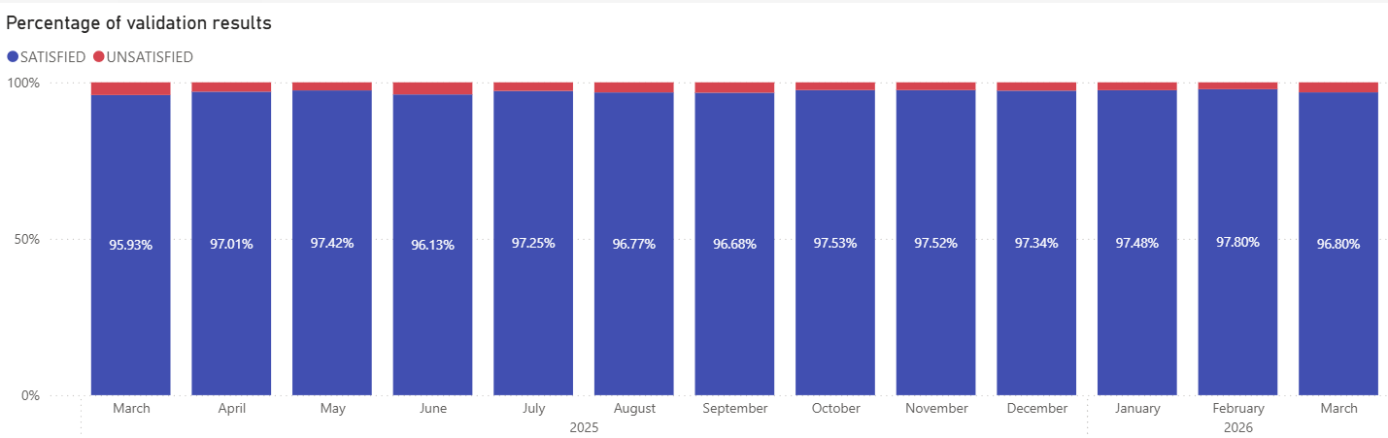
Changes to Assertions – ‘warning’ to ‘error’ (blocking)
With few exceptions, these assertions are satisfied for most reporting agents. DNB may bilaterally reach out to reporting entities leading up to 2027 to discuss specific cases.

Slide 11
Update Manual on Monetary Reporting (DNB)
DNB published an updated Manual on Monetary Reporting at the end of June 2026
  - incorporates changes to the BSI taxonomy
  - anticipates use of counterpart information as published in DLR
  - clarifications and amendments resulting from queries and comments of reporting agents and/or discussions with the ESCB. This is a continuous process.
  Both clean and “track changes” versions have been published on the website

Slide 12
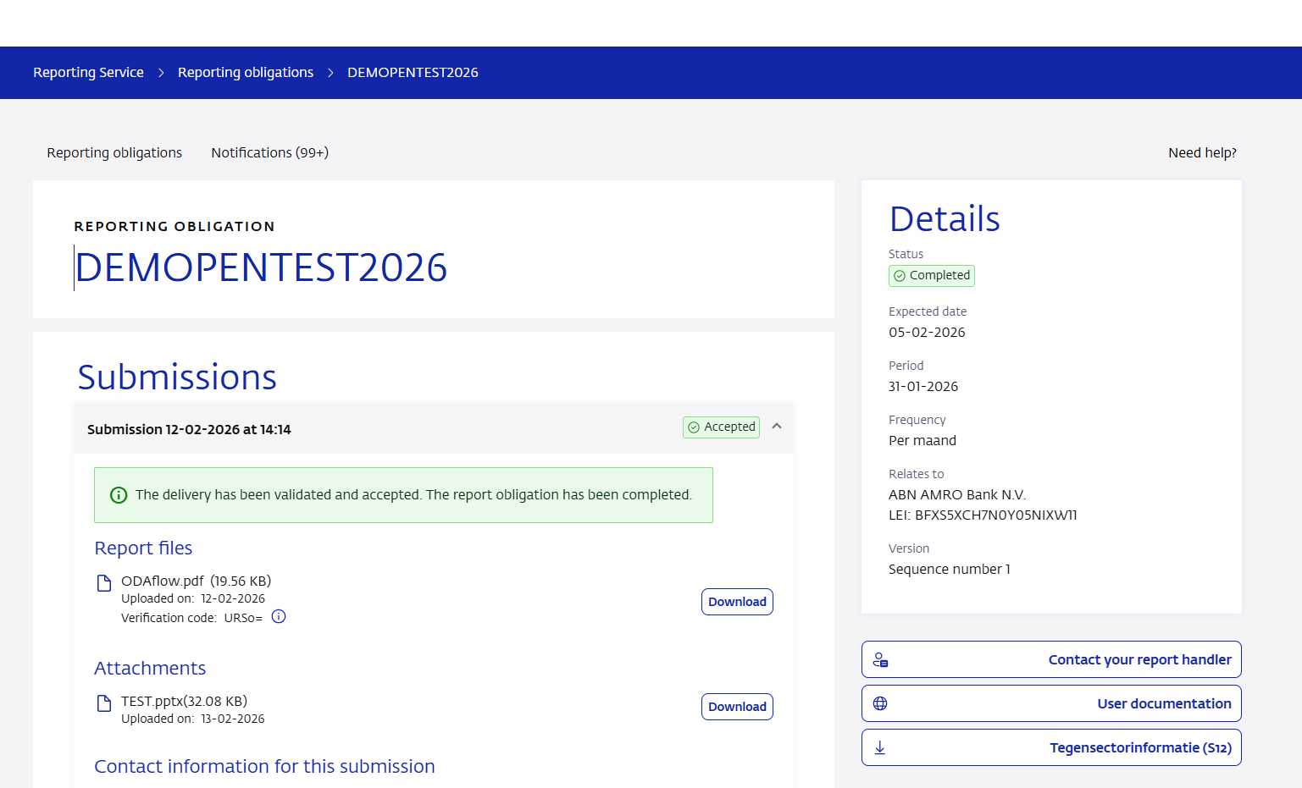
Publication counterpart information in DLR
Please contact monrap@dnb.nl in case of questions

Slide 13
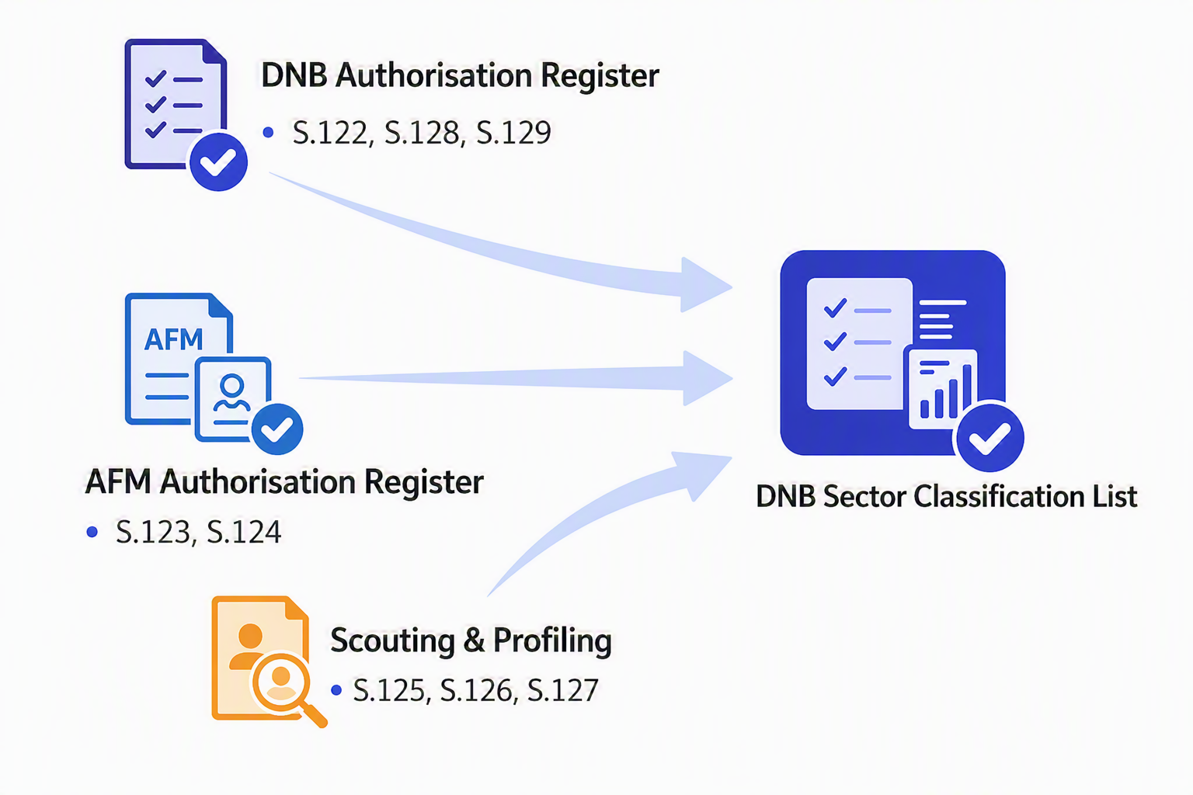
How is the sector classification determined?
ESA 2010
Entities in the list are reporting agents – determined by several teams at DNB.

Slide 14
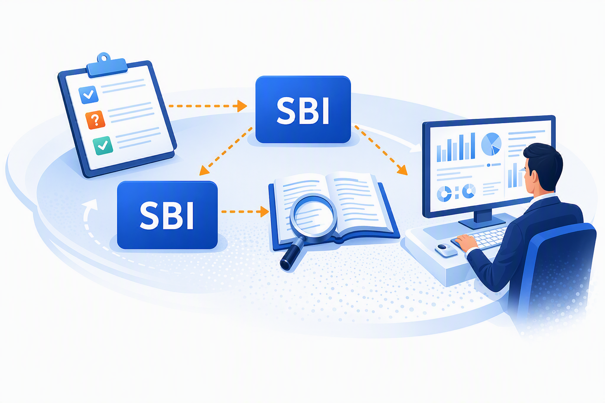
Reason for possible differences – e.g. based on SBI
DNB teams do not automatically follow the SBI (Standaard Bedrijfsindeling) code from KvK as it is seen as unreliable at certain instances
Sector classification is based on register information, complemented with experts’ judgement
BSI & MIR (& AnaCredit) colleagues responsible for S.122 (e.g. “banks”) classification.
monrap@dnb.nl first point of contact for differences between the list as published by DNB and banks’ own systems – but we need to liaise with other teams within DNB and the CBS.

Slide 15
Questions?

Slide 16
Q&A with the sector
Q: When will the next Working Group on Monetary Statistical Reporting (WG MSR) meeting take place?
A: DNB is currently liaising with the Nederlandse Vereniging van Banken (NVB) how to best resume these meetings. Pending the outcome, DNB has decided to organize this ad-hoc digital meeting to provide further clarification on the taxonomy changes and to discuss the latest updates to the Monetary Reporting Manual.
Q: Where can we find the assertions for the BSI and MIR taxonomies?
A: The assertions can be found in the DNB DPM Dictionary and Annotated Templates BSI 2.3.0 and DNB MIR DPM Dictionary and Annotated Templates 1.2.0. DNB has also published a file listing all changes to the BSI taxonomy. No equivalent file has been published for the MIR taxonomy, as the only change concerns the introduction of xBRL-CSV submission.

Slide 17
Q&A with the sector
Q: A new section on reclassifications has been added to the Monetary Reporting Manual. Can you provide more information on how reclassifications should be handled in practice?
A: DNB requests reporting agents to notify DNB in advance when they think a reclassification is required. This should include information on the reclassification, such as the instrument categories, counterparty information and amounts involved.
DNB will assess the impact of the reclassification and inform the reporting agent whether the reclassification should be reported by submitting the same reference period twice. The first submission must exclude the reclassifications. The second submission must include the reclassifications. The difference between the first and second submission must exclusively reflect the reclassifications occurring in the reference period. DNB will also inform the reporting agent whether revisions to earlier reporting periods are required in order to implement the reclassification in an earlier reference period, for example the December reporting period.
Q: What is DLR (Digitaal Loket Rapportages)?
A: DLR or Reporting Service is DNB's reporting portal used by reporting agents to submit statistical and supervisory reports to DNB.

Slide 18
Q&A with the sector
Q: DNB has published a list of counterparty sector classifications for statistical reporting. Where can we find this list?
A: The list of counterparty sector classifications is available via DNB's Reporting Service. Reporting agents can access the list after logging in to the portal. Please refer to slide 12 of this PowerPoint presentation for detailed instructions on where to find it.
Q: DNB publishes a list of counterparty sector classifications for statistical reporting, such as BSI. Is this list also applicable to supervisory reporting, such as FINREP?
A: The list of counterparty sector classifications is based on ESA 2010 (ESR 2010) and has been developed for statistical reporting purposes. This information is not intended for use in supervisory reporting, unless you are explicitly asked to use the ESA 2010 (ESR 2010) sector classification for the supervisory report, or the classification for a statistic that refers to it, such as the BSI Regulation. An example of this is Annex V, Part 1, paragraph 42 of the Supervisory Reporting Implementing Technical Standards for banks (Implementing Regulation (EU) 2021/451).

Slide 19
Q&A with the sector
Q: Will DNB provide a mapping table between SBI codes and the sector classifications used by DNB?
A: DNB does not provide a mapping table between SBI codes and the sector classifications used for statistical reporting. SBI codes do not always provide a sufficiently accurate basis for determining the appropriate statistical sector classification. Therefore, a direct mapping would not be sufficiently reliable.
Q: Will the list of counterparty sector classifications will be leading in the future for statistical report of DNB?
A: Yes, the list of counterparty sector classifications published by DNB is likely to be the leading source for statistical reporting purposes.
Q: Why are there differences between the list of counterparty sector classifications and other classification lists published by DNB or and list published by other organisations?
A: Classification lists may serve different purposes. The list of counterparty sector classifications is compiled specifically for statistical reporting purposes.

Slide 20
Q&A with the sector
Q: Will we be able to submit test reports, and will DNB provide support?
A: DNB will open test reporting obligations in November 2026. Reporting agents requiring support can contact DNB via monrap@dnb.nl. Although testing with the new taxonomy is not mandatory, DNB encourages reporting agents to participate in the testing phase.

