Slide 1
Residential Real Estate report
Information session – 21 February 2018

Slide 2
Outline of the presentation
Background and content
Architecture and the Data delivery agreement
Logical data model
Organisation and planning

Slide 3
Background
Wim Goes

Slide 4
The first start...
Since Q4 2012 – data on a quarterly and voluntary basis
10 reporting agents – approx. EUR 530 billion – approx. 80% coverage of total RRE market
Based on ECB’s loan level initiative – initial focus on securitised loans – mainly via business area instead of reporting area
Main use: analysis of financial stability household sector and financial sector
Notes:
In het allereerste begin kregen we de data op allerlei manieren aangeleverd, waaronder zelfs memory sticks. Destijds verliepen de contacten via uitvoerende toezichtafdelingen zelf. Al snel werd deze rapportage overgedragen aan Statistiek, omdat toezicht zelf het niet meer kon behappen. Toen heeft Statistiek er een e-Line containerrapportage van gemaakt. En successievelijk de taxonomie wat strikter gemaakt zodat we aan DNB-zijde het inlezen wat beter konden automatiseren. In het begin deden we er soms maanden over om alle bestanden in te lezen, omdat we soms ook technische zaken moesten aanpassen in de bestanden. Nu kan het binnen een week gebeurd zijn.

Slide 5
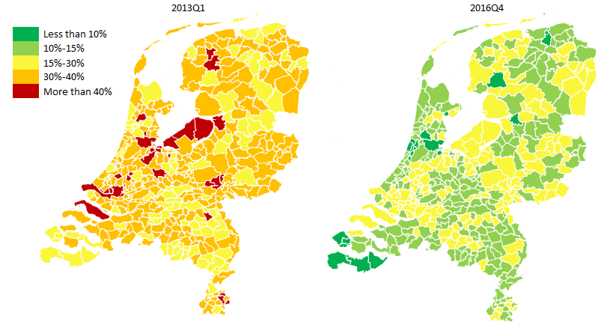
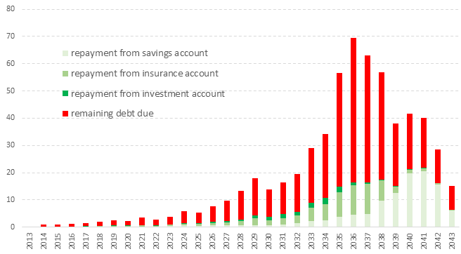
Some analysis...
Percentage of underwater
mortgages
Maturing non-amortizing debt (billions of EUR)
Valuable new insights, used on all levels within DNB, including the Board
Balemans, Damhof, Goes – Statistics Department – February 2018
Notes:
Dergelijke analyse worden van hoog tot laag gebruikt en zijn zeer nuttig om kwetsbaarheden in kaart te brengen. Tegelijk kan het ook helpen om mythes die over de Nederlandse hypotheekmarkt leven door te prikken, ook voor bijvoorbeeld instellingen als het IMF.

Slide 6
The legal basis
CBS Mandate is expanded and published in the Staatcourant for the purpose of the RRE report in March 2016.
Reporting agents are informed of the legal basis in May 2016 in the so-called ‘Aanbiedingsbrief’.
Balemans, Damhof, Goes – Statistics Department – February 2018

Slide 7
The reason for the legal basis
Lacking data quality
Some important attributes are missing
Guidelines originating from the ECB loan level initiative are not strict enough. Every reporting agent uses different definitions and scope -> lack of harmonisation.
Abovementioned issues were accepted while the report was voluntary. In order to professionalise the granular data on mortgages a legal basis is deemed necessary.
Data sharing with CBS for statistics production (sector accounts).
Balemans, Damhof, Goes – Statistics Department – February 2018

Slide 8
The CBS Mandate
Since several years, close cooperation between CBS and DNB regarding sharing of (confidential) data.
Cooperation implies that DNB collects all data on the financial sectors and (if needed) shares the data with CBS.
CBS Mandate authorizes DNB to collect information from the financial sector on the basis of the competences of CBS written down in the Wet op het CBS.
Advantages: data needs of both institutions can be combined into one report avoiding double reporting burden. One figure for the financial sector (één-cijfer-gedachte) which leads to more consistency and better communication.
Sharing data also with supervisory tasks of DNB and AFM, combining data needs into one data model avoiding double reporting burden.
Balemans, Damhof, Goes – Statistics Department – February 2018

Slide 9
The usage of the RRE data
Quality improvement and filling data gaps in existing statistical frameworks, e.g. the (financial) accounts of the sector households governed in the ESA regulation and the interest rate statistics governed in the MIR regulation.
Performing new and improved (statistical) analysis regarding vulnerabilities of the sector households and the financial sector and institutions.
Calibrating new macro-prudential instruments.
These goals are in line with the strong recommendations of the European Council, European Systemic Risk Board and the IMF regarding the Dutch RRE market.
Balemans, Damhof, Goes – Statistics Department – February 2018

Slide 10
Why now?
Data needs from users!
Increasing international pressure for measures on RRE issues (ECB, ESRB, IMF/FSAP, EC)
AnaCredit focusses on legal entities, leaving RRE out of scope. Uncertain if and when AnaCredit will include these instrument. Given the relevance of the market in the Netherlands, additional data is needed.
Balemans, Damhof, Goes – Statistics Department – February 2018

Slide 11
Content
Wim Goes

Slide 12
Overriding principle
In general, and to the extent possible, the same concepts, attributes and definitions as in AnaCredit.
Special mention: the keys should be the same between AnaCredit and RRE in order to connect both datasets if possible. No encryption of keys.
This should lead to maximum consistency in data models.
Sometimes, new or modified attributes were introduced, mainly due to user needs and specific characteristics in the RRE market.
More details are available in the RRE manual part I and II.
Balemans, Damhof, Goes – Statistics Department – February 2018

Slide 13
Reporting and observed agents
Reporting agents -> credit institutions. Other institutions e.g. insurance corporations, investment funds and pension funds are out of scope for the moment. DNB is assessing whether and when other institutions can be added to the scope.
Observed agents -> only the domestic part of reporting agents, i.e. the legal entity resident in the Netherlands and all the domestic branches (one institutional unit). All foreign branches are excluded (contrary to AnaCredit). In line with the BSI, however a domestic subsidiary of a reporting agent which is a credit institution will be treated as a separate reporting agent (like in AnaCredit).
Balemans, Damhof, Goes – Statistics Department – February 2018

Slide 14
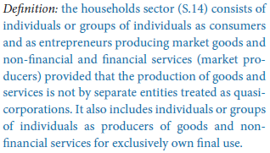
Debtors
Only those instruments where the debtors comply with the definition of ESA2010 sector ‘households’ (S.14) are subject to RRE reporting. In addition to individuals, the sector also includes sole proprietors (‘zzp-er’ and ‘eenmanszaak’) and partnerships (‘VOF’, ‘CV’, ‘rederij’ and ‘maatschap’). But excludes large corporations which, although they might be partnerships, can be regarded as quasi-corporations. In line with BSI sector 2251.
Balemans, Damhof, Goes – Statistics Department – February 2018

Slide 15
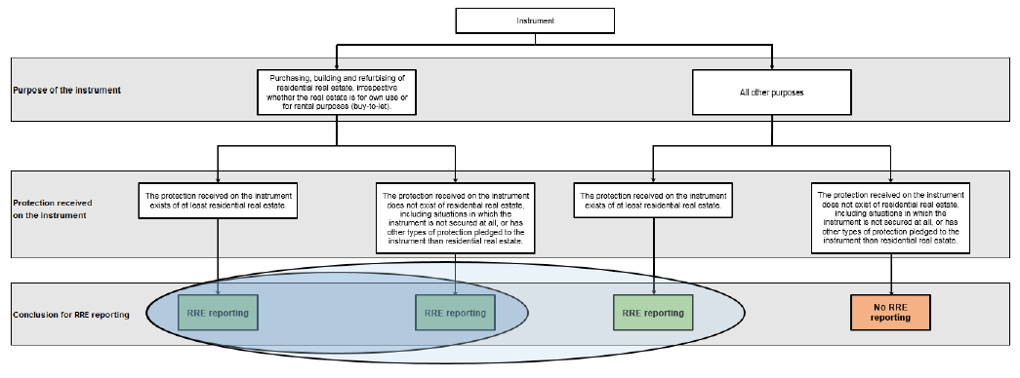
Instruments (1/3)
Explicit RRE collateral. Only algemene bankvoorwaarden is not sufficient
Balemans, Damhof, Goes – Statistics Department – February 2018

Slide 16
Instruments (2/3)
However, with respect to the instruments which are granted for other purposes, only those instruments are in scope for which residential real estate is explicitly received as protection and for which the protection is mentioned in the contractual agreements of the instrument. Instruments are not in scope in case the residential real estate can be used to cover losses only on the basis of general banking conditions (so-called algemene bankvoorwaarden).
Balemans, Damhof, Goes – Statistics Department – February 2018

Slide 17
Instruments (3/3)
In addition, the RRE instruments…
...give rise to credit risk for the observed agent, or
...are an assets of the observed agent, or
...are recognised under the relevant accounting standard used by the observed agent’s legal entity and gave rise to credit risk for the observed agent in the past, or
...are serviced by the observed agent and are held by a legal entity which is not a credit institution resident in the Netherlands.
There is no reporting threshold
Balemans, Damhof, Goes – Statistics Department – February 2018

Slide 18
Data attributes (1/2)
In total 120 data attributes, of which 13 keys and 107 other data attributes.
After defining the user needs...then,
(1) if feasible, data attributes were taken from the AnaCredit requirements [65]
(2) on top and if non-existent in (1), data attributes for OSBE purposes were included [29]
(3) on top and if non-existent in (1) and (2), some existing LLD data attributes were included [10]
(4) on top and if non-existent in (1), (2) and (3), some extra data attributes were included [16]
Balemans, Damhof, Goes – Statistics Department – February 2018

Slide 19
Data attributes (2/2)
In the manual, elaborate definitions are presented.
In principle, no changes in definitions of concepts, data attributes and domain values which originate from existing frameworks (AnaCredit, OSBE, LLD). However, in some case this might be needed, please see the Manual for more information.
For example, the domain list of the data attribute ‘Type of protection’ is expanded in comparison to the AnaCredit domain list, e.g. KEW, SEW, BEW, NHG, Bankspaarrekening, Bankspaarrekening met beleggingscomponent. Due to special characteristics of the RRE market and high relevance for users.
Balemans, Damhof, Goes – Statistics Department – February 2018

Slide 20
National identifier for resident natural persons
The unique identification of debtors across observed agents which is also stable in time, is essential for data users.
Solution is designed in which DNB receives an alternative number for the BSN based on an encryption only known to CBS and the reporting agents. Ergo, DNB receives no personal data or no data which can be derived to a specific natural person. CBS is able to combine existing sources within the CBS, which has the mandate and experience to work with personal data. Proposed solution will be assessed by Autoriteit Persoonsgevens soon, on request of the NVB.
Implementation of RRE not to be delayed by the discussion. National identifier is no key, only another data attribute.
Balemans, Damhof, Goes – Statistics Department – February 2018

Slide 21
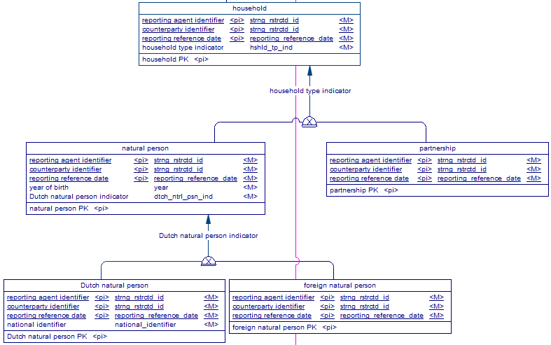
Position of national identifier in data model
Balemans, Damhof, Goes – Statistics Department – February 2018

Slide 22
Architecture and DDA
Ronald Damhof

Slide 23
What is our mission in data?
A focus on elementary data quality, from the get-go
An unambiguous (public) formalisation of concepts, meaning and structure
Focusing on protecting the data, keeping its integrity and being fully transparent
Enabling – as much as possible - all parties to automate and validate their data
Balemans, Damhof, Goes – Statistics Department – February 2018

Slide 24
Why did we choose the formal approach
Some characteristics of granular data:
Quality needs to be established on the granular level
Granular data contains many perspectives and huge opportunities for integration
In the supply chain process the risk of interpretation/ambiguity grows exponentially and the risk of worthless data at the end of the chain is high
Balemans, Damhof, Goes – Statistics Department – February 2018

Slide 25
Why did we choose the formal approach
It is vital for concepts and relationships between concepts to be described precise and non-ambiguous
It is vital that all parties involved in the supply chain process of RRE are talking the same language
It is vital for concepts and relationships between concepts to be described precise and non-ambiguous
A logical data model and data delivery agreement as the formal language is necessary for data to be precise and transparent
Balemans, Damhof, Goes – Statistics Department – February 2018

Slide 26
Why did we choose the formal approach
Characteristics of a formal language:
Communication with business
Is the ‘middle man’ between business and technical implementation
Is based on existing formal theory, notation and specification, methodology
Addresses concerns on the business/domain level, never on the technical level
Is developed and maintained in professional data modelling software
Is communicated and shared with all parties involved in the supply chain process
Balemans, Damhof, Goes – Statistics Department – February 2018

Slide 27
Why did we choose the formal approach
Characteristics of the logical data model as the formal language:
A non-ambiguous representation of the documents (e.g. Manuals) and functions as linking pin between those documents
A mathematical transformation of these documents (text)
Entails the structure, consistency and integrity of the data
Leading in how the (technical) delivery is designed
Leading with regards to the validation strategy
Agnostic with regards to technical implementations of RAs (e.g. API)
Is a pre-requisite for a data supply chain to be automated
Is a pre-requisite for data to be integrated with other data domains
Balemans, Damhof, Goes – Statistics Department – February 2018

Slide 28
Why did we choose the formal approach
Characteristics of the data delivery agreement as the formal language:
Three objectives:
    Governance instrument
    Design instrument
    Processing instrument
Two files delivered periodically:
    1 Logius metadata file containing 1 zip:
      1 metadata file (XML)
      1 zip file containing 1 csv for every entity in the logical data model
  1 reporting agent, 1 model, 1 delivery per quarter, 1 deadline
Keep it simple stupid (KISS); NO delta’s, NO differentiation between static & dynamic data, NO differentiation in type of data, NO variety in data deliveries
Content of the RRE DDA:
    Leading document in how RRE data is to be delivered to DNB
    Responsibilities of parties involved
    References to legislation and additional information
    Formal logical data model + business glossary
    Supply chain process, data quality strategy, validations (feedback) & plausibility
    Detailed technical specifications & delivery schema
    Aspects of the supply chain process: e.g. channel, messages, security, periodicity
Balemans, Damhof, Goes – Statistics Department – February 2018

Slide 29

Managed data collection, validation, integration and dissemination
A production line in the DNB Data Factory for any data delivery
Reporting Agent
DNB
Data Delivery Agreement
Publish on website
Data Delivery Agreement
Techn
Public Key
Techn
Public Key
.
.
LDM
Specs
LDM
Specs
.
.
DNB
Reporting
Portal
Agreement &
Obligations
DNB
Process
Monitor
Status obligation =Open
Status obligation =Open
Balemans, Damhof, Goes – Statistics Department – February 2018

Slide 30

Managed data collection, validation, integration and dissemination
A production line in the DNB Data Factory for any data delivery
Reporting Agent
DNB
Data Delivery Agreement
Publish on website
Data Delivery Agreement
Techn
Public Key
Techn
Public Key
.
.
LDM
Specs
LDM
Specs
.
.
DNB
Reporting
Portal
Agreement &
Obligations
DNB
Process
Monitor
Status Obligation =Open
Status Obligation =Open
Logius
Validation result
RRE
Technical
Validations
Logius XML
Container
DNB Metadata XML
Balemans, Damhof, Goes – Statistics Department – February 2018
CSV’s

Slide 31
Managed data collection, validation, integration and dissemination
A production line in the DNB Data Factory for any data delivery
Reporting Agent
DNB
Data Delivery Agreement
Publish on website
Data Delivery Agreement
Techn
Public Key
Techn
Public Key
.
.
LDM
Specs
LDM
Specs
.
.
DNB
Reporting
Portal
Agreement &
Obligations
DNB
Process
Monitor
Status Obligation =Open
Status Obligation =Open
Logius
Validation result
Status 400 / 410
RRE
Technical
Validations
RRE
Pre-technical
Validations
Balemans, Damhof, Goes – Statistics Department – February 2018

Slide 32
Managed data collection, validation, integration and dissemination
A production line in the DNB Data Factory for any data delivery
Reporting Agent
DNB
Data Delivery Agreement
Publish on website
Data Delivery Agreement
Techn
Public Key
Techn
Public Key
.
.
LDM
Specs
LDM
Specs
.
.
DNB
Reporting
Portal
Agreement &
Obligations
DNB
Process
Monitor
Status obligation =Open
Status Delivery = Received
Status obligation =Open
Status Delivery=Received
Logius
Validation result
Status 400 / 410
Administrative
Validations
RRE
Technical
Validations
RRE
Pre-technical
Validations
Balemans, Damhof, Goes – Statistics Department – February 2018

Slide 33
Managed data collection, validation, integration and dissemination
A production line in the DNB Data Factory for any data delivery
Reporting Agent
DNB
Data Delivery Agreement
Publish on website
Data Delivery Agreement
Techn
Public Key
Techn
Public Key
.
.
LDM
Specs
LDM
Specs
.
.
DNB
Reporting
Portal
Agreement &
Obligations
DNB
Process
Monitor
Status obligation =Open
Status Delivery = Received or Not Accepted
Status obligation =Open
Status Delivery= Received or Not Accepted
Logius
Validation result
Status 400 / 410
Post-technical
Validations
Administrative
Validations
RRE
Technical
Validations
RRE
Pre-technical
Validations
Balemans, Damhof, Goes – Statistics Department – February 2018

Slide 34
Managed data collection, validation, integration and dissemination
A production line in the DNB Data Factory for any data delivery
Reporting Agent
DNB
Data Delivery Agreement
Publish on website
Data Delivery Agreement
Techn
Public Key
Techn
Public Key
.
.
LDM
Specs
LDM
Specs
.
.
DNB
Reporting
Portal
Agreement &
Obligations
DNB
Process
Monitor
Status obligation =Open
Status Delivery = Not Accepted
Status obligation =Open
Status Delivery= Not Accepted
Logius
Logical
Validations
Validation result
Status 400 / 410
Post-technical
Validations
X
Administrative
Validations
Delivery not accepted, correct and resumbmit (same obligation)
RRE
Technical
Validations
RRE
Pre-technical
Validations
Balemans, Damhof, Goes – Statistics Department – February 2018

Slide 35

Managed data collection, validation, integration and dissemination
A production line in the DNB Data Factory for any data delivery
Reporting Agent
DNB
Data Delivery Agreement
Publish on website
Data Delivery Agreement
Techn
Public Key
Techn
Public Key
.
.
LDM
Specs
LDM
Specs
.
.
DNB
Reporting
Portal
Agreement &
Obligations
DNB
Process
Monitor
Status obligation =Completed
Status Delivery = Accepted
Status obligation =Completed
Status Delivery= Accepted
Logius
Logical
Validations
Validation result
Status 400 / 410
Post-technical
Validations
Administrative
Validations
Delivery accepted, Obligation completed
RRE
Technical
Validations
RRE
Pre-technical
Validations
Balemans, Damhof, Goes – Statistics Department – February 2018

Slide 36
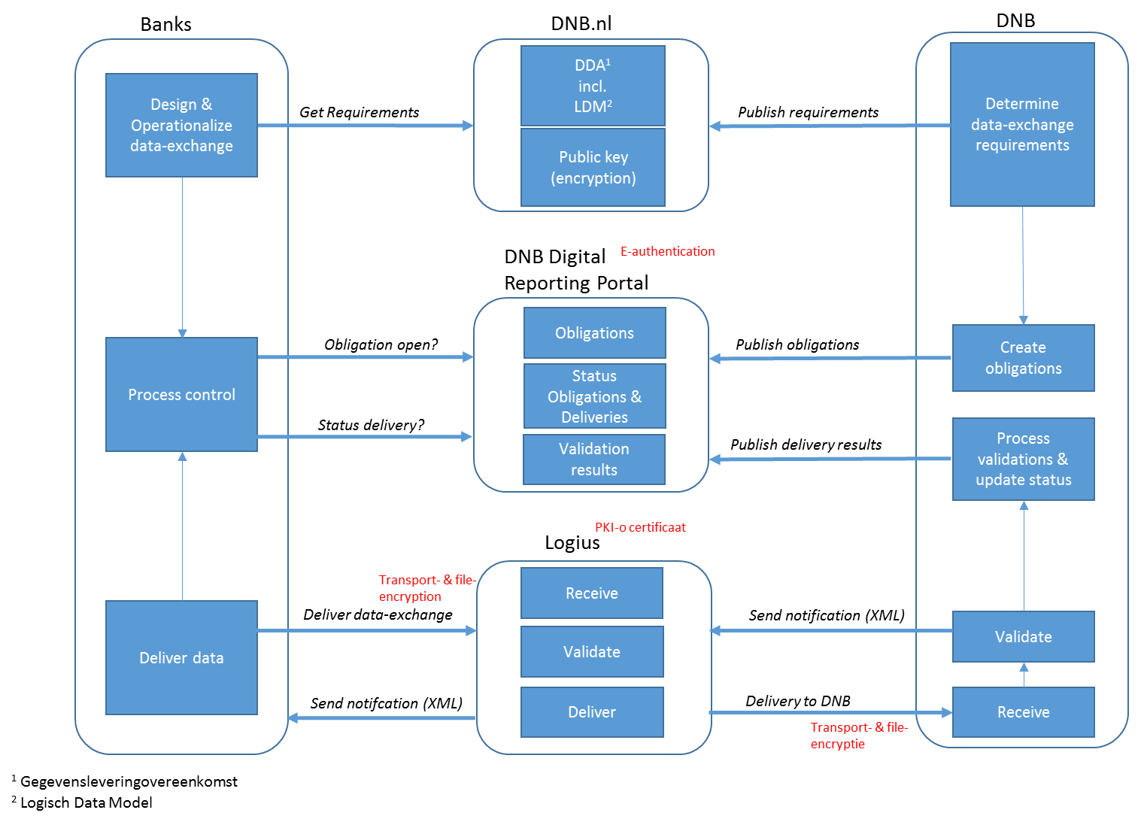
Overview
Global description of the process:
DNB determines the RRE data-exchange specifications (Data Delivery Agreement, Logical Data Model);
DNB publishes these specifications, including the public key for encryption on the website of DNB;
Banks use this information to operationalize the RRE data exchange;
DNB publishes the RRE data-exchange obligations in the DNB Digital Reporting Portal;
Banks have secure access to the DNB Digital Reporting Portal where they can view the obligation;
Banks deliver the RRE data exchange files to Logius, transport as well as files are encrypted;
Logius receives the data, performs a number of technical checks and send a delivery notification back to the bank. Subsequently Logius is pushing the to DNB;
DNB received the data, performs a number of technical and logical validations, updates the status of the obligation and publishes the outcome of these validations to the DNB Digital Reporting Portal;
Designated (by the bank) employees will receive a notification;
Banks can view these outcomes (and status) in the DNB Digital Reporting Portal.
Balemans, Damhof, Goes – Statistics Department – February 2018

Slide 37
Logical data model
Iris Balemans

Slide 38
A Logical data model reflects the structure of data concepts
counterparty
Protection provider
debtor
instrument
protection
Main concepts for RRE are named in terms of the AnaCredit regulation
Additional concepts complete the data model (household, LGD-model, non-immovable property…)
Notes:
Kleuren in het model geven verschillende groepen van hoogover entiteiten aan. Een soort van ‘thema’.

Slide 39
Data modeling is all about language
Concepts are taken from the definition of the required attributes
Attributes are concepts as well
The structure between concepts stems from the meaning of the definition
These links in the meaning translate to attributes of entities and relationships between entities.

Slide 40
Translating attributes to main concepts
Example:
Interest rate reset frequency: The frequency at which the interest rate is reset after the initial fixed-rate period, if any.
Notes:
This links the concept “interest rate reset frequency” to the concept “instrument”.
If any laat zien dat het non-applicable is maar aangegeven is dat het attribuut mandatory moest zijn. Optioneel <> non-applicable!
Non-applicable wordt opgenomen in de referentie table interest rate reset frequency naast warden als “overnight”, “monthly” etc.

Slide 41
Relationships are the glue between concepts
Relationships determine how concepts relate to each other.
Example:
Inception date: The date on which the contractual relationship originated, i.e. the date on which the contract agreement become binding for all parties.
Notes:
This links the concept “inception date” to the concept “contract”.
A new entity is needed because several instruments can be part of a contract and inception date is needed on the contract level since it’s the same for all the instruments below the contract.
In anacredit was contract instrument table samengevoegd (platgeslagen)

Slide 42
Subtypes partition the applicable attributes (1)
Example:
Settlement date: The date on which the instrument was used or drawn for the first time after the inception date of the instrument.
Notes:
Settlement date is only applicable to a drawn instrument not to an undrawn instrument. Both are subtypes of instrument

Slide 43
Subtypes partition the applicable attributes (2)
Split the data according to reporting needs
Reduce the number of optional attributes or non-applicables
This reduction reduces reporting omissions and errors thus increasing data quality
Notes:
Settlement date is only applicable to a drawn instrument not to an undrawn instrument. Both are subtypes of instrument

Slide 44
Counterparty is either a protection provider or not
    A counterparty can both be a protection provider for instrument A as well as a non-protection providing counterparty for instrument B
Notes:
Debtor is één van de vier rollen van de counterparty (debtor, creditor, servicer, originator). De counterparty kan één of meerdere rollen hebben, maar kan ook geen enkele rol hebben (maar bijvoorbeeld louter protection provider zijn, bijvoorbeeld een ouder die louter garant staat voor zijn kind die een hypotheek is aangegaan).
Het datamodel zegt dat een counterparty slechts één van beide kan zijn: protection provider en non-protection providing counterparty. Indien een en dezelfde
counterparty bij instrument A wel een protection provider is maar bij instrument B geen protection provider is, dan blijft het feit gelden dat de betreffende counterparty een protection provider is voor een in RRE te rapporteren instrument (welk instrument het dan ook precies is) en deze gegevens dus aangeleverd dienen te worden. Nonprotection providing counterparty gegevens worden niet aangeleverd ondanks dat de counterparty voor instrument B geen protection provider is.

Slide 45
Indicators split the data according to reporting needs
Attributes referring to a reference table, or an indicator created especially for this purpose
Indicators reflect validations:
    Less querying of business rules (e.g. reference rate maturity value is only needed when interest rate type <> “fixed”)
    Ensures that the model is correct
    Ensures data is delivered properly

Slide 46
LDM is basis for data delivery agreement
LDM is integral part of the DDA
HTML report of the LDM is provided separately
LDM is the source for these parts of the DDA:
List of .csv files to report
Lay-out of the .csv files
Mapping of the .csv files to the LDM
List of validations
List of entity types, attributes and primary keys

Slide 47
LDM is basis for content-based validations
Referential integrity is build in. Validations on correct relationships are done automatically. This also includes reference data ‘pick-lists’.
As much of the integrity checks as possible are build into the model
Subtypes are deployed for specific sub-sets of data where extra attributes are applicable.
Business rules describe validations on the element where they are applicable.
Notes:
Pick-lists zijn opgenomen in een eigen business terms list op de website.

Slide 48
RRE closely follows AnaCredit
There are 110 entity types in the LDM of RRE
Those provide structural integrity
Results in 53 files to report
Of which 36 overlap with AnaCredit
And 17 are specific for RRE
Notes:
De GLO van RRE geeft de overeenkomsten aan in attributen.
Please note that all keys (identifiers) included in the abovementioned entities should – content-wise – be the same for RRE and for AnaCredit. This should ensure that both datasets can be connected with each other, especially when – in the future – the scope of AnaCredit and RRE could overlap.
In the column remarks there is stated whether there are difference in the domain lists. In addition, please read the RRE Manual Part I and Part II closely, because some slight methodological differences might arise between attributes in RRE and AnaCredit due to the different scope and general methodology of RRE in relation to AnaCredit.

Slide 49
Organisation and planning
Wim Goes

Slide 50
Communication (1/2)
Communication via mailbox (rre@dnb.nl). New documents will be posted on the dedicated RRE website (https://www.dnb.nl/statistiek/digitaal-loket-rapportages/statistische-rapportages/banken/residential-real-estate-rre/index.jsp).
Plenary meetings and bilateral meetings if necessary
Documentation available on the website.

Slide 51
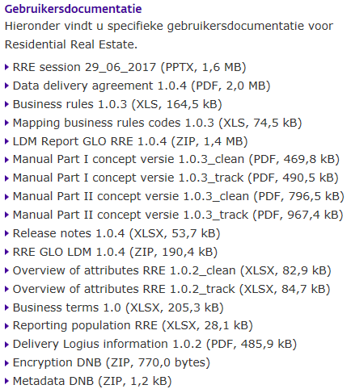
Communication (2/2)
Notes:
Ook melden dat de domeinwaarden die gerapporteerd moeten worden in het business terms document staat.

Slide 52
Pre-production and shadow reporting
Pre-production period starts in Q2 2018. Pre-production reports on Q1 2018 should be submitted end-May 2018 at the latest. For more details, please refer to the letter send to the reporting agents on 31 January 2018.
Current way of reporting the loan level data should be maintained up to and including reference periode Q4 2018. So there will be a period of shadow reporting.

Slide 53
Planning and phase-in (1/2)
First RRE report should be submitted the last working day of July 2018 on reference period Q2 2018.
Back data should be reported as well on Q1 2018 and Q4 2017. Q1 2018 should be submitted on the last working day of November 2018 and Q4 2017 on the last working day of December 2018.

Slide 54
Planning and phase-in (2/2)
Some attributes have special high relevance. In the documentation on the website, we have indicated which attributes belong to stage 1 and which to stage 2. Stage 1 attributes should be reported from the start (including back data). Stage 2 attributes should be reported from reference periode Q4 2018 onwards at the last working day of January 2019 (without back date).
In December 2017 DNB and the reporting agents had a meeting which has led to the shift of some attributes from stage 1 to stage 2 in order to give the reporting agents more time for the implementation of some attributes.

Slide 55
Thank you for your attention. Questions??

