Slide 1
A quantity-based approach to constructing climate risk hedge portfolios
by Alekseev et al.
DNB Conference Discussion:
Marcin Kacperczyk (Imperial College)
June, 2022

Slide 2
Motivation
Climate change poses a significant risk to society and investors/companies
Physical, related to damages induced by physical events
Transition, related to policy, technology, and social beliefs
Finance is an important element of hedging this risk
Literature has provided some directions how to hedge the risk
Traditional approaches are based on return responses to aggregate climate shocks
Narrative approach vs. mimicking portfolio approach
Requires a longer time-series to estimate the sensitivities to shocks
Requires assumptions on the stationarity of the underlying elasticities
Empirically, these methods do not work that well with the climate hedging

Slide 3
Motivation
Climate change poses a significant risk
This paper:
(1) Exploit trades of mutual fund managers/advisers with respect to climate shocks
(2) Use the observed responses as a proxy for industry-level sensitivities to shocks
(3) Measure price implications for the portfolios that follow the same types of exposures in response to climate shocks
(4) The new hedging does significantly better in terms of its ability to hedge the aggregate shocks

Slide 4
Summary
A very important paper on the first-order question
Methodology extends beyond the climate change setting
Comments/Suggestions:
1) Whose beliefs?
2) Industry-level sorts
3) Extras

Slide 5
Comment 1: Whose beliefs?
Paper looks at the behavior of mutual fund companies to various shocks. Mutual fund managers are a good proxy for demand side response but the paper needs to deal with the joint–hypothesis problem
While fund managers may be sophisticated, fund investors may not
Also, fund managers can respond to different incentives than climate alone
Suggestion 1: Can you condition the experiment on the type of investor flows: retail vs. institutional?
Suggestion 2: Can you condition on fund managers’ careers? Do you find different results conditional on the performance/experience of the fund managers?
The ultimate questions are: who is the marginal investor and what is external validity on that?
Does it matter for the results if beliefs are stationary? What if they evolve over time?

Slide 6
Comment 2: Industry-level sorts
The paper aggregates mutual fund responses to industry-level portfolios
Underlying assumption: within-industry variation is similar across stocks
This is a strong assumption: evidence suggests that:
a) within-industry level variation is quite significant
b) price effects differ across stocks within the same industry

Slide 7
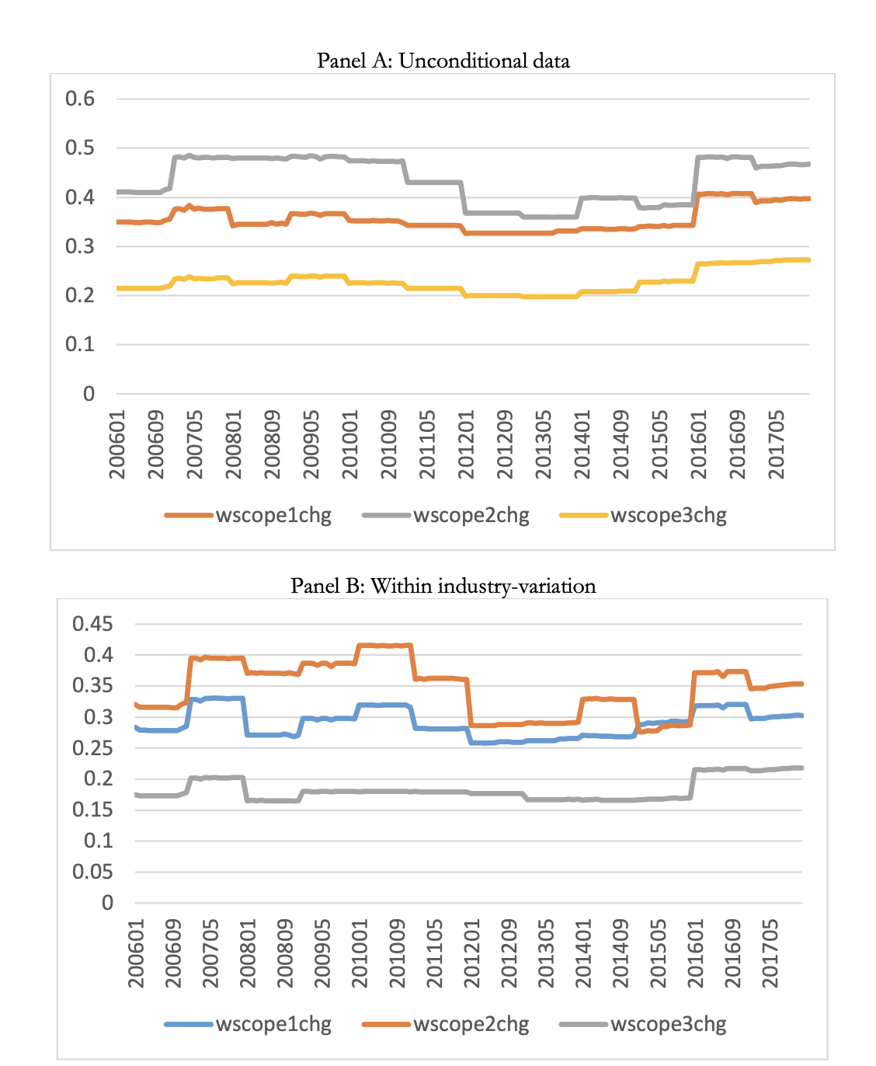
Comment 2: Cross and within-industry effects (a)

Slide 8
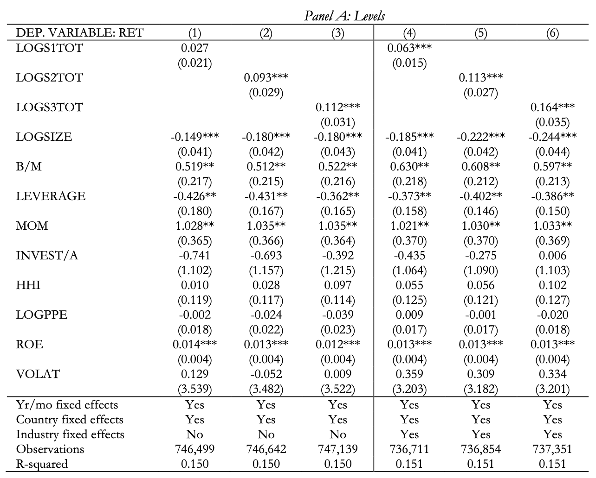
Comment 2: Cross and within-industry effects (b)

Slide 9
Comment 2: Industry-level sorts
The paper aggregates mutual fund responses to industry-level portfolios
Underlying assumption: within-industry variation is similar across stocks
This is a strong assumption: evidence suggests that:
a) within-industry level variation is quite significant
b) price effects differ across stocks within the same industry
Suggestion 1: Look at the effects from the firm-level perspective
Suggestion 2: Show the robustness of the results wrt to different industry definitions

Slide 10
Comment 3: Extras
Paper looks at two types of shocks: climate news and transition risk news
Should we expect the hedging process to each to be the same?
What is the role of investment horizon?
The paper looks at the responses of fund managers and fund advisers to shocks
These are not the same entities, or is the language used to mean the same?
Does the heterogeneity across managers matter for your results?
What if we exclude ESG funds from the sample of managers? Does it matter for the sorts?
How statistically powerful is the sample based on textual analysis?
For example, reports by corporate executives have been quite sparse up until 2018

