Slide 1
Discussion of “Interbank Payment Timing is Still Closely Coupled” Afonso, Duffie, Rigon, Shin
Gary Gorton
Yale and NBER

Slide 2
Important Topic
Evidence suggests that strategic cash hoarding reduces liquidity.
“These dynamics are especially important if adjustments in the timing of payments occur on days when reserve balances in the banking system are relatively low, because banks might also need to further adjust their liquidity management practices, reinforcing the strategic complementarity of payment timing.”
Banks appear to be very risk averse with respect to holding cash.

Slide 3
Main Point of the Paper
Banks continue to use incoming payments to make outgoing payments, despite large amounts of reserves.
Surprising.
“Strategic complementarity” - - repeated 22 times in the paper and an additional twice in the abstract.

Slide 4
MacAndrews and Rajan (2000) found the same result.
“We find that incoming payments used by banks to offset outgoing payments that are entered within the same minute account for 25 percent of the value of these transfers during normal activity periods and as much as 40 percent during peak periods.”

Slide 5
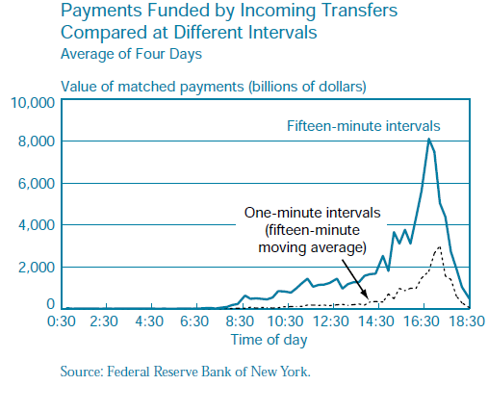

Slide 6
Explanation
Authors suggest that the explanation for their findings is that banks are more risk averse - - hoarding reserves.
But then there should other evidence that banks have become more risk averse about hoarding cash.
For example, have they cut back on credit lines?

Slide 7
How Can Banks Pay?
Bank A needs to pay Bank B $100. Bank A’s choices:
Pay out of reserves
Use payments received, if available
Daylight overdraft
Borrow from other banks
4 is too expensive.

Slide 8
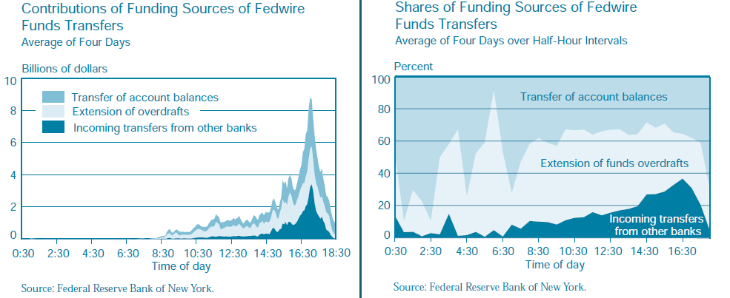

Slide 9
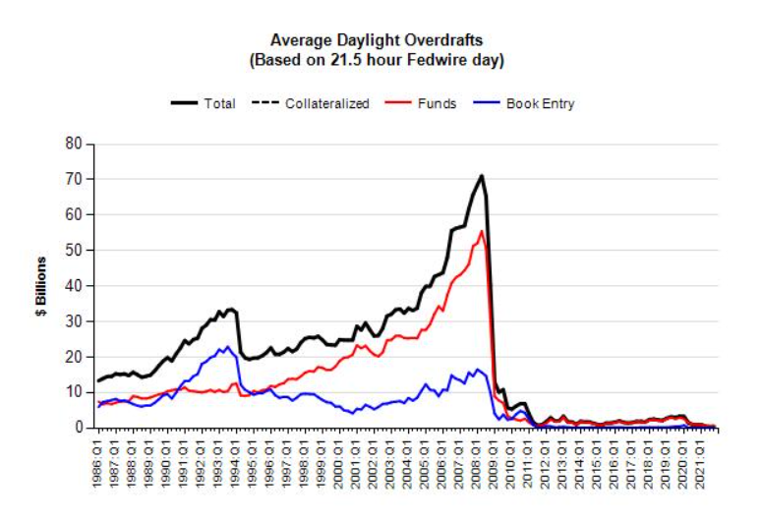

Slide 10
Using Reserves More Frequently Afterall?
If daylight overdrafts are not used, and incoming used to pay to roughly the same extent now as before, then reserves are being used more.
Best to do what MacAndrews and Rajan did: account for all sources of funds.

Slide 11
Strategic Complementarity?
Best evidence: “the relationship varies for different level of opening balances: On days with high aggregate opening balances, the link between payments and past receipts persists, but is dampened relative to days with low aggregate balances.”

Slide 12
But - -
To what extent is the matching of outflows to incoming payments a matter of many, many payments in each direction?
With thousands of payments, it seems likely that many would match the criterion of outflow matched by inflow in the last 15 minutes.
Placebo tests: How about inflow matched by outflow in the last 15 minutes.

Slide 13
Thank You

