Slide 1
T2-T2S
Connecting to the Eurosystem Single Market Infrastructure Gateway
Update on connectivity testing Prod
3 May 2022

Slide 2
T2-T2S connecting to ESMIG Prod
Status Summary
1
Connectivity tests – next milestones
2
Preliminary operations with NSP
3
Lesson Learnt
4
Validation of U2A for connectivity test and usage of Probe pages
5
Validation of A2A connectivity test
6
T2 Service Desk support

Slide 3
T2-T2S connecting to ESMIG Prod
1 - Connectivity test – next milestones
CSLD.NCOP1 - Network connectivity tests on production will start on 1st May 2022 - These are mandatory tests Participants have to perform on the production environment before the start of their pre-migration activities.
CSLD.NCOP2 - Network connectivity tests on production have to be completed within 31st July 2022 - Participants have completed the connectivity testing on the production environment and are ready to start the pre-migration activities.

Slide 4
T2-T2S connecting to ESMIG Prod
2 - Preliminary operations with the NSPs -
Network Service Provider Selection (allegedly, already done)
  TARGET Services Actors registration is mainly supported by the establishment of a contractual relationship between them and the selected NSP. Once done, they are registered in the NSP Website and their representatives (admin) nominated.
Two different CGU (Closed Group of Users) subscriptions
  CBs
  Target Service Actors (excluding CBs)
  The NSP shall create and manage CGUs containing the relevant TARGET Services Actors for both the Production environment (PROD) and the Test environment (UTEST and EAC), one CGU for each environment and for each Eurosystem Market Infrastructure (T2, T2S, TIPS, ECMS). The subscription to a CGU, and any subsequent modification to such subscription, are arranged through an electronic workflow on the Internet
Designation of the Authorized approvers
  A limited number of people is entitled per institution to submit the NSP tickets for CGU subscription. Each CB needs to approve or reject these tickets.
The ESMIG Portal is the same for all the TARGET services (T2, T2S, ECMS and TIPS)

Slide 5
T2-T2S connecting to ESMIG Prod
3 - Lessons learnt
The previous connectivity testing phase for User Testing has highlighted possible different testing results, yet all valid to determine if the connectivity is successfully in place
These results depend on the presence of already existing CRDM configurations as well as the status of the backend applications that change over the testing period
Benefitting from this previous experience, the deployment of the backend modules will be organized to take such needs of clarity into due account
Back-end modules in Production will tentatively be installed on 23 July 2022, so the results to consider a test successful will need to take into account this information

Slide 6
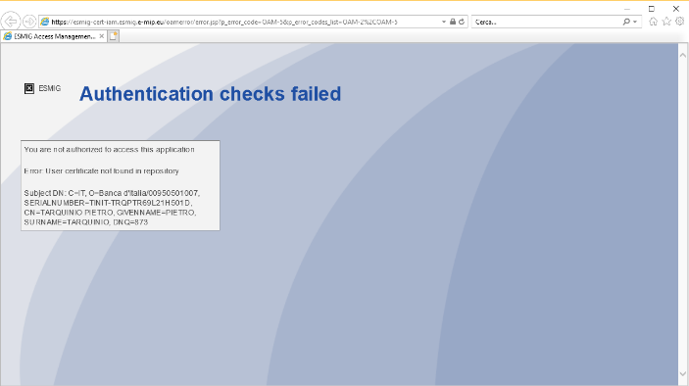
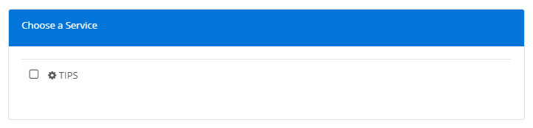
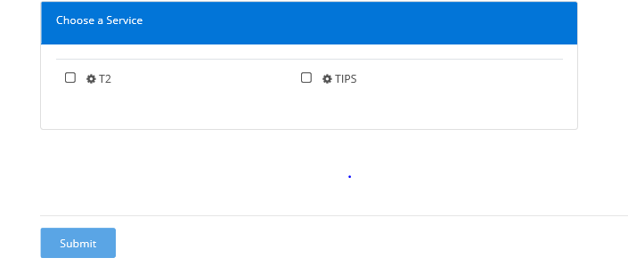
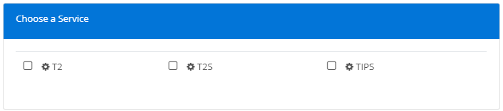
T2-T2S connecting to ESMIG Prod
4 - Validation of U2A for connectivity test
Users that were never configured in PROD will get the error “You are not authorized to access this application” (see screenshot) below)
For users that were already configured, it is correct that TIPS service (or T2S) is already visible in PROD environment; depending on privileges already assigned to the user they will be able see the page where there is an option to select the applications.

Slide 7
T2-T2S connecting to ESMIG Prod
4 - Validation of U2A and usage of Probe pages for connectivity test
As the U2A applications backend modules (CRDM, CLM, ...) will only become available at a later stage, it is highly recommended for participants to make some tests related to connectivity in advance using the Probe pages. This will ensure all the local settings and NSP configurations are correct so avoiding late detection.
Probe pages can also be useful when troubleshooting access to the U2A applications later.
In case the Probe pages cannot be accessed, after verification with its NSP, the participant should report it to its National Service Desk (NSD). The NSD will then submit the evidence to TARGET Service Desk (TSD) for analysis.
There are 2 types of Probe pages:
Non Authenticated Probe pages:
used to Check external connectivity with 4CB reverse proxies.
Authenticated Probe pages :
to check external connectivity with 4CB reverse proxies and IAM authorization.

Slide 8
T2-T2S connecting to ESMIG Prod
4 - Validation of U2A and usage of Probe pages for connectivity test
Probe pages are built in order to allow faster detection of possible issue when a participant is receiving an error accessing the T2 Production Application via ESMIG.
Probe pages are not bound to the application, therefore they are used to do a connectivity test before invoking the application and facilitate the evaluation of where the error is.
They are of two types: unauthenticated and authenticated
The unauthenticated test is used to verify the functionality of the proxies.
The authenticated test is for testing the IAM so the sequence should be:
  unauthenticated test -> proxy ok
  authenticated test -> IAM ok
  application test -> Appl ok
Probe pages analysis will help in isolating a problem (if any) as they segment the access so that it is possible to verify the different components without having interactions with the following ones.
A classic scenario is:
the user connects to the application and gets an error;
test the unauthenticated probe and so we can understand if the proxies are ok;
test the authenticated probe and so we know if the IAM is ok
Participant sends to the T2 Service Desk the results of the 3 tests (access to: application, not authenticated and authenticated) so that relevant people have all the elements to identify where the problem is and intervene in a faster way.

Slide 9
T2-T2S connecting to ESMIG Prod
4 - Probe pages – SIA url
SIA Non Authenticated Probe pages:
https://t2-tkt.u2a.sianet.sia.eu/probe/probeSUrl-sia.html
https://t2-crdm.u2a.sianet.sia.eu/probe/probeSUrl-sia.html
https://t2-dmt.u2a.sianet.sia.eu/probe/probeSUrl-sia.html
https://t2-dwh.u2a.sianet.sia.eu/probe/probeSUrl-sia.html
https://t2-clm.u2a.sianet.sia.eu/probe/probeSUrl-sia.html
https://t2-rtgs.u2a.sianet.sia.eu/probe/probeSUrl-sia.html
https://t2-bdm.u2a.sianet.sia.eu/probe/probeSUrl-sia.html
https://t2-econs.u2a.sianet.sia.eu/probe/probeSUrl-sia.html
https://t2-bill.u2a.sianet.sia.eu/probe/probeSUrl-sia.html
SIA Authenticated Probe pages :
https://t2-tkt.u2a.sianet.sia.eu/probe/probepageauth.html
https://t2-crdm.u2a.sianet.sia.eu/probe/probepageauth.html
https://t2-dmt.u2a.sianet.sia.eu/probe/probepageauth.html
https://t2-dwh.u2a.sianet.sia.eu/probe/probepageauth.html
https://t2-clm.u2a.sianet.sia.eu/probe/probepageauth.html
https://t2-rtgs.u2a.sianet.sia.eu/probe/probepageauth.html
https://t2-bdm.u2a.sianet.sia.eu/probe/probepageauth.html
https://t2-econs.u2a.sianet.sia.eu/probe/probepageauth.html
https://t2-bill.u2a.sianet.sia.eu/probe/probepageauth.html

Slide 10
T2-T2S connecting to ESMIG Prod
4 - Probe pages – SWIFT url
SWIFT Non Authenticated Probe pages:
https://t2-tkt.t2.swiftnet.sipn.swift.com/probe/probeSUrl-swift.html
https://t2-crdm.t2.swiftnet.sipn.swift.com/probe/probeSUrl-swift.html
https://t2-dmt.t2.swiftnet.sipn.swift.com/probe/probeSUrl-swift.html
https://t2-dwh.t2.swiftnet.sipn.swift.com/probe/probeSUrl-swift.html
https://t2-clm.t2.swiftnet.sipn.swift.com/probe/probeSUrl-swift.html
https://t2-rtgs.t2.swiftnet.sipn.swift.com/probe/probeSUrl-swift.html
https://t2-bdm.t2.swiftnet.sipn.swift.com/probe/probeSUrl-swift.html
https://t2-econs.t2.swiftnet.sipn.swift.com/probe/probeSUrl-swift.html
https://t2-bill.t2.swiftnet.sipn.swift.com/probe/probeSUrl-swift.html
SWIFT Authenticated Probe pages :
https://t2-tkt.t2.swiftnet.sipn.swift.com/probe/probepageauth.html
https://t2-crdm.t2.swiftnet.sipn.swift.com/probe/probepageauth.html
https://t2-dmt.t2.swiftnet.sipn.swift.com/probe/probepageauth.html
https://t2-dwh.t2.swiftnet.sipn.swift.com/probe/probepageauth.html
https://t2-clm.t2.swiftnet.sipn.swift.com/probe/probepageauth.html
https://t2-rtgs.t2.swiftnet.sipn.swift.com/probe/probepageauth.html
https://t2-bdm.t2.swiftnet.sipn.swift.com/probe/probepageauth.html
https://t2-econs.t2.swiftnet.sipn.swift.com/probe/probepageauth.html
https://t2-bill.t2.swiftnet.sipn.swift.com/probe/probepageauth.html

Slide 11

T2-T2S connecting to ESMIG Prod
5 - Validation of A2A connectivity test – NO backend modules installed
Before deployment of the backend modules (tentatively 23/07/2022) the user could receive:
· For Store and Forward traffic, upon subscription for the Delivery Notification to get the confirmation from the NSP that the message was delivered to T2 (for example they could have an NSP GUI showing the following):
· For Real Time traffic, the admi.007 - that will confirm correct reception of the message from the ESMIG. This message is sent after 40 seconds to inform about the triggering of the timeout management process. This is the expected behavior if no backend module is present
In any case the T2 Service Desk can be contacted by the CBs (t2@target-ssp.eu) to get the evidences of messages/files received by the platform with a specific request (that must include DN used and exact time of the message together with the confirmation that the ack from the NSP was correctly received).
Any of above outcome can be considered as the A2A connectivity is successful.

Slide 12
T2-T2S connecting to ESMIG Prod
5 - Validation of A2A connectivity test – backend modules installed
After deployment of the backend modules tentatively foreseen 23/07/2022:
business validation errors will trigger the relevant business response message (eg. Pacs.002, camt.025 and reda.xxx according to the service/component the message has been sent to)
the response message will return the relevant error and status ‘RJCT’ in the Application Header (below an extract response to a pacs010)
</AppHdr></IGXMApplicationData><IGXMMessage><Document xmlns="urn:iso:std:iso:20022:tech:xsd:pacs.002.001.10"> <FIToFIPmtStsRpt><GrpHdr><MsgId>NONREF</MsgId><CreDtTm>2022-XX-XX23T15:53:45.969+00:00</CreDtTm></GrpHdr><TxInfAndSts><OrgnlGrpInf><OrgnlMsgId>TEST</OrgnlMsgId><OrgnlMsgNmId>pacs.010.001.03</OrgnlMsgNmId></OrgnlGrpInf><OrgnlInstrId>TEST1</OrgnlInstrId><OrgnlEndToEndId>TEST1</OrgnlEndToEndId><OrgnlUETR>3cf95ac2-0150-41f4-85e3-3c5b4084c569</OrgnlUETR><TxSts>RJCT</TxSts><StsRsnInf><Rsn><Prtry>D008</Prtry></Rsn><AddtlInf>Invalid financial or non-financial institution BIC inFIDrctDbt/CdtInstr/InstdAgt/FinInstnId/BICFI</AddtlInf></StsRsnInf></TxInfAndSts></FIToFIPmtStsRpt></Document></IGXMMessage></IGXM>
The error will be consistent and can be checked in the UDFS
Admi.007 are anyway still possible to be received in case of errors.

Slide 13

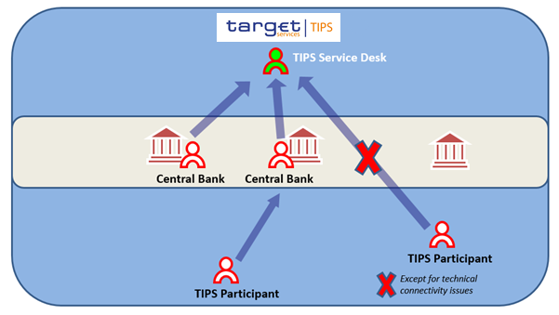
T2-T2S connecting to ESMIG Prod
6 - Service Desk support
The operations management of T2 is shared among all the T2 Actors and is structured in three levels of responsibility:
On the topmost level is the T2 Service Desk. The T2 Operator has visibility over the whole platform
NCBs are the entry point for all support requests coming from the participants
The T2 Participants can interact directly with the T2 Service Desk only for requests related to pure connectivity matters
T2 Service Desk
T2 Participant
T2 Participant
Email addresses:
  Production t2@target-ssp.eu
  Test t2-test@target-ssp.eu

