Slide 1
Interbank Payment Timing is Still Closely Coupled Discussion by Cecilia Skingsley Macroprudential Conference 21 June 2022 in Amsterdam

Slide 2
Content
Paper by Afonso, Duffie, Rigon and Shin
“Interbank Payment Timing is Still Closely Coupled”
Basic message
Banks send more payments the minute after receiving payments
Banks wait with sending payments until they have received payments

Slide 3
Comments
Digital currencies and systemic liquidity – CBDC?
Not every bank can always wait to send all payments
CB reserves at the individual bank level is important
Incoming payments and Central bank reserves matter but so do collateral
QE transformed collateral to Central bank reserves
Can the results be generalised to other countries?
Swedish large bank A: Indeed similar pattern with significant positive slope
Swedish large bank B: No pattern and no significant slope
Looking at net flow rather than only inflows: No relationship

Slide 4
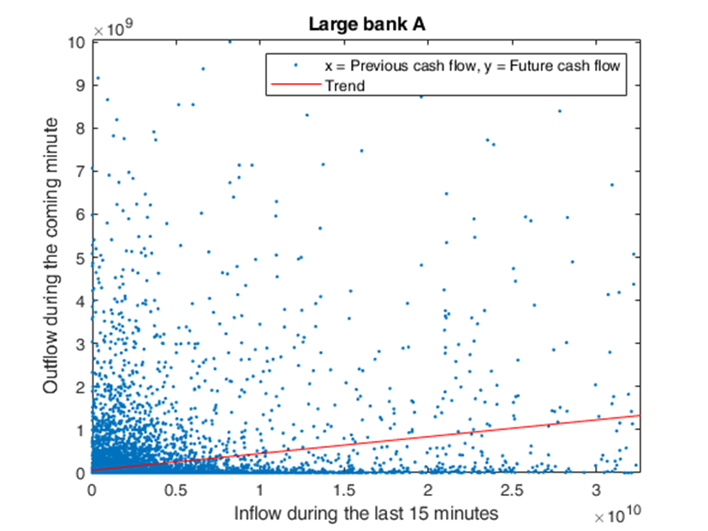

Slide 5
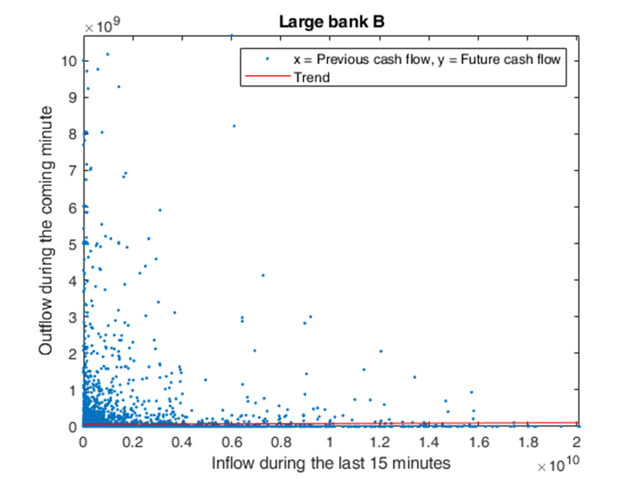

Slide 6
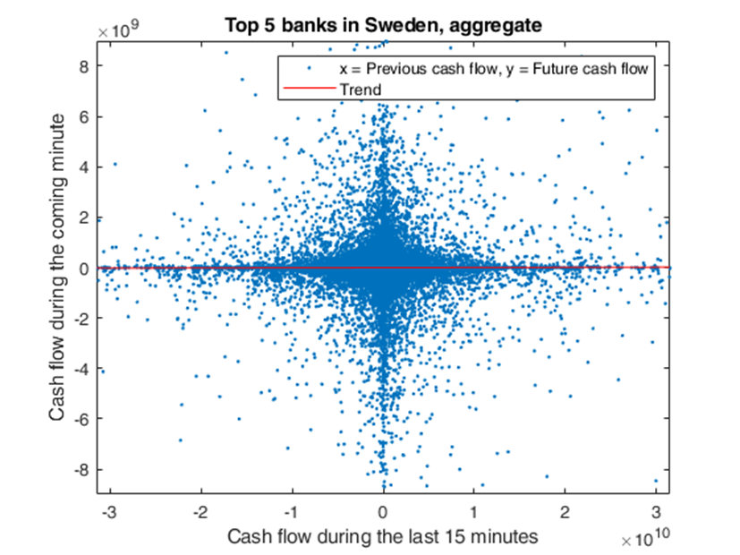

Slide 7
Policy
Likely that banks pay more attention to their intraday liquidity now than before GFC
Could be good as it may reduce volatility in banks’ positions
QE may hide the degree of strategic complementarity between banks and if so reducing the QE may increase the systemic liquidity consequences of such behaviour
Facilities whereby banks can borrow freely from the central bank during the day and without costs may become more important as QE is scaled back…
Potential future studies:
Net cash flow more important than only inflows/outflows
Are balances in the system more/less volatile during the day? Less volatility could imply lower probability of payment failure such as hen a bank does not have enough collateral/reserves.

